Slide 1
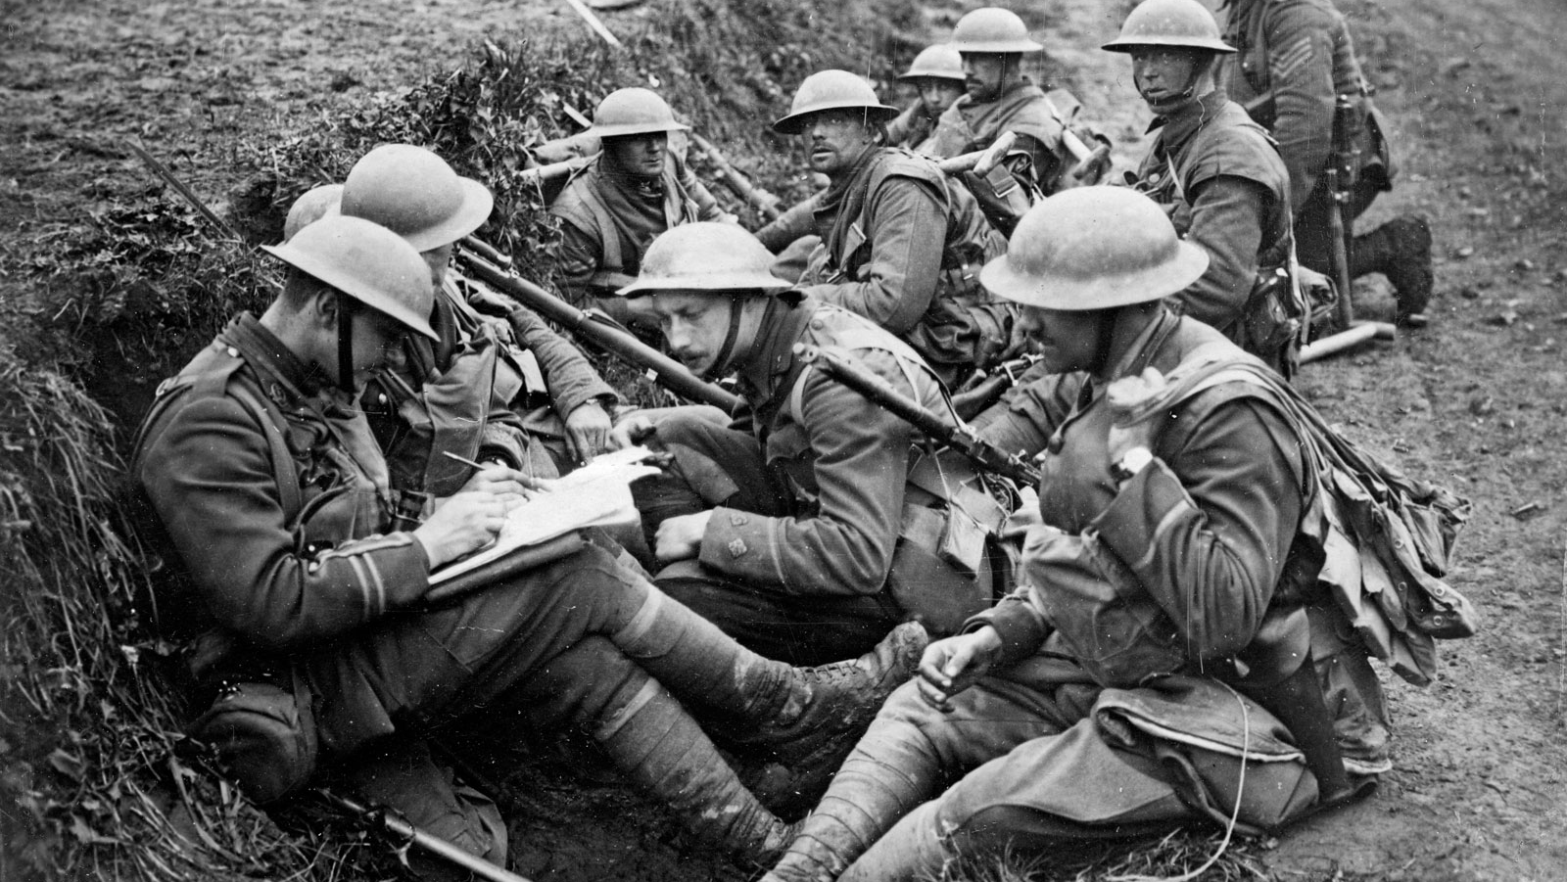
Imagine being away from your family and friends in the cold and awful conditions of WW1 and WW2
You would probably spend your days wondering if you would make it back home alive to see them. Imagine how important a letter from home would be.
Write a letter home, as if you were in the trenches. You could be an infantry soldier, a nurse, a doctor, an officer etc., Describe the conditions, the worries, how much you miss home, who your new friends are, how they are helping you to cope.
Competition: Write a letter from the frontline

Slide 2
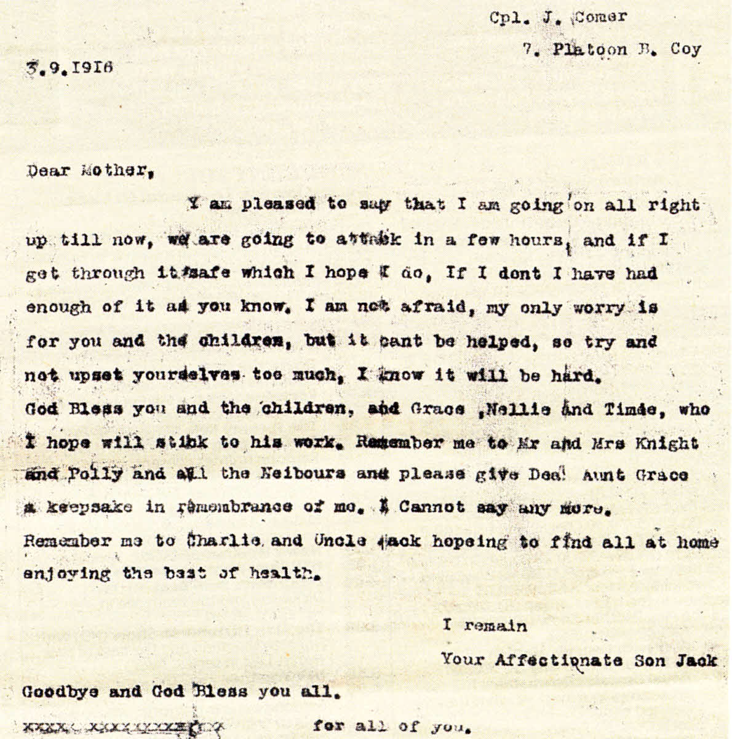
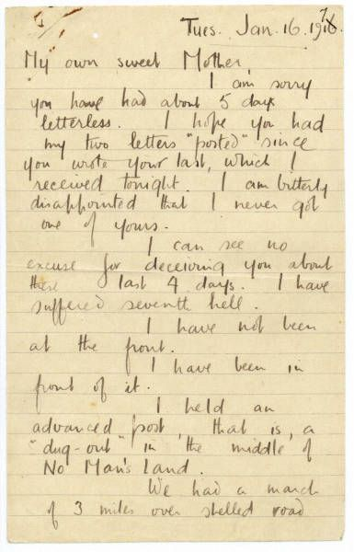

Slide 3
Look up:
Examples of WW1 and WW2 letters home
(you may also use other wars involving British soldiers:- Afghanistan/Falklands/Gulf War/Iraq if you prefer to write a more modern letter home).
Examples of censored letters (Where the post was checked beforehand and any negativity or information not to be shared has been crossed out.
(Please do not copy letters, you can select ideas and rephrase them instead, try to add your own thoughts too)
Additional ideas
It would be great to have actual letters to display in the library. You could crumple the paper and tea-stain or smudge colour into the paper to age it.
Hand your letters to your tutors by Friday 20th November 2020.
V o u c h e r p r i z e f o r w i n n i n g e n t r y.

