Slide 1



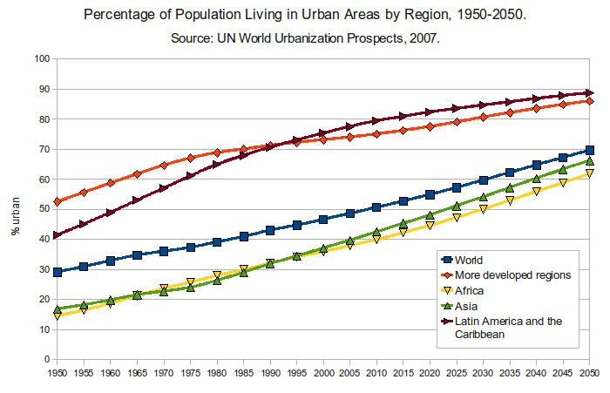

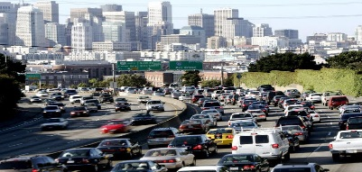





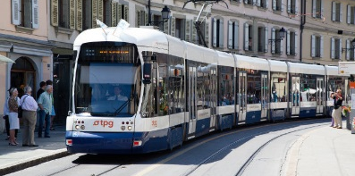

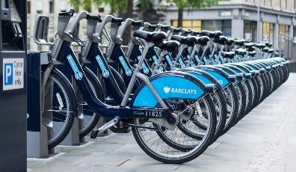



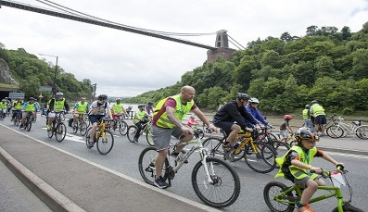
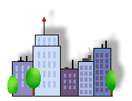
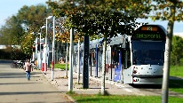
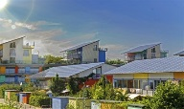
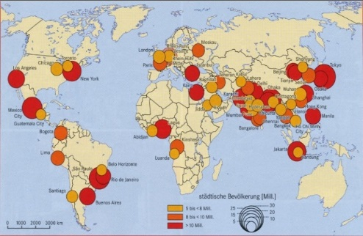




What is Urbanisation?
This is an increase in the amount of people living in urban areas such as towns or cities. In 2007, the UN announced that for the first time, more than 50 % of the world’s population live in urban areas.
Where is Urbanisation happening?
Urbanisation is happening all over the word but in LICs and NEEs rates are much faster than HICs. This is mostly because of the rapid economic growth they are experiencing.
Sustainable Urban Living
Sustainable urban living means being able to live in cities in ways that do not pollute the environment and using resources in ways that ensure future generations also can use then.
Water Conservation | Energy Conservation
This is about reducing the amount of water used. Collecting rainwater for gardens and flushing toilets. Installing water meters and toilets that flush less water. Educating people on using less water. | Using less fossil fuels can reduce the rate of climate change. Promoting renewable energy sources. Making homes more energy efficient. Encouraging people to use energy.
Creating Green Space | Waste Recycling
Creating green spaces in urban areas can improve places for people who want to live there. Provide natural cooler areas for people to relax in. Encourages people to exercise. Reduces the risk of flooding from surface runoff. | More recycling means fewer resources are used. Less waste reduces the amount that eventually goes to landfill. Collection of household waste. More local recycling facilities. Greater awareness of the benefits in recycling.
Traffic Management
Urban areas are busy places with many people travelling by different modes of transport. This has caused urban areas to experience different traffic congestion that can lead to various problems.
Environmental problems
Traffic increases air pollution which releases greenhouse gases that is leading to climate change.
Economic problems | Social Problems
Congestion can make people late for work and business deliveries take longer. This can cause companies to loose money. | There is a greater risk of accidents and congestion is a cause of frustration. Traffic can also lead to health issues for pedestrians.
Congestion Solutions
Widen roads to allow more traffic to flow easily. Build ring roads and bypasses to keep through traffic out of city centres. Introduce park and ride schemes to reduce car use. Encourage car-sharing schemes in work places. Have public transport, cycle lanes & cycle hire schemes. Having congestion charges discourages drivers from entering the busy city centres.
Causes of Urbanisation
Rural - urban migration (1) | The movement of people from rural to urban areas.
Push |  | Pull
Natural disasters War and Conflict Mechanisation Drought Lack of employment |  | More Jobs Better education & healthcare Increased quality of life. Following family members.
Natural Increase (2) | When the birth rate exceeds the death rate.
Increase in birth rate (BR) |  | Lower death rate (DR)
High percentage of population are child-bearing age which leads to high fertility rate. Lack of contraception or education about family planning. |  | Higher life expectancy due to better living conditions and diet. Improved medical facilities helps lower infant mortality rate.
Unit 2a
Urban Issues & Challenges
Sustainable Urban Living Example: Freiburg
Background & Location | Sustainable Strategies
Freiburg is in west Germany. The city has a population of about 220,000. In 1970 it set the goal of focusing on social, economic and environmental sustainability. | The city’s waste water allows for rainwater to be retained. The use of sustainable energy such as solar and wind is becoming more important. 40% of the city is forested with many open spaces for recreation, clean air and reducing flood risk.
Traffic Management Example: Bristol
In 2012 Bristol was the most congested city in the UK. Now the city aims to develop it’s integrated transport system to encourage more people to use the public transport. The city has also invested in cycle routes and hiring schemes.
Types of Cities
Megacity | An urban area with over 10 million people living there.
 |  | More than two thirds of current megacities are located in either NEEs (Brazil) and LICs (Nigeria). The amount of megacities are predicted to increase from 28 to 41 by 2030.
Integrated Transport System | Greenbelt Area
This is the linking of different forms of public and private transport within a city and the surrounding area. | This is a zone of land surrounding a city where new building is strictly controlled to try to prevent cities growing too much and too fast.
Brownfield Site | Urban Regeneration
Brownfield sites is an area of land or premises that has been previously used, but has subsequently become vacant, derelict or contaminated. | The investment in the revival of old, urban areas by either improving what is there or clearing it away and rebuilding.

Slide 2


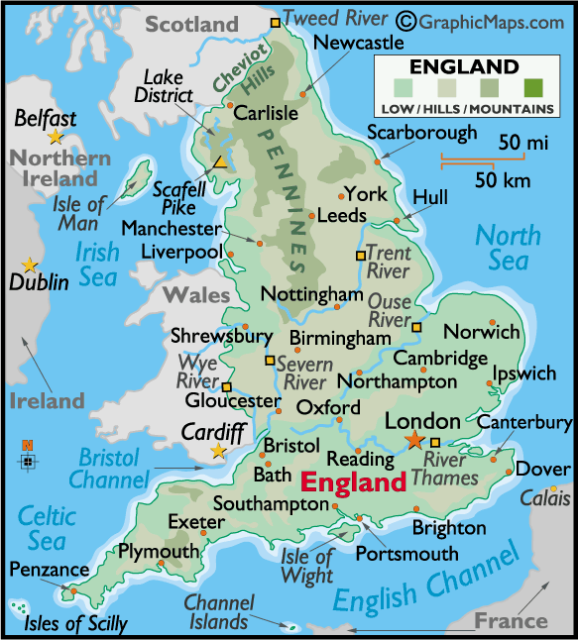
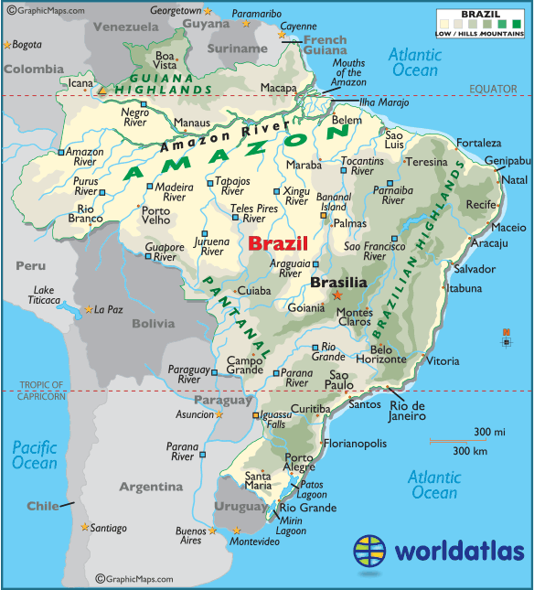
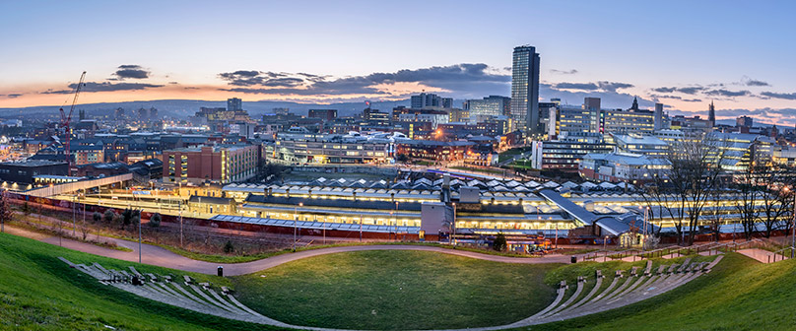
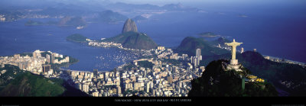
Urban Change in a Major UK City: Sheffield Case Study
Location and Background |  | City’s Importance
Sheffield is a city in South Yorkshire in the North of England. The population of the city is 575,000, making it the fifth largest in the UK. The city grew during the industrial revolution. |  | The city enjoys a large sporting heritage with famous athletes and football clubs. Sheffield is famous for being described as the greenest city in Europe. Sheffield has a thriving community of international students. Sheffield has two major UK universities popular with young students. Fastest growing city outside of London.
Migration to Sheffield |  | City’s Opportunities
During the industrial revolution, the population dramatically increased with people migrating from nearby rural communities. With the attraction of working in the large steelworks or mines, international migrates from Ireland, Pakistan and the Caribbean came to work in Sheffield from 1900-1960. More recently, refugees have arrived from Syria and Iraq. Also Sheffield has attracted thousands of students from the UK & abroad. |  | Social: Sheffield has various cultural attractions such as the Crucible Theatre & museums. Also Meadowhall is very popular with shoppers.
 |  | Economic: The retail sectors contribute to thousands of jobs. The Universities and advanced manufacturing contributes to the city’s economy.
 |  | Environmental: Sheffield is described as being the greenest city in Europe. It’s close to the Peak District and has various open spaces (i.e. the Peace Garden) for residents to enjoy.
City Challenges |  | Sheffield City Centre Regeneration Projects
Social: House prices have increased along with greater house shortages. A third of households live in the 10% of the most deprived wards in the UK. |  | Aims: Sheffield wanted to attract investment in more businesses and job opportunities. Also the projects aim to improve public spaces with more green urban environments. Main features: Brownfield sites and derelict buildings pulled down, £50 million invested on its train station to improve connections, £120 million on green open spaces with the construction of the Winter Gardens and Peace Gardens, £430m to improve the retail quarter and attract shoppers away from Meadowhall.
Economic: Closure of the steelworks and factories caused large scale unemployment. Poor transport connections to large economic hubs such as London and Manchester.
Environmental: Urban sprawl has led to increased pressure and decline of greenfield sites around the city.
Urban Change in a Major NEE City: RIO DE JANEIRO Case Study
Location and Background |  | City’s Importance
Rio is a coastal city situated in the South East region of Brazil within the continent of South America. It is the second most populated city in the country (6.5 million) after Sao Paulo. |  | Has the second largest GDP in Brazil It is headquarters to many of Brazil’s main companies, particularly with Oil and Gas. Sugar Loaf mountain is world heritage site One of the most visited places in the Southern Hemisphere. Hosted the 2014 World Cup and 2016 Summer Olympics. Christ the Redeemer is a new 7 wonder.
Migration to Rio De Janeiro |  | City’s Opportunities
The city began when Portuguese settlers with slaves arrived in 1502. Since then, Rio has become home to various ethnic groups. However, more recently, millions of people have migrated from rural areas that have suffered from drought, lack of services and unemployment to Rio. People do this to search for a better quality of life. This expanding population has resulted in the rapid urbanisation of Rio de Janeiro. |  | Social: Standards of living are gradually improving. The Rio Carnival is an important cultural event for traditional dancing and music.
 |  | Economic: Rio has one of the highest incomes per person in the country. The city has various types of employment including oil, retail and manufacturing.
 |  | Environmental: The hosting of the major sporting events encouraged more investment in sewage works and public transport systems.
City Challenges |  | Self-help schemes - Rocinha, Bairro Project
Social: There is a severe shortage of housing, schools and healthcare centres available. Large scale social inequality, is creating tensions between the rich and poor. |  | The authorities have provided basic materials to improve peoples homes with safe electricity and sewage pipes. Government has demolished houses and created new estates. Community policing has been established, along with a tougher stance on gangs with military backed police. Greater investment in new road and rail network to reduce pollution and increase connections between rich and poor areas.
Economic: The rise of informal jobs with low pay and no tax contributions. There is high employment in shanty towns called Favelas
Environmental: Shanty towns called Favelas are established around the city, typically on unfavourable land, such as hills.

