Slide 1
Component 2
Knowledge Organiser
Name: _________________________
Target Grade: __________
Media Studies
AWE05 – Mr Williams

Slide 2
Component 2 - Vocational Context and Task 1
Brief Context to be added in Jan.
Images to support ideas to be added.
The Brief:
Pre-production phase:
You should engage with media pre-production processes and practices, including:
generating and developing ideas for your media product
practical experimentation
applying sector specific skills and techniques to shape your ideas into pre-production material
reviewing pre-production work to refine and improve outcomes.

Slide 3
How to Research
a. Primary Research
Primary Research is research that YOU do yourself.
Examples of Primary Research:
  Survey – Used to gather information from a group of people. Could be used to find opinions on a certain topic, or to get feedback on a product.
  Interviews – Conducted by yourself, often used to find out how certain aspects of a media product has been created, or to get opinions of a topic.
  Consuming the Media Product – By viewing a media product and making notes is a form of primary research.
b. Secondary Research
Secondary Research is conducted by someone else and presented in an analytical or formal way.
Examples of Secondary Research:
  Essays – academic writings that other people have published can be a great way to find quotes or information needed to back up your points.
  Books – Theory, non-fiction and academic books are often used to help find information that helps prove your point in your written paper.
  Documentaries – documentaries can offer a wide range of information presented in an accessible way. Producers would have already researched the information and then will have presented it in a different way. This means that you can take information and quote it to support your points.
  Websites – these are built to deliver information. Looking at various online articles can help build your research and essay.
References - Don’t forget to add a reference page at the bottom of each task.
This should be done as follows:
Websites – Link (e.g https://www.imdb.com/title/tt1684562/?ref_=hm_fanfav_tt_t_6_pd_fp1_r)
Books – Title, Author, Year (e.g Key themes in media theory, Dan Laughey, 2007)
Articles – Title, Author, Year, how you accessed it (e.g The Hollywood Action and Adventure Film, Yvonne Tasker, 2015)
Media Products – Title, Director/Author/Creator, Production Company, Year (e.g Barbie, Greta Gerwig, Warner Bros., 2023)
BANNED SITES
You cannot use the following websites as part of your research:
Wikipedia
Chat GPT or any other A.I.

Slide 4
Pre-Production Processes
It is important that all media products go through a stage of pre-production. See the workflow below:
1. Generate Ideas:
Mind mapping, Visualisation, Product Research
2. Developing Ideas:
Storylines, Synopsis, Visuals, Content Outline
3. Practical Experimentation:
Testing Images, Editing, Layouts, Writing Copy
6. Reviewing Ideas:
Expand, Reject and Refine
5. Visualise Ideas:
Mood Boards, Sketches, Page Mock-ups
6. Finalise Ideas:
Review, Reject, Improve, Plan, Refine.
Reviewing Words | Definition
Expand | Give more information around your ideas, drawings and research.
Review | Offer an honest critique of your ideas. What works? What won’t? Make recommendations to add to your ideas. Refer to the theme and the target audience.
Reject | State which ideas won’t work and why, refuse to accept some ideas and offer new ones to replace them.
Improve | Make suggestions on how you can improve your ideas and final outcomes. Be critical in your improvements.
Plan | Explain how you will fulfil this idea and brief. Include where hurdles may be and how you will overcome them.
Refine | Finalise and explain the final outcome that you hope to produce. You should use your improvements and rejections to finalise your chosen idea.
Keywords | Definition
Visualisation | Gathering and recording of existing products to help inspire your outcome. This can be do through images, drawings or descriptive writing.
Synopsis | A brief summary or general survey of what your product will entail.
Mood boards | A collection of images, colours, fonts and ideas that will help you visualise your final outcome.
Page Mock-Ups | Will be completed on paper and digitally. These will be a visual representation of what your final product will look like. It should be clearly labelled too.

Slide 5
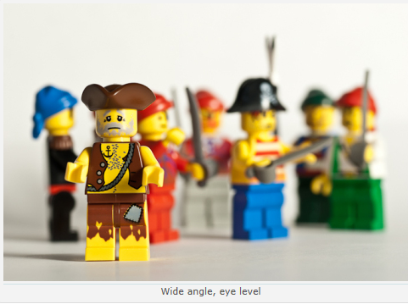
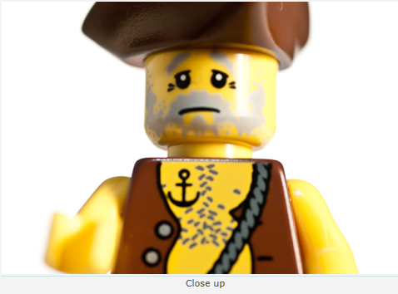
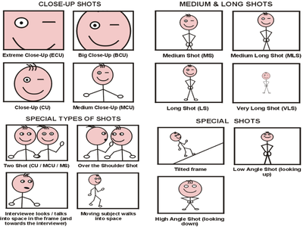
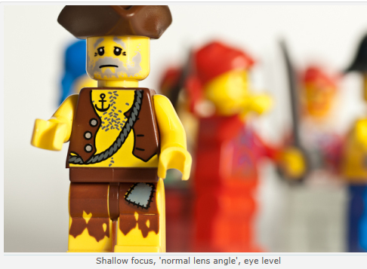
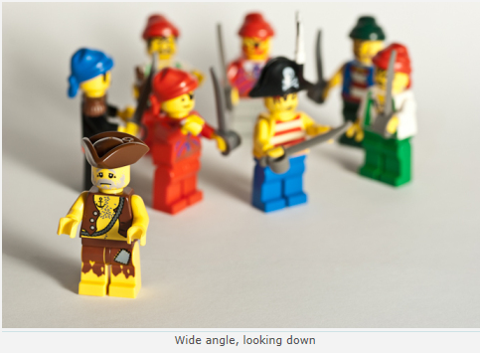
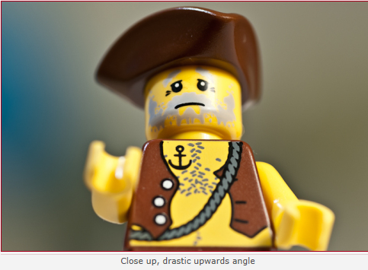
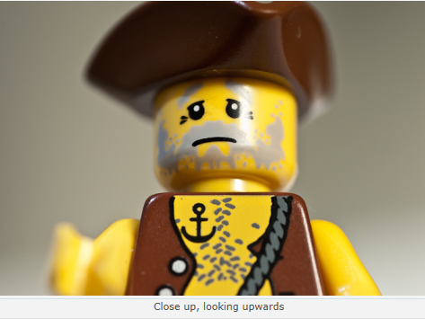
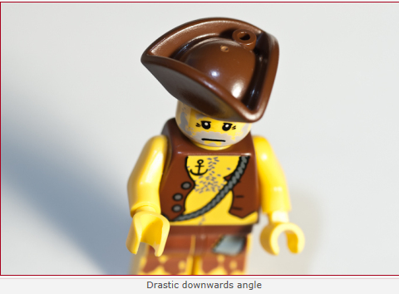
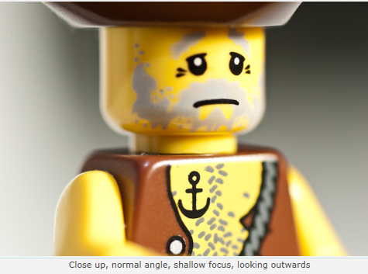
Camera Angles
Camera angles generate huge meanings for the audience. For example, a low angle shot (looking up) generates the meaning that the character has power. Whereas, a high angle shot (looking down generates the meaning of fragility and dominance.
Wide angle eye level
Close up
Shallow Focus, ‘normal lens angle’, eye level
Wide angle, looking down
Close up, drastic upwards angle
Close up, looking upwards
Drastic downwards angle
Close up, normal angle, shallow focus, looking outwards
Notes:
https://quizlet.com/gb/217971345/gcse-media-studies-camera-techniques-flash-cards/

Slide 6
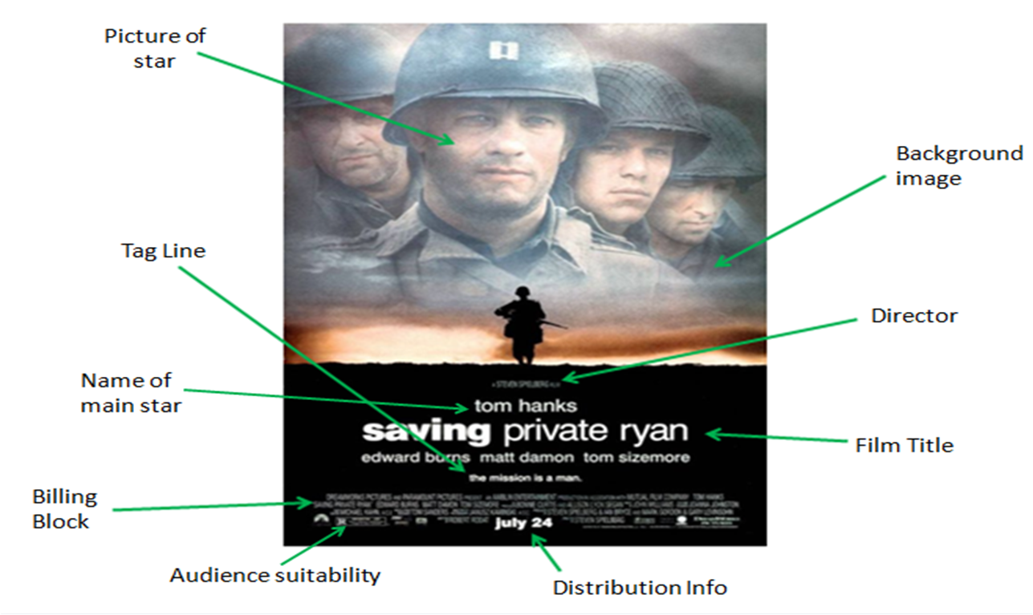
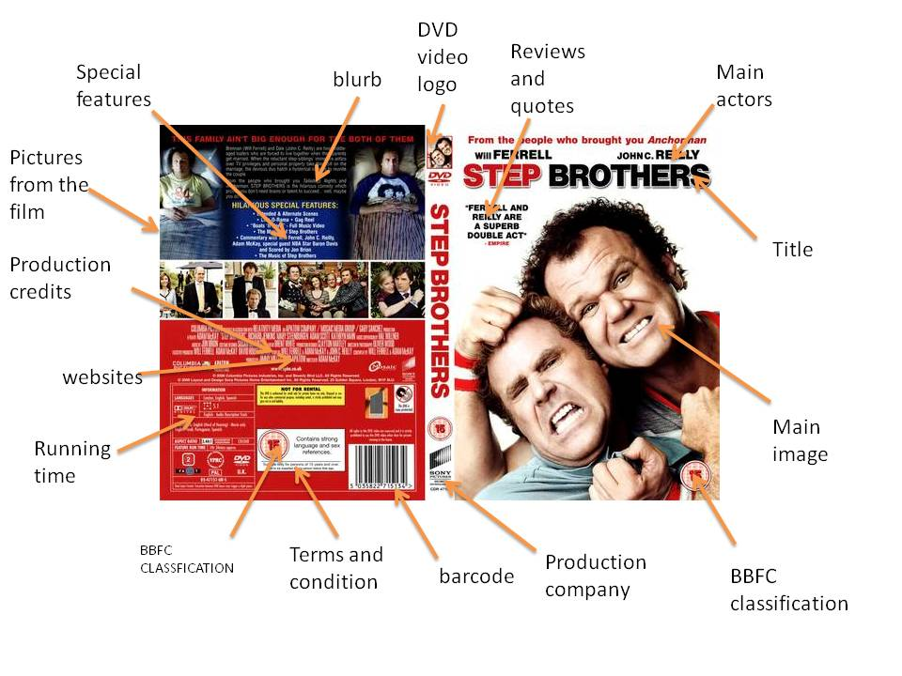
Film Print Based Conventions
Make sure your product and annotations has all conventions.
DVD Cover
Film Poster

Slide 7
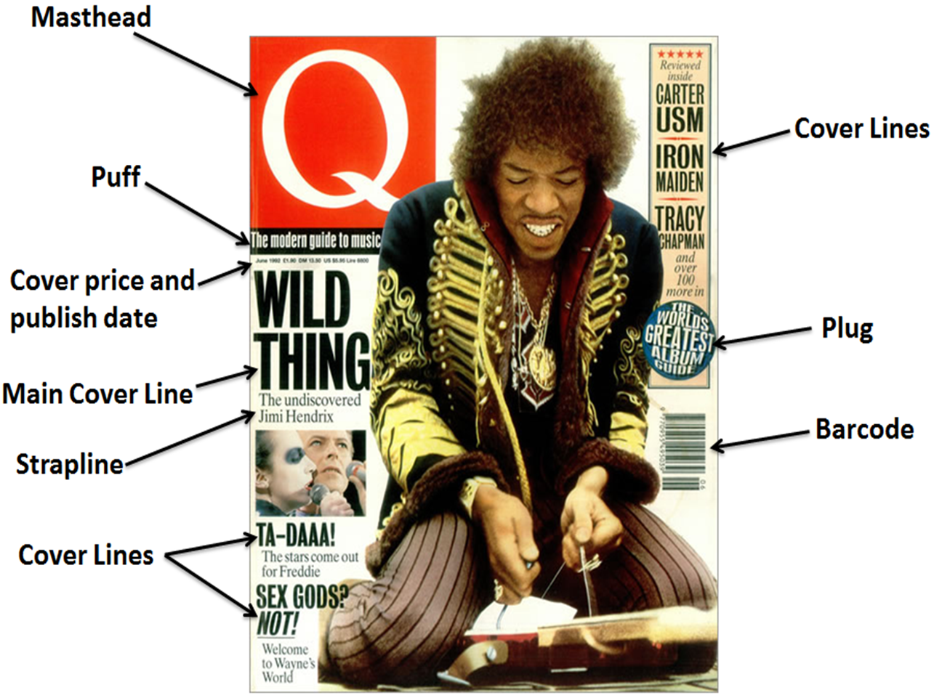
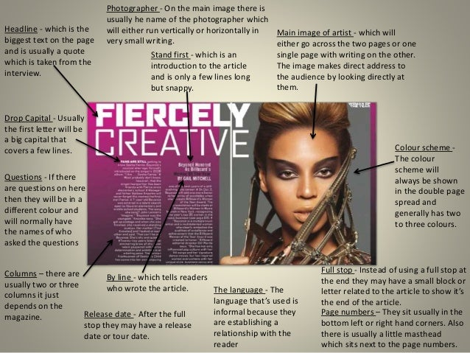
Magazine Conventions
Make sure your product and annotations has all conventions.
Double Page Spread
Magazine Cover

Slide 8
Mode of Address
Mode of address = The way the copy talks to the reader and involves them.
Persuasive Language Devices
Persuasive language devices are used on magazine covers.
These can include:
Rhetorical Questions
Triple
Facts
Alliteration
Repetition
Emotive Language
Lexis
Hyperbole
Direct Quotes
Imperative Sentences
Type of Mode of Address | Definition
Direct | The subject looks directly at the audience, or the writing speaks to ‘you’.
Indirect | The subject looks away, or the writing refers to ‘people’ or ‘the public’.
Formal | Using formal phrasing and terminology. The language used will be Standard English.
Informal | Using more conversational language and colloquial language (slang).
Hostile | The text challenges or insults the reader.
Humorous | The writer/presenter is trying to make you laugh. The tone could be sarcastic or ironic.
Serious | The writer/presenter wants you to take their point seriously. The tone would be sincere consider the use of nouns and the effect that they have on address. I, YOU, WE, THEY etc
Lexis – Subject specific words which help attract specific audiences. (Game magazines will use game specific language.)
Hyperbole – Exaggerated Language
Direct Quotes – pulled from the article, can be used to make coverlines.
Imperative Sentences – Instructions. “Reinvent yourself”, “Lose weight now”, “Get the new looks of 2020”

Slide 9
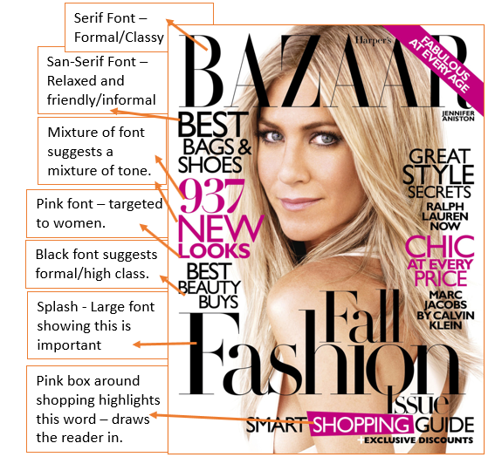
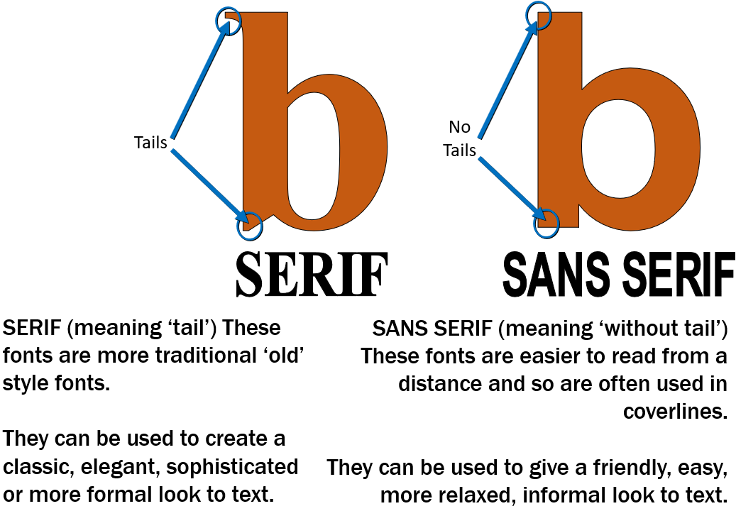


Copy and Typography
Copy = written text on a media product
Typography = the way the copy is arranged to be readable to the audience. This relates to the style, colour, structure and feelings given to the audience.
Font Styles
Magazines and Film Posters often use a specific typography that is unique to them when designing their mastheads/headings. This then acts as a logo and helps them to create a brand.
When it comes to analysing copy and typography you need to make sure you look for the denotations (what you see) and the connotations (what it could suggest). Be sure to think about language techniques too.
You can see some annotations here of an example magazine front cover (It’s the same for Film Print Products.)

Slide 10
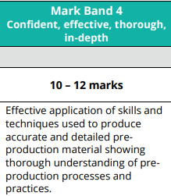
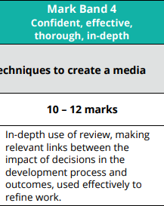
Task 1 Marking Criteria
Everyone is aiming for the top mark band.
In-depth = Covering most, or all, important points of a subject.
Effective = Applies relevant knowledge and understanding and/or skills appropriately to a task and achieves the desired outcome; successful in producing a desired or intended result.
Thorough = Comprehensive and extremely attentive to accuracy and detail.
Confident = Exhibit certainty, having command over information/ argument, etc. Demonstrate secure application of skills or processes.

Slide 11
Notes

Slide 12
Task 2 Brief
Production and post-production phase:
You should engage with media production and post-production processes and practices to develop, review and refine a media product in response to the brief, including:
applying media production skills and techniques to create content
applying media post-production skills and techniques to edit and combine content together
testing and reviewing production and post-production work to refine and improve outcomes
exporting the final product for digital distribution.
Suggested evidence A portfolio of work including:
evidence of the development of your media product through the production and post-production phases
evidence of testing, review and refinement
the final outcomes of your media production work: print products should be approximately three pages (any size)

Slide 13
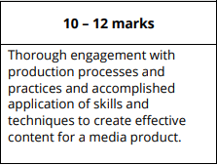
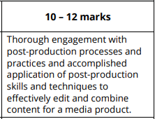
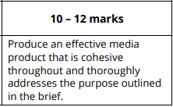
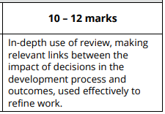
Task 2 Marking Criteria
Everyone is aiming for the top mark band.
In-depth = Covering most, or all, important points of a subject.
Effective = Applies relevant knowledge and understanding and/or skills appropriately to a task and achieves the desired outcome; successful in producing a desired or intended result.
Thorough = Comprehensive and extremely attentive to accuracy and detail.
Confident = Exhibit certainty, having command over information/ argument, etc. Demonstrate secure application of skills or processes.

Slide 14
Production Processes
It is important that all media products go through a stage of production. See the workflow below:
1. Production Workflow:
Ordering tasks. Setting deadlines and monitoring progress.
5. Images:
Plan and shoot all images for your work. Select the best images.
6. Practical Experimentation:
Test edit images and make 2 digital mock-ups using your images and copy.
4. Reviewing Copy:
Act on feedback, review what you have written and expand on your copy.
7. Review:
Gain feedback on your products. Review, Expand, Reflect and Improve final idea.
2. Write Copy:
Plan and write your main copy for your products.
3. Audience Feedback:
Ask for feedback on what you have written.
8. Final Images:
Plan and shoot final images for your work.
Select and review the best/worst.
9. Final Copy:
Write your final article using feedback and review to help improve.
10. Final Edit:
Create your final edit whilst screenshotting and explaining the process you have taken.
12. Final Review:
Evaluate your final products. What works, what doesn’t? How impactful is it?
11. Final Feedback:
Ask your audiences a final time to give feedback on your final product.

Slide 15
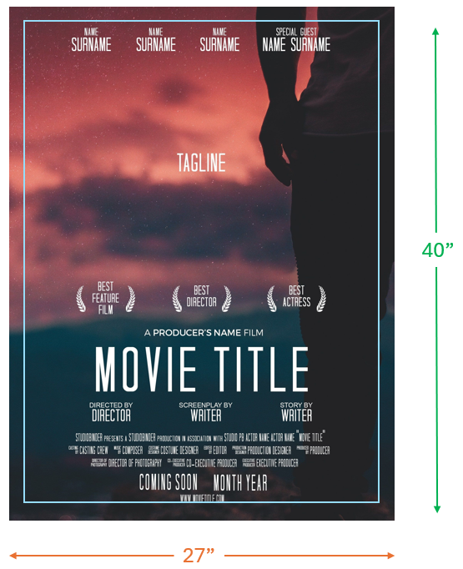
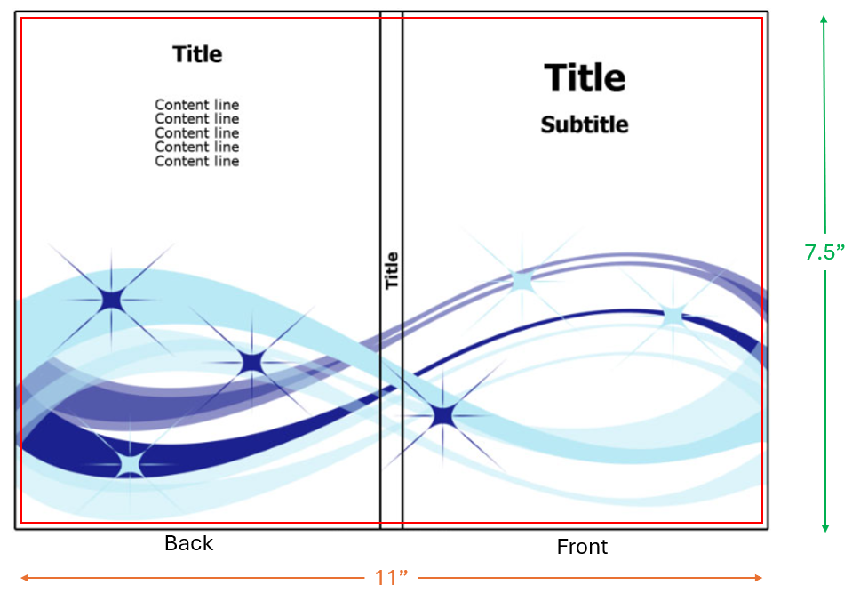
Film Document Sizes
Movie Poster:
Height – 40”
Width – 27”
Resolution – 200
Bit-Rate – 8-bit
Bleed – 2” in
DVD Cover:
Height – 7.5”
Width – 11” in total
Spine – 0.5”
Resolution – 200
Bit-Rate – 8-bit
Overfill – 0.1”

Slide 16
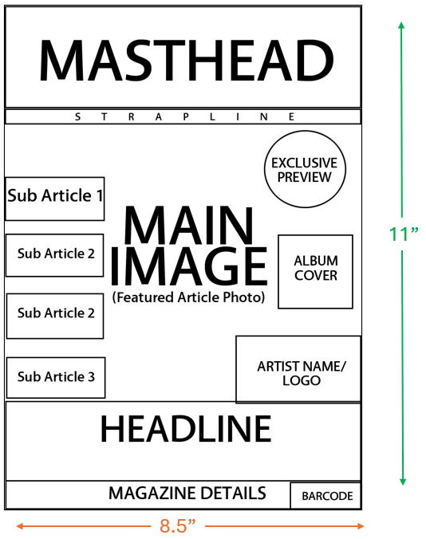
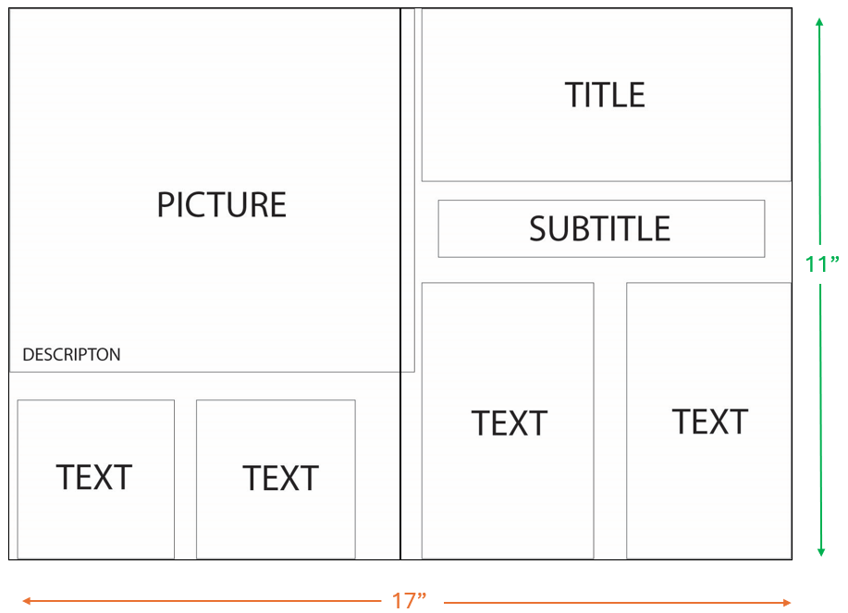
Magazine Document Sizes
Magazine Coverr:
Height – 11”
Width – 8.5”
Resolution – 200
Bit-Rate – 8-bit
Double Page Spread:
Height – 11”
Width – 17” in total
Resolution – 200
Bit-Rate – 8-bit

Slide 17
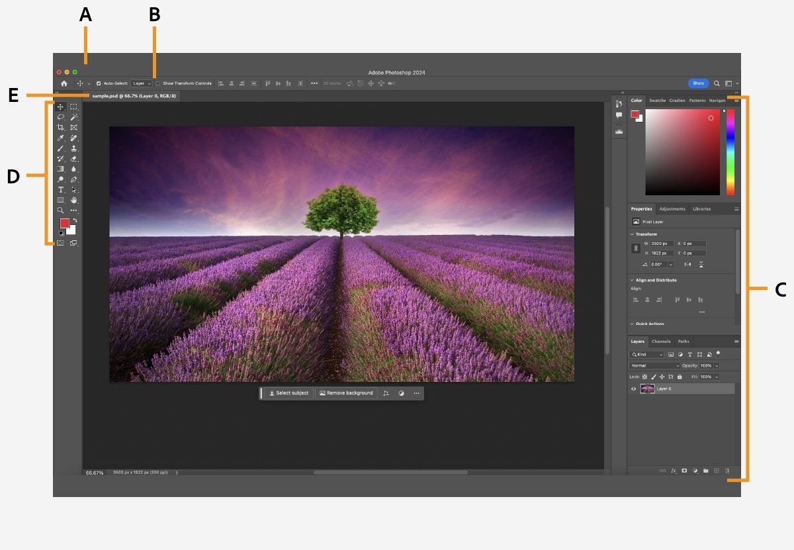
Photoshop Window Layout
Key:
A – Application Frame
B – Application Bar
C – Panels
D – Tool Bar
E – Document Window
F – Layers
G – Workspace
G
F

Slide 18
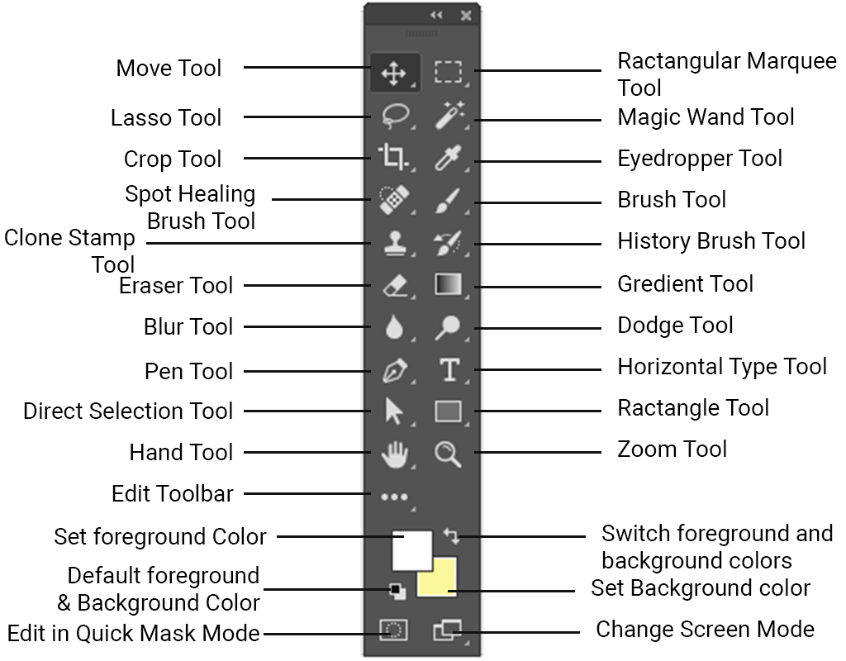
Photoshop Tool Bar

Slide 19
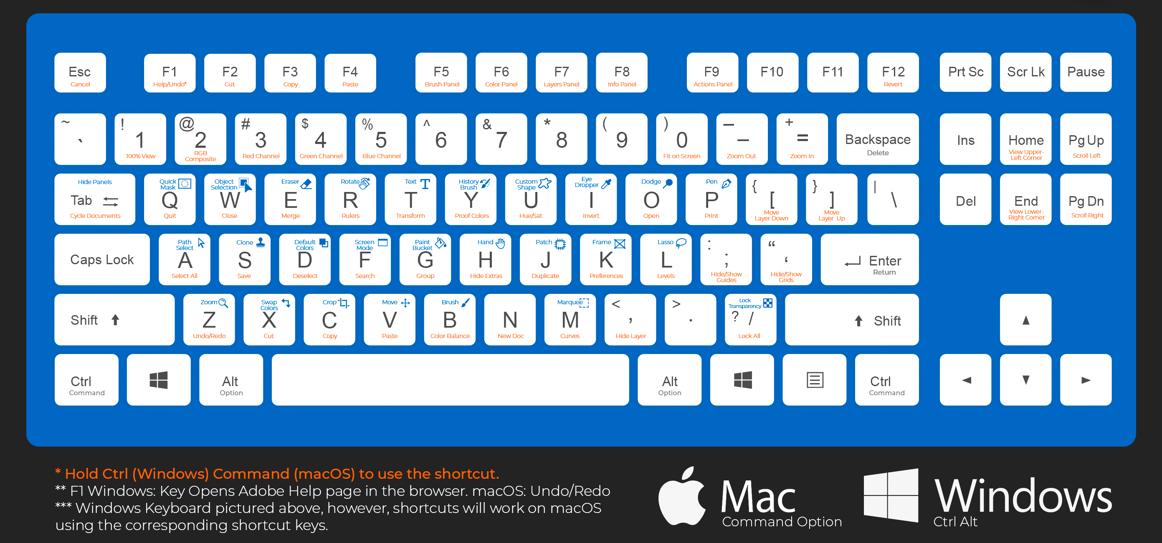
Photoshop Keyboard Shortcuts

Slide 20
Notes

