Slide 1
Year 9 – Spring Term:
Magazines
Knowledge Organiser
Media Studies
Name:
__________________
AWE05
Mr Williams

Slide 2
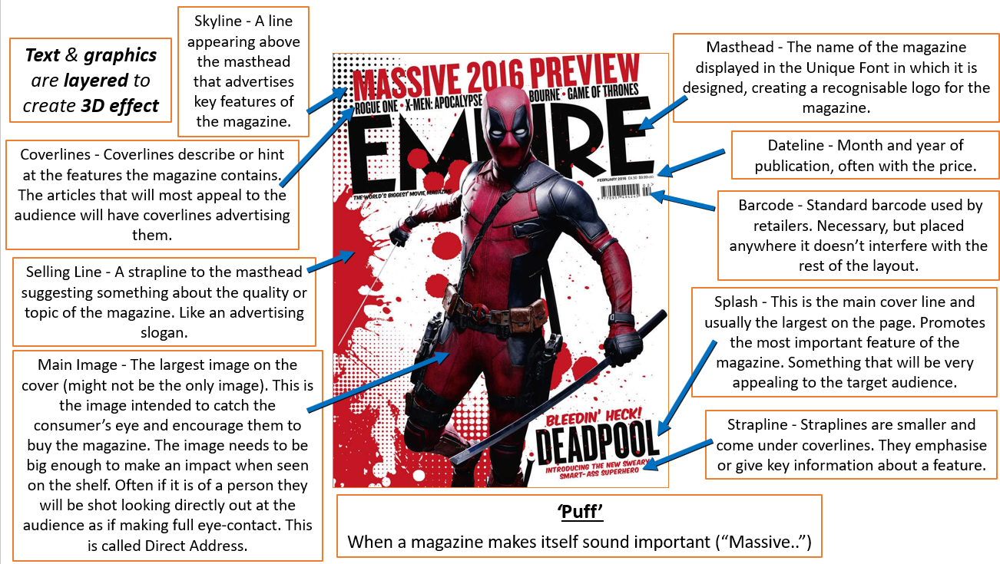
Media Studies
Magazines
Mr Williams
What is a Magazine?
Magazines are part of the publishing sector. They are a print based product but can be distributed online too. They often focus on a specific genre or subject aimed at a readership. For example, sports, fashion or fishing.
1
2
Publishing Sector = print based media products e.g. magazines, film posters, adverts.
Readership = Readers of a magazine, newspaper or book.
Genre = type or category of a media product.
Distributed = made available to readers.
We analyse magazine front covers by using Media Language.
Mise-en-Scene = what is in the image.
Copy = Text/Language/Typography
Layout and Design = how the page is arranged.
The purpose of a magazine is to inform or entertain readers.
They contain a wide variety of text in articles, which are commonly supported by images.
Magazine Genres:
Food
Fashion
Music
Tech
Education
Art/photography
Film/TV
Children’s
Gossip/Lifestyle
Beauty
Health and Fitness
Plus many more.
3
Magazine Front Cover Conventions
4

Slide 3
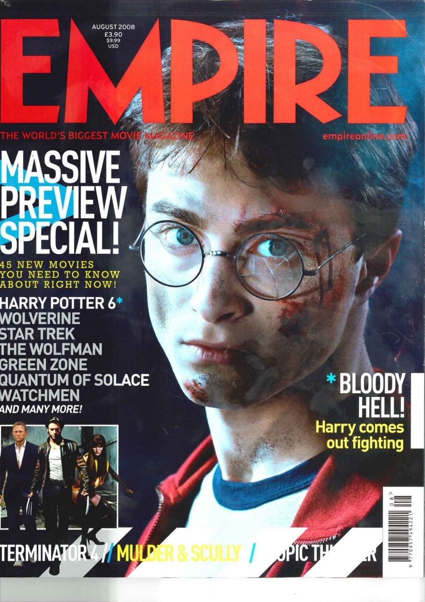
Media Studies
Magazines
Mr Williams
1
2
The Four Principles of Layout and Design
Balance creates stability and visual harmony:
  Symmetrical – Symmetrical balance is like a mirror image, where elements on one side of the page are evenly matched on the other side. This creates a very structured and formal look.
  Asymmetrical - Asymmetrical balance is when the elements on one side of the page are not identical to the other side, but they still balance each other out. It can create a dynamic and visually interesting layout.
Alignment is how it is position on the page:
  Left Alignment – common in western magazines, all the text is aligned on the left side as it is neat and easy to read.
  Centre Alignment – can be used for more formal or artistic look, but should only be used on occasions.
  Grid Layout – the use of the grid (similar to rule of thirds) helps to make the magazine look professional and cohesive.
Proximity is the space and grouping of elements:
  Grouping related elements – Placing topics, titles and images that are related helps audiences see what they may be interested in on the poster.
  Spacing between unrelated elements – helps reduce clutter and improves the readability of the cover.
Contrast - Contrast is the second principle, and it's all about making certain elements stand out and draw the reader's attention. This is done through:
  Text and Images
  Typography – style of font
  Colour
Cover star = the person on the cover of the magazine.
Layout and Design
Magazine covers all tend to be designed around a grid of thirds (see green lines). This brings the reader’s eye to look into the centre third of the magazine cover, they can then connect with the cover star. The text is then placed around the outside in the outer thirds.
It is common that readers will read the cover in a ‘Z’ formation (see purple lines), therefore the masthead, Empire, is at the top of the page and then they are directed to the image, then to the coverlines.

Slide 4
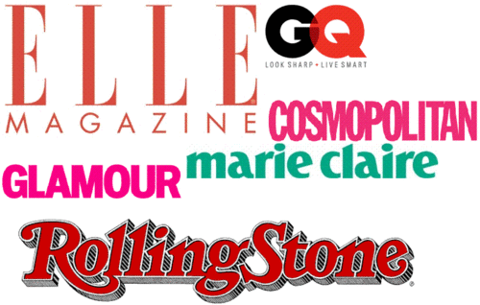
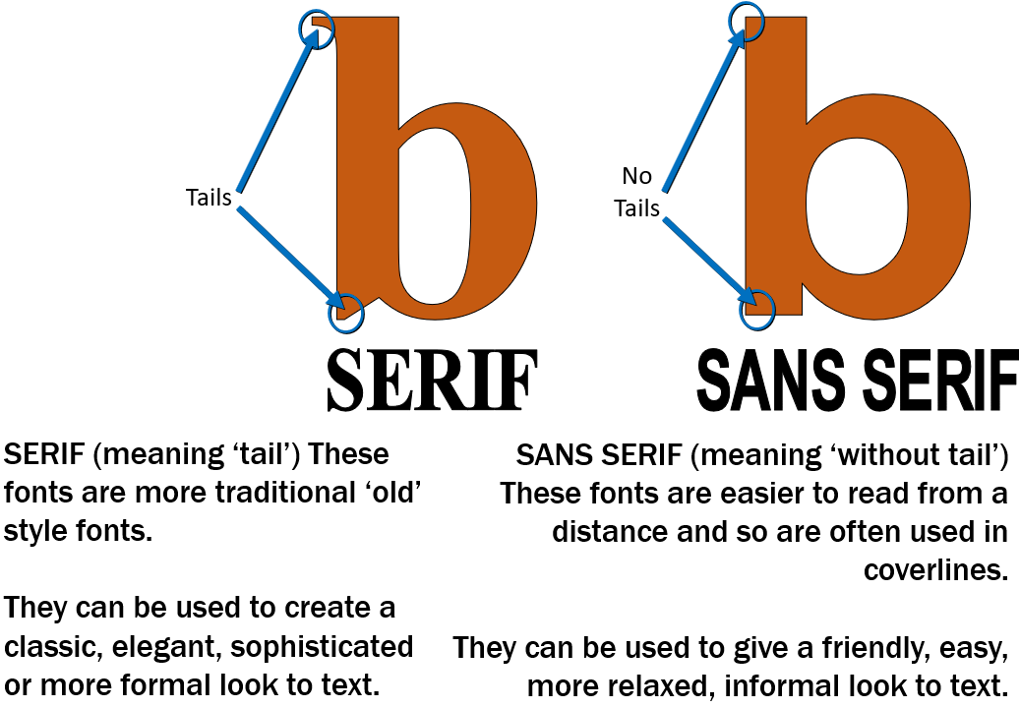
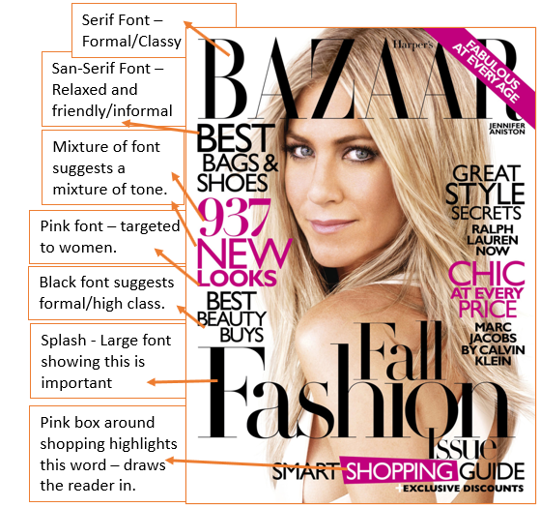
Media Studies
Magazines
Mr Williams
1
2
Copy = written text on a media product
Typography = the way the copy is arranged to be readable to the audience.
This relates to the style, colour, structure and feelings given to the audience.
Magazines often use a specific typography that is unique to them when designing their mastheads. This then acts as a logo and helps the magazine to create a brand.
3
Font Styles
4
5
When it comes to analysing copy and typography you need to make sure you look for the denotations (what you see) and the connotations (what it could suggest). Be sure to think about language techniques too.
You can see some annotations here of an example front cover.

Slide 5
Media Studies
Magazines
Mr Williams
1
Persuasive Language Devices
Persuasive language devices are used on magazine covers.
These can include:
Rhetorical Questions
Triple
Facts
Alliteration
Repetition
Emotive Language
Lexis
Hyperbole
Direct Quotes
Imperative Sentences
Mode of Address
The way the copy talks to the reader and involves them.
3
2
Types of Mode of Address
Direct – The model looks directly at the audience, or the writing speaks to ‘you’.
Indirect – The model looks away, or the writing refers to ‘people’ or ‘the public’.
Formal - Using formal phrasing and terminology. The language used will be Standard English.
Informal - Using more conversational language and colloquial language (slang).
Hostile – The text challenges or insults the reader.
Humorous – The writer/presenter is trying to make you laugh. The tone could be sarcastic or ironic.
Serious – The writer/presenter wants you to take their point seriously. The tone would be sincere consider the use of nouns and the effect that they have on address. I, YOU, WE, THEY etc
Lexis – Subject specific words which help attract specific audiences. (Game magazines will use game specific language.)
Hyperbole – Exaggerated Language
Direct Quotes – pulled from the article, can be used to make coverlines.
Imperative Sentences – Instructions. “Reinvent yourself”, “Lose weight now”, “Get the new looks of 2020”
4

Slide 6
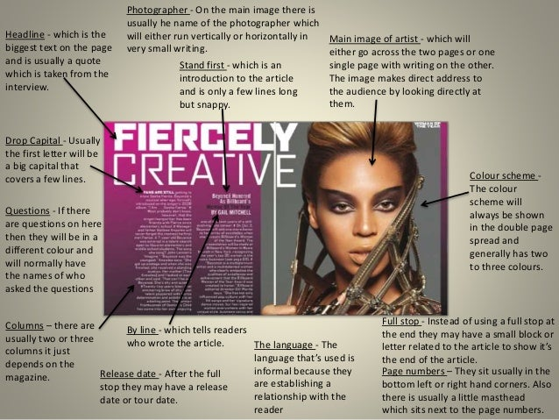
Media Studies
Magazines
Mr Williams
Conventions of a Double Page Spread

