Slide 1
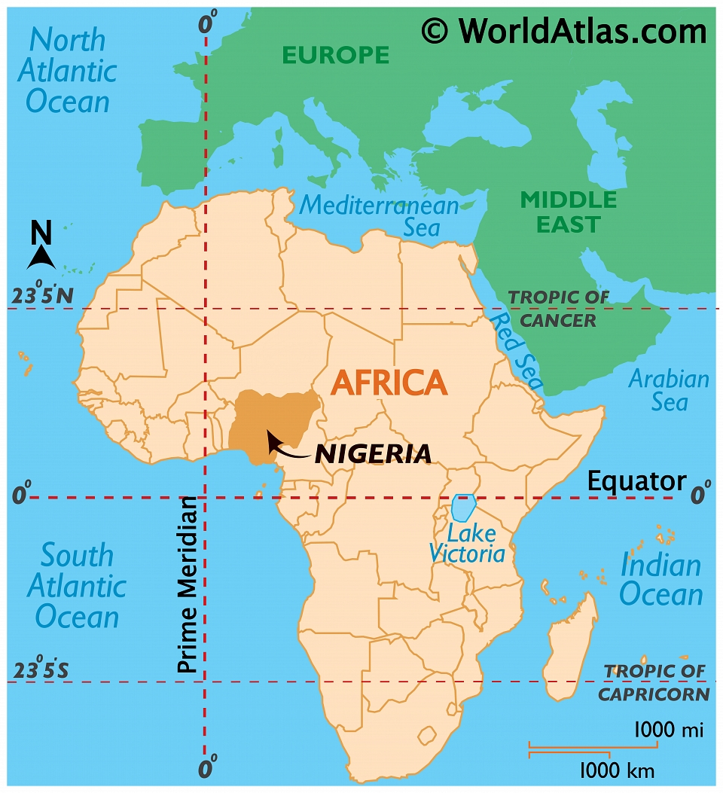
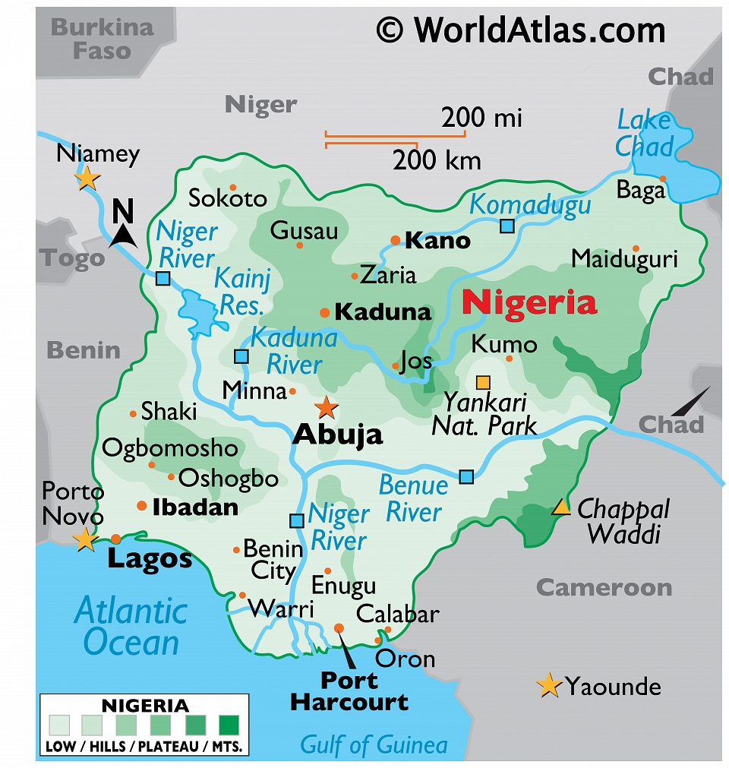


A growing percentage of the world’s population lives in urban areas.
>Urbanisation is the growth in the proportion of a country’s population living in urban areas. >50% of the world’s population live in urban areas, this is increasing every day. >HIC are more economically developed e.g. Japan. Urbanisation happened during the industrial revolution, most of the population here already live in urban areas. >HIC’s have a slow rate of urban growth, many people are moving away from urban areas as they seek better qualities of life# >Fastest rates of urbanisation are in LICs
Urbanisation is caused by rural to urban migration and natural increase
Push factors | Pull factors
Natural disasters War Desertification High cost of living | Better quality of life Better access to higher education Better rights, same sex marriage Mild climate
A case study of a major city in an LIC or NEE
>Lagos is the biggest city in Nigeria, >Nigeria is an NEE >Lagos has 21 million people
Opportunity #3 Lagos Mass Transit
Positives | Negatives
A new light railway scheme is being developed in Lagos. The system carries seven times as many passengers as the BRT. [Bus Rapid Transit which 200,000 people use per day] It is an integrated transport system that links road, rail and waterway networks | Blue-Rail is likely to only be complete in 2022. Construction has involved many delays since 2011. The Federal Government of Nigeria is currently seeking a loan of about US $40bn to US $46bn to complete the ongoing rail projects.
Urban growth creates opportunities for cities in LICs and NEEs.
Social opportunities | Economic opportunities
>Better access to services e.g. healthcare and education compared to rural area >Better access to resources e.g. clean water compared to rural areas | >More jobs and better wages are available through the different industries in urban areas. >Industries can sell to the global market - thus increasing profits.
Urban growth creates challenges for cities in LICs and NEEs.
Social/Economic challenges | Environmental challenges
>Creation of squatter settlements >Overcrowdedness >Lack of access to basic services >Due to people’s lack of education, people work jobs asking for long hours and offering little pay. | >Rubbish isn’t collected everywhete >Air pollution comes from burning fuel, vehicle exhaust fumes and factories. >Road system was not able to cope with all vehicles. Congestion causes increased greenhouse gas emissions. >Sewage and toxic chemicals aren’t disposed of adequately.
Urban Issues and Challenges – Year 10
Opportunity #1 Eko Atlantic
It will become the new financial center of Nigeria, and perhaps West Africa.
Positives | Negatives
Will be home to 250,000 people, employ 150,000 people, and attract big global multinational businesses to Lagos, will also protect Lagos from storm surges, flooding and sea level rise. | The project is not aimed at the urban poor but at rich people from abroad, money from foreign companies is funnelled abroad again, there are concerns over how much surrounding the material which has been dredged to create the reclaimed land.
Opportunity #4 Electricity
Positives | Negatives
Lagos Solar Power Project has generated 5MW of solar power to education and health facilities and given access to renewable power for 172 schools and 11 public health centres Solar projects could increase the availability of electricity to almost 80 million people who currently have none | Businesses spend almost $14bn a year on imported, expensive and dirty diesel for their onsite generators, creating smog in major cities like Lagos, 98 million people in Nigeria are without access to electricity.
Opportunity #2 Makoko Floating School
Positives | Negatives
Education is seen as a passport out of poverty, Has two classrooms for 60 pupils in total Built by a charity out of sustainable and reclaimed materials | Only 61 percent of 6-11 year-olds regularly attend primary school and only 35.6 percent. The school sunk in 2016 after continuous storms

Slide 2
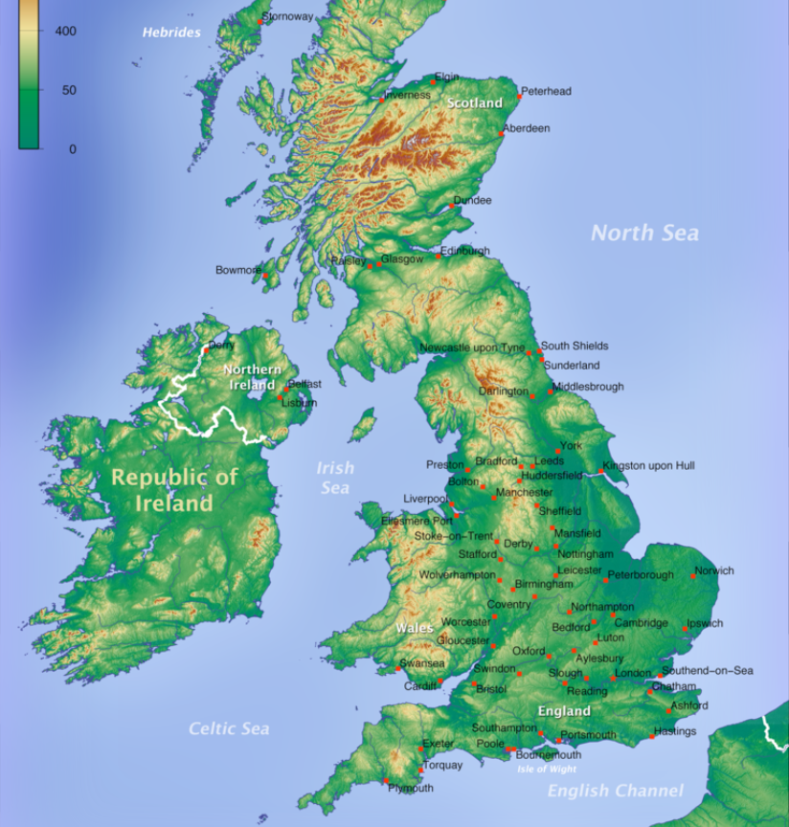
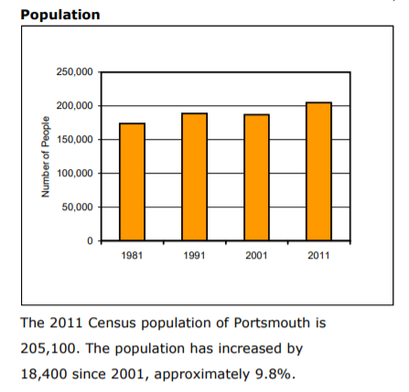
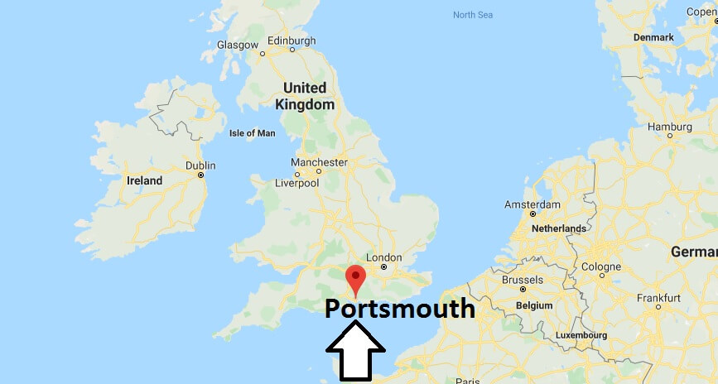
Overview of the distribution of population and the major cities in the UK.
Growth of Portsmouth
This graph shows the growth in the population of Portsmouth over time
Opportunity #2 Urban Greening Hornsea Country Park
The new country park will feature wildflower meadows, cycle trails, footpaths, picnic areas and stunning views across Portsmouth’s historic harbour. 30% of Portsmouth is covered by nature protection orders The council have refused planning permission for any development that reduces the current net area of open space
>The population distribution in the UK is uneven.
>Most urban areas are in lowland regions and in the south.
>Most rural areas are in upland areas and the north.
Opportunity #3 House Building
Water Pollution | Air Pollution
Portsmouth city council are building more than 200 brand new energy efficient homes social housing homes to ease housing waiting lists. In 2018 a bid was approved to build 300 ‘affordable’ homes on council owned land. Portsmouth's car-free £1bn Tipner West super peninsula with 4,000 homes Catherine House containing 1000 student rooms costing £169 was built in place of Zurich House | Second most densely populated city in the UK behind London There are 2211 applicants on the Housing Register; 67 of them are homeless, 838 required a one bedroom property 15,000 immigrants arrived in Portsmouth between 2000-11 Portsmouth's population has grown by 9.8% since 2001
Case study of a major city in the UK
 | Location It is situated in the county of Hampshire in the south of England. To the south of Portsmouth is the Solent and the Isle of Wight followed by the English Channel. To the East of Portsmouth is Chichester, Brighton and West Sussex.
Portsmouth is a port city and naval base on England’s south coast, mostly spread across Portsea Island. It’s known for its maritime heritage and Portsmouth Historic Dockyard.
Regional and global importance of Portsmouth
>26% of the university are international students >Cross channel ferry links to France, Spain, Channel Islands and Isle of Wight. >17,200 people are employed in the navy in Portsmouth. >BAE systems supplies defence products to countries such as the India, Saudi Arabia. >25 in every 100 births in Southampton were born to foreign born mothers in 2016
Urban Issues and Challenges
Opportunity #1 Gunwharf
Positives | Negative
>Opened in 2001 >It was decommissioned as a Royal Navy site in 1986 > 93 shops, 25 pubs and restaurants >UK’s only waterfront outlet centre >310 homes >A 26 lane Bowlplex >A 14 screen cinema, casino, 24 hour health & fitness centre and waterside >A 130 bed hotel. >2000+ jobs have been created directly and indirectly | . >Caused gentrification in a working class city which has priced some people out. >Jobs created are often low paid/low hours/go to students as opposed to local people.
Opportunity #2 Urban Greening Hornsea Country Park
Park will include 50,000 trees Being built on a former landfill site. It will offer visitors 128 acres of public green open space.
Opportunity #4 Hard Interchange/Park and Ride
Positive |  | Negative
The satnav company TomTom has reported that drivers spend 13 minutes more in traffic in the morning in traffic and 15 minutes more in traffic in the evening due to congestion. CO2 emissions in the city have decreased by 36 per cent between 2005 and 2017 - from 1,280.2 kilotonnes to 813.3 kilotonnes. |  | On average 370 cars park in the park and ride each day and 710 bus trips are made to and from the park and ride The park and ride project is part of £1.8billion investment planned for the city during the next 20 years. It is vital to the western transport corridor which plans to improve the city centre road layout

Slide 3
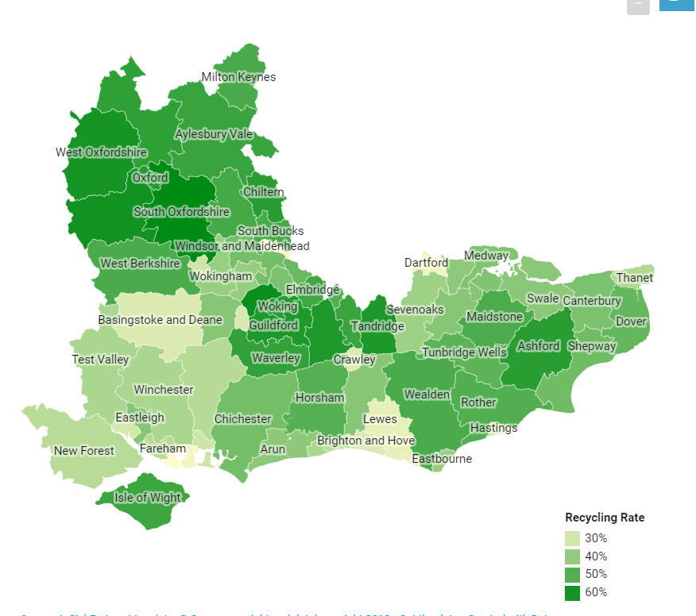
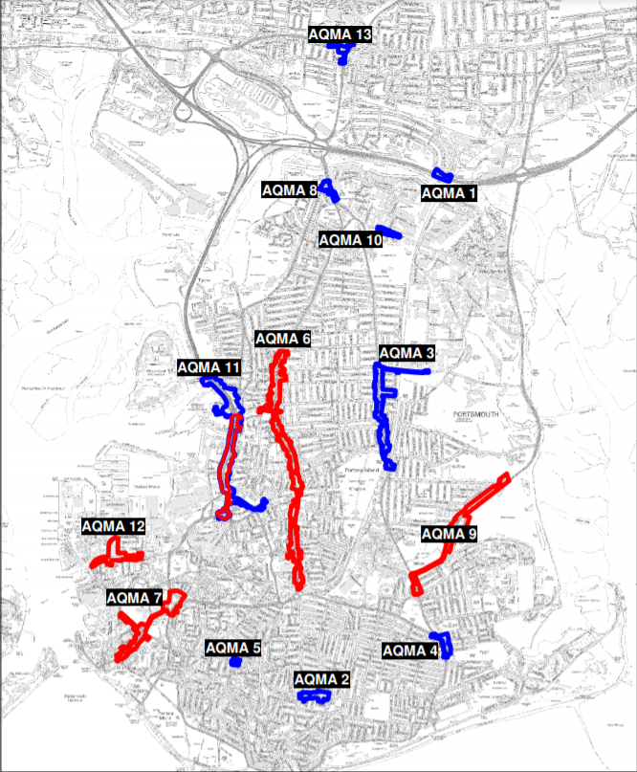
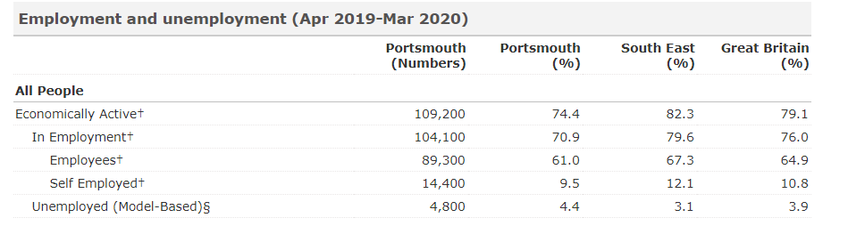
Urban Issues and Challenges Glossary
Key words | Definitions
Brownfield site | Land that has been used, abandoned and now awaits some new use. Commonly found across urban areas, particularly in the inner city.
Inequalities | Differences between poverty and wealth, as well as in peoples' wellbeing and access to things like jobs, housing and education
Literacy Rate | The % of people that can read and write beyond the age of 15.
Integrated Transport System | When different transport methods connect together, making journeys smoother and therefore public transport more appealing
Megacities | Mega-cities An urban area with a total population in excess of ten million people.
Migration | When people move from one area to another. In many LICS people move from rural to urban areas (rural-urban migration).
Social deprivation | The degree to which an individual or an area is deprived of services, decent housing, adequate income and local employment.
Squatter settlement | An area of poor-quality housing, lacking in amenities such as water supply, sewerage and electricity, which often develops spontaneously and illegally in a city in an LIC.
Sustainable urban living | A sustainable city is one in which there is minimal damage to the environment, the economic base is sound with resources allocated fairly and jobs secure, and there is a strong sense of community, with local people involved in decisions made
Urban greening | The process of increasing and preserving open space such as public parks and gardens in urban areas.
Urban regeneration | The revival of old parts of the built‐up area by either installing modern facilities in old buildings (known as renewal) or opting for redevelopment (ie demolishing existing buildings and starting afresh).
Urban sprawl | The unplanned growth of urban areas into the surrounding countryside.
Challenge #3 Air Quality
In Portsmouth, the main pollutants which may impact on human health are principally the products of combustion from road traffic – mainly nitrogen dioxide. There are currently five Air Quality Management Areas (AQMAs) predicted to exceed the annual nitrogen dioxide National Air Quality Objective (NAQO)
Urban Issues and Challenges
Challenge #2 Rates of unemployment
The rate of unemployment is higher in Portsmouth than in the UK as a whole Average gross weekly earnings are £469, which is lowers than the UK as a whole [£565]. There are many multinational companies operating in and around Portsmouth including: BAE, WIggle, IBM, Blake Morgan, Airbus, The Royal Navy.
Challenges of living in a growing city
Challenge #1 Waste disposal
Each year we throw away approximately 1 tonne of waste per person. Portsmouth City Council (PCC) has one of the lowest recycling rates in the UK, coming in at 340th out of 352 local authorities for the period April 2016 to March 2017, with only 24.7% of household waste sent to be reused, recycled or composted.

Slide 4
Urban Sustainability
Key Idea: Urban sustainability requires management of resources and transport. Cities use a huge amount of resources and are not able to supply their own food or energy, making them more sustainable would improve the quality of life of the people living there.
Eddington, Cambridge [small-scale]
Energy - The design of the homes and buildings makes extensive use of photo-voltaic roof panels (solar panels), and the centralised energy centre and district heating network. Waste & Recycling - Underground chutes replace thousands of traditional wheelie bins in an innovative waste disposal system, the largest of its kind in the country. Rainwater Harvesting - Eddington is home to the UK’s largest site-wide water recycling system. Biodiversity - key worker housing provides nest sites for house sparrows, swifts and starlings. In addition, features to encourage use of new buildings by roosting bats, some 2000 trees, plants and brambles will be planted in the first phase of the development with layers of maturity to create a sense of place.
Copenhagen, Denmark [large-scale]
Energy - Since 2007, Samso island in Copenhagen has been 100 % sustainable, relying entirely on renewable energy. Transport - In 2011, Copenhagen’s new two-line metro carried 54.3 million passengers. The driverless trains run 24 hours a day, at an average speed of 40 km/h. Waste & Recycling - ⅔ of all waste is recycled, Copenhagen sends less than 2% of its waste to landfill. Food - Organic food makes up 24% of the total food sales in Copenhagen, it is sold in all schools, hospitals and nursing homes.
Sustainable Urban Living | Where there is minimal damage to the environment, the economic base is sound , resources are fairly allocated and jobs secure.
Traffic congestion | Occurs when there is too great a volume of traffic for roads to cope with so traffic jams and traffic slows to a crawl.
Solutions from Other Cities
Freiburg: Built an efficient tram network and restricts car parking in the centre with car park spaces costing £20,000
Singapore: High petrol prices and an overhead railway system.
Beijing: Only 20% of people applying to own a vehicle are allowed to do so and a congestion charge has been introduced.
London: A congestion charge to enter the city centre.
Integrated Transport Systems | When different transport methods connect together, making journeys smoother. Better integration should result in more demand for public transport and reduce private car use.

Slide 5
Exam Style Questions
Urbanisation Which term is best defined by the phrase, ‘the increasing percentage of the population living in towns and cities’? [1 mark] A Urban Sprawl B Urbanisation C Migration D Urban regeneration What is a megacity? [1 mark] Suggest two reasons for the slow rate of urban growth in many higher income countries (HICs). [2 marks]
City in an LIC Evaluate the effectiveness of an urban planning strategy in helping to improve the quality of life for the urban poor. Use an example of a city in a lower income country (LIC) or newly emerging economy (NEE). [9 marks + 3 SPag] To what extent do urban areas in lower income countries (LICs) or newly emerging economies (NEEs) provide social and economic opportunities for people? [6 marks] Evaluate the effectiveness of an urban transport scheme(s) you have studied.[9 marks + 3 SPaG]
3 SPaG = 3 marks for Spelling, Punctuation and Grammar

Slide 6
Exam Style Questions
UK city Outline one way that national migration has led to change in the character of a named UK city [2 marks]. To what extent has urban change created environmental challenges in a UK city you have studied? [9 marks + 3 SPaG] Outline one way that international migration has led to change in the character of a named UK city. [2 marks] What is urban sprawl? [1 mark]
Sustainability Explain how urban living can be made more sustainable.[9 marks + 3 SPaG] What is sustainable urban living? [1 mark] Traffic congestion is a problem in many urban areas.Explain how traffic congestion can be reduced. [6 marks]
3 SPaG = 3 marks for Spelling, Punctuation and Grammar

Slide 7
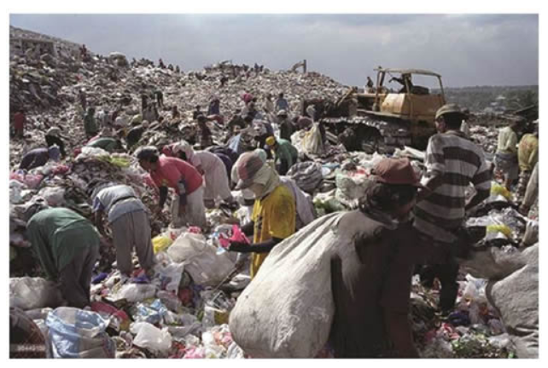
Exam Style Questions
Figure questions Study the photograph of a rubbish dump in the Payatas slum in Manila, a city in the Philippines. Suggest one opportunity for people shown in the photograph. [2 marks] Use the photograph and a case study of a city in a LIC / NEE to assess the challenge of providing services to the city’s population.[6 marks]
3 SPaG = 3 marks for Spelling, Punctuation and Grammar

Slide 8
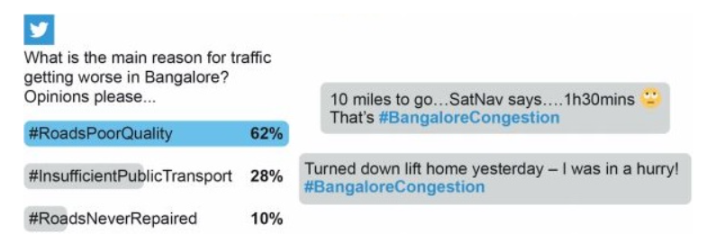
Exam Style Questions
Figure questions Study some social media comments about traffic in Bangalore, a city in India. Using the social media comments above suggest one problem faced by people in Bangalore as a result of traffic box congestion.[2 marks] Use the social media comments above and a case study of a city in a LIC or NEE to suggest why managing traffic congestion and air pollution may be challenging. [6 marks]

Slide 9
Question: Use the social media comments above and a case study of a city in a LIC or NEE to suggest why managing traffic congestion and air pollution may be challenging
Purple = figure usage
Green = case study
Red = Developed points
The figure above shows a number of Twitter comments showing how problematic the congestion is in Bangalore. One comment says that it is going to take them ‘1h30mins’ to travel 10 miles. 62% of respondents to the poll say that road quality here is poor. Like Lagos in Nigeria, growing cities can often have problems with: congestion, public transport and air pollution. In Lagos there is an ongoing project to create the Lagos mass transit which will carry 70x more passengers than the previous bus system. This will help to take cars and motorcycles off of the road which will both reduce congestion and air pollution once it is complete.

Slide 10
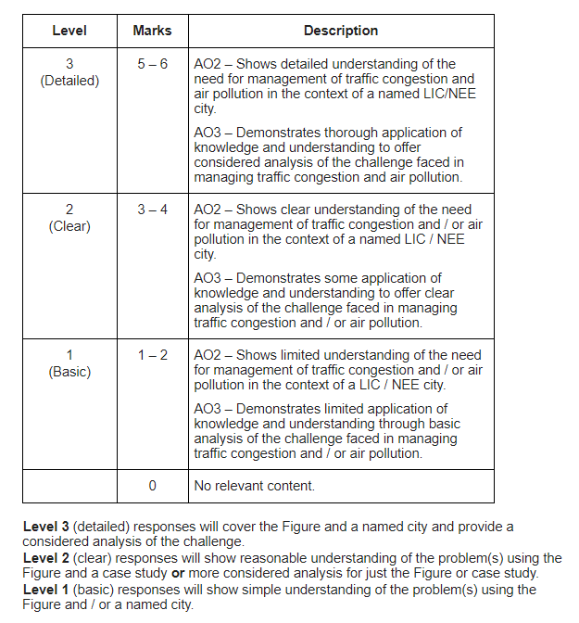
Question: Use the social media comments above and a case study of a city in a LIC or NEE to suggest why managing traffic congestion and air pollution may be challenging
Mark Scheme

Slide 11
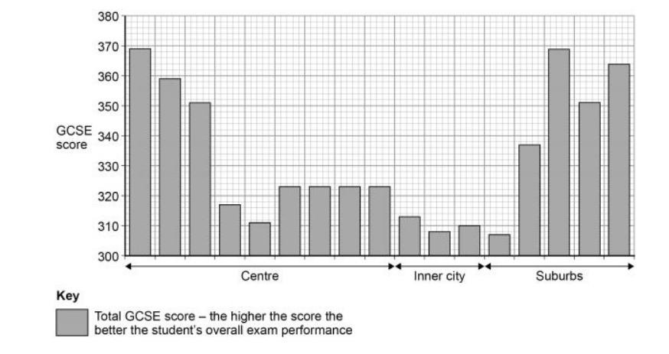
Study the graph below showing GCSE scores along a transect through a UK city.
Using the graph and your own understanding, suggest reason(s) for inequalities in education in urban areas in the UK.[4 marks]
Model Inequality in this graph means the difference between the highest GCSE scores and the lowest GCSE scores that we can see. The reason for the inequality might be due to de-industrialisation of big cities such as Nottingham or Sheffield which led to lots of social deprivation even now. Families in these inner city areas might not be able to afford revision materials or laptops for home. You may not get many qualified teachers wanting to work in more deprived inner cities.
Overview of what the graph is showing
Finding reasons for inequalities in grades

