Slide 1
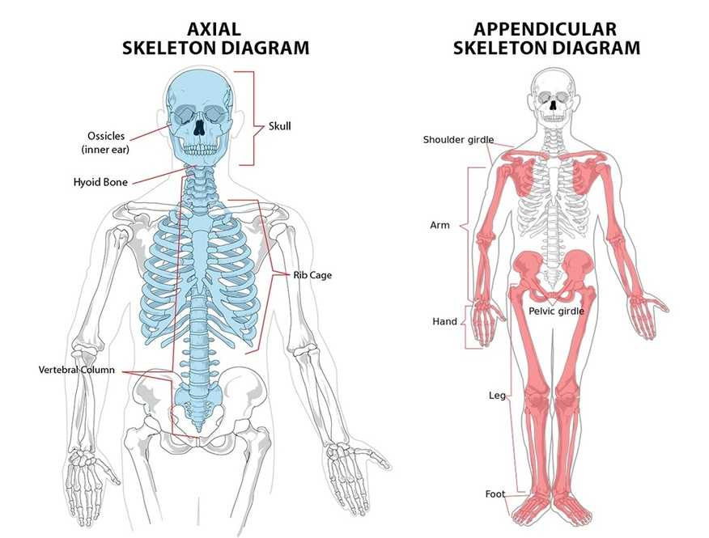
Structure of the Skeleton

Slide 2
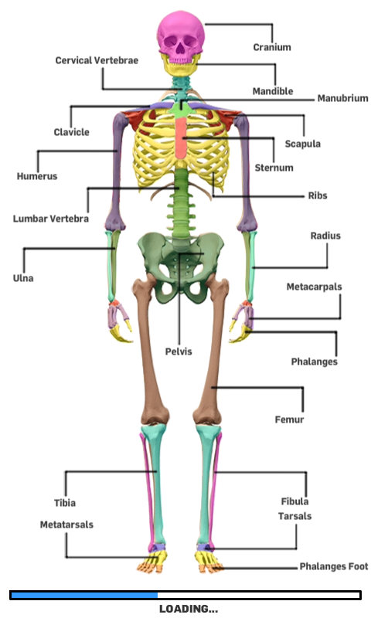
Structure of the Skeleton

Slide 3
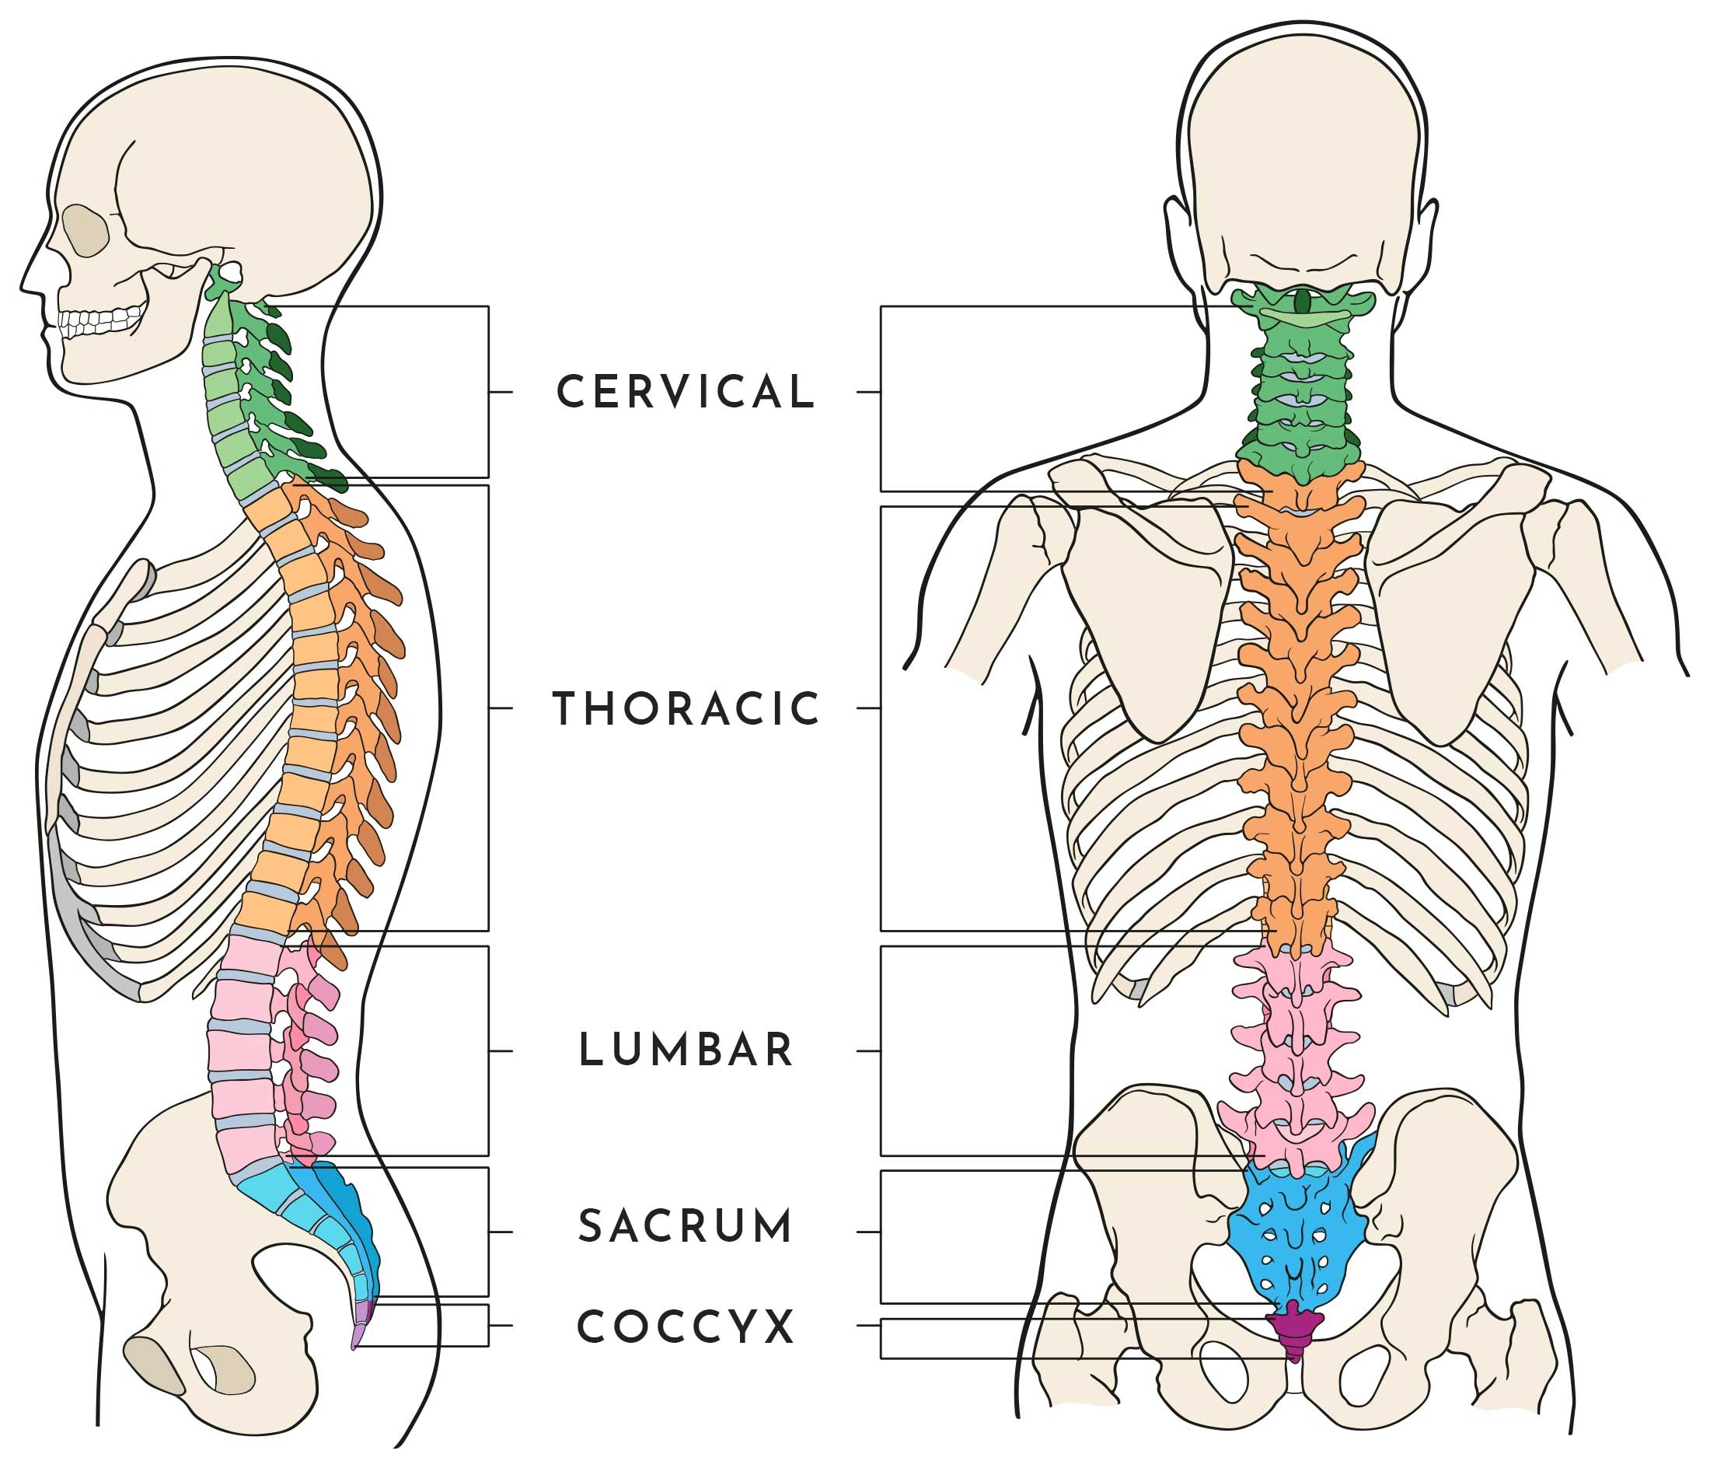
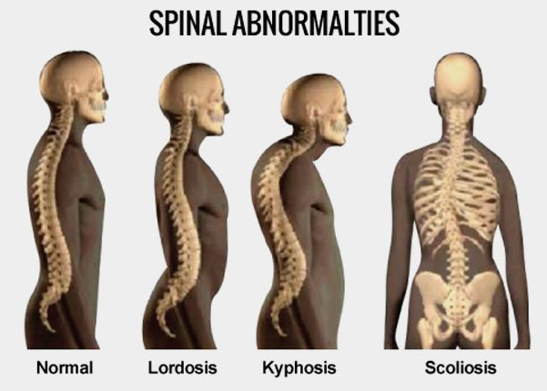
Structure of the Spine

Slide 4

Functions of the Skeletal System
Protection
Movement
Blood cell production
Support
Shape / Structure
Storage of minerals
BPM

Slide 5
Types of Bones
LONG | SHORT | FLAT | IRREGULAR | SESAMOID
Acts as levers to create movement | Strong and light bones used for weightbearing | Protection of vital organs | Protection of spinal cord | Protection of a joint
Humerus Femur Clavicle Radius Ulna Metacarpals Metatarsals Tibia Fibula Phalanges | Carpals Tarsals | Ribs Sternum Scapula Cranium | Vertebrae | Patella

Slide 6
Joint- the point at which two or more bones meet
Types of Joints
FIXED | SLIGHTLY MOVEABLE | SYNOVIAL
No movement | Small amounts of movement | Large amounts of movement
Cranium | Vertebrae | BALL & SOCKET | Hip | Shoulder
 |  | HINGE | Knee | Elbow
 |  | PIVOT | Neck
 |  | SADDLE | Thumb
 |  | CONDYLOID | Wrist
 |  | GLIDING | Wrist

Slide 7
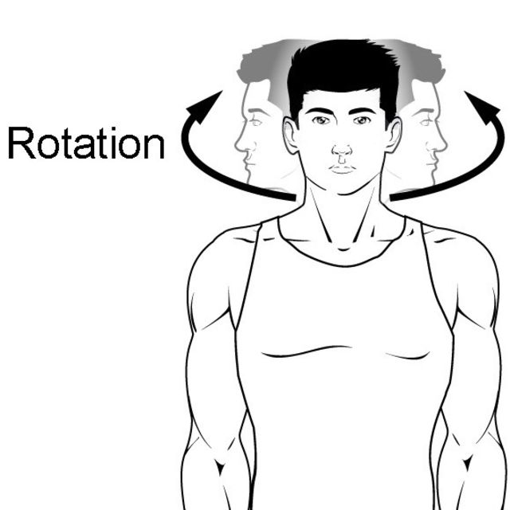
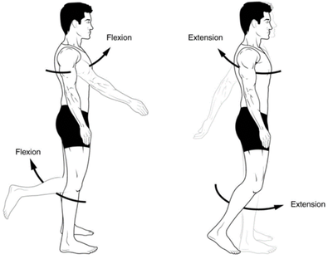
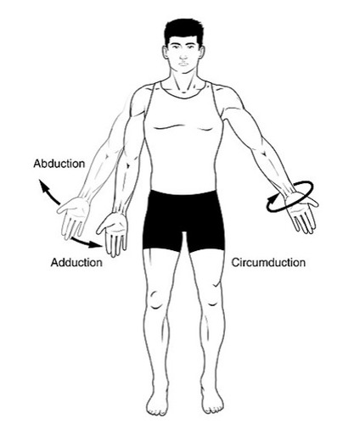
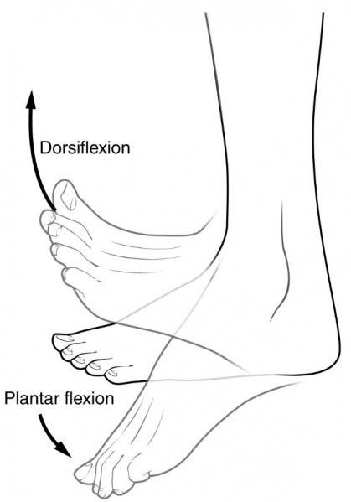
Joint Actions

Slide 8
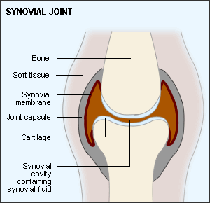
Structure of a Synovial Joint
CAPSULE | MEMBRANE | CARTILAGE | LIGAMENTS | FLUID
Surrounds and seals the synovial joint. Provides stability. | Lines the joint Cavity. Produces synovial fluid. | Smooth, lubricated covering at the end of bones. Prevents friction between bones and absorbs shock. | Tough tissue that connects bones to bones. Provides stability. | Lubricates the joint. Reduces friction between bones.

Slide 9
Types of Muscle
MUSCLE | LOCATION | CHARACTERISTICS | FUNCTIONS
Cardiac | Walls of the heart | Involuntary. Myogenic (controls its own rhythm). Requires oxygen. | Circulation of blood.
Smooth | Digestive system Blood vessels Lungs Bladder | Involuntary. Contracts in all directions to aid movement of particles. Requires oxygen. | Movement of food through digestive tract. Distribution of blood. Control flow of air through lungs. Control of urine release.
Skeletal | Attached to bones | Voluntary. Can contract with oxygen (aerobic) or without oxygen (anaerobic). | Movement. Aids posture.

Slide 10
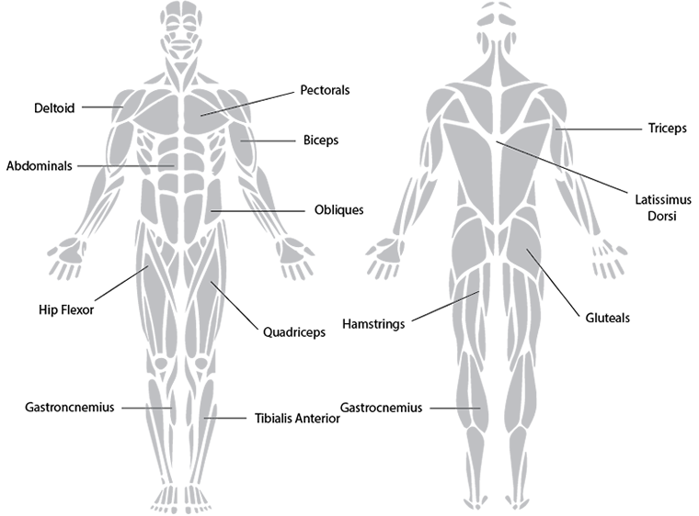
Structure of the Muscular System
Trapezius
Soleus

Slide 11
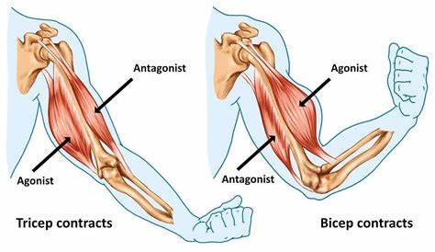
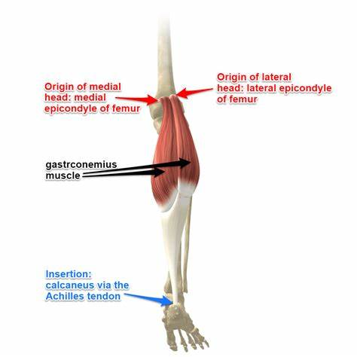
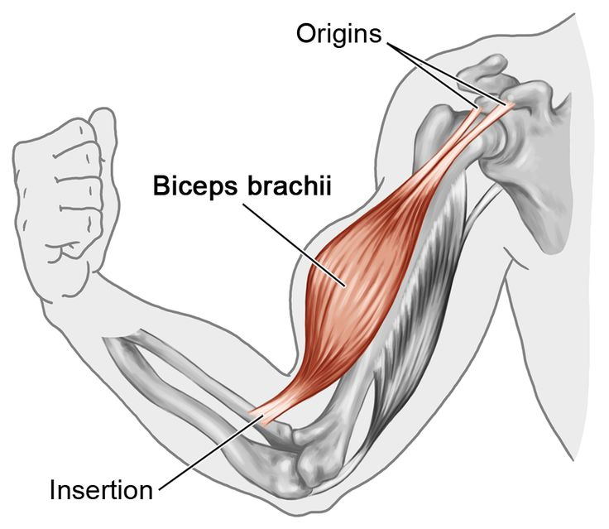
Muscle Movement
Agonist: The muscle that contracts.
Antagonist: The muscle that relaxes.
Origin: Where the muscle attaches to a bone that doesn’t move.
Insertion: Where the muscle attaches to a bone that does move.

Slide 12
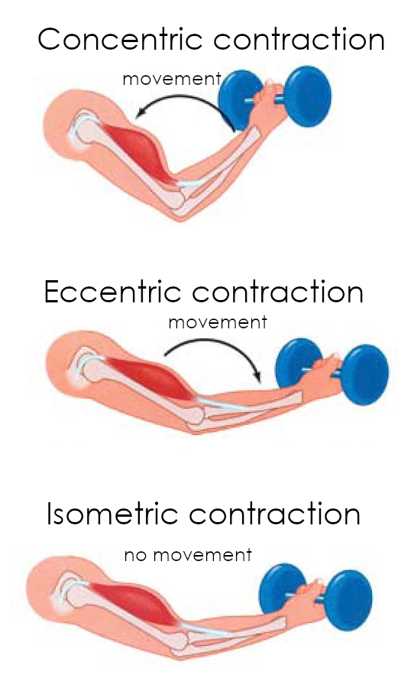
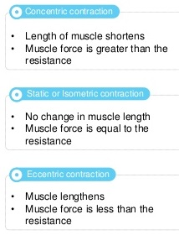
Muscle Contractions
Isotonic: muscle contraction that results in movement and changes the length of the muscle.
Concentric: The muscle gets shorter.
Eccentric: The muscle gets longer.
Isometric: static muscle contraction that results in no movement (the plank).

Slide 13
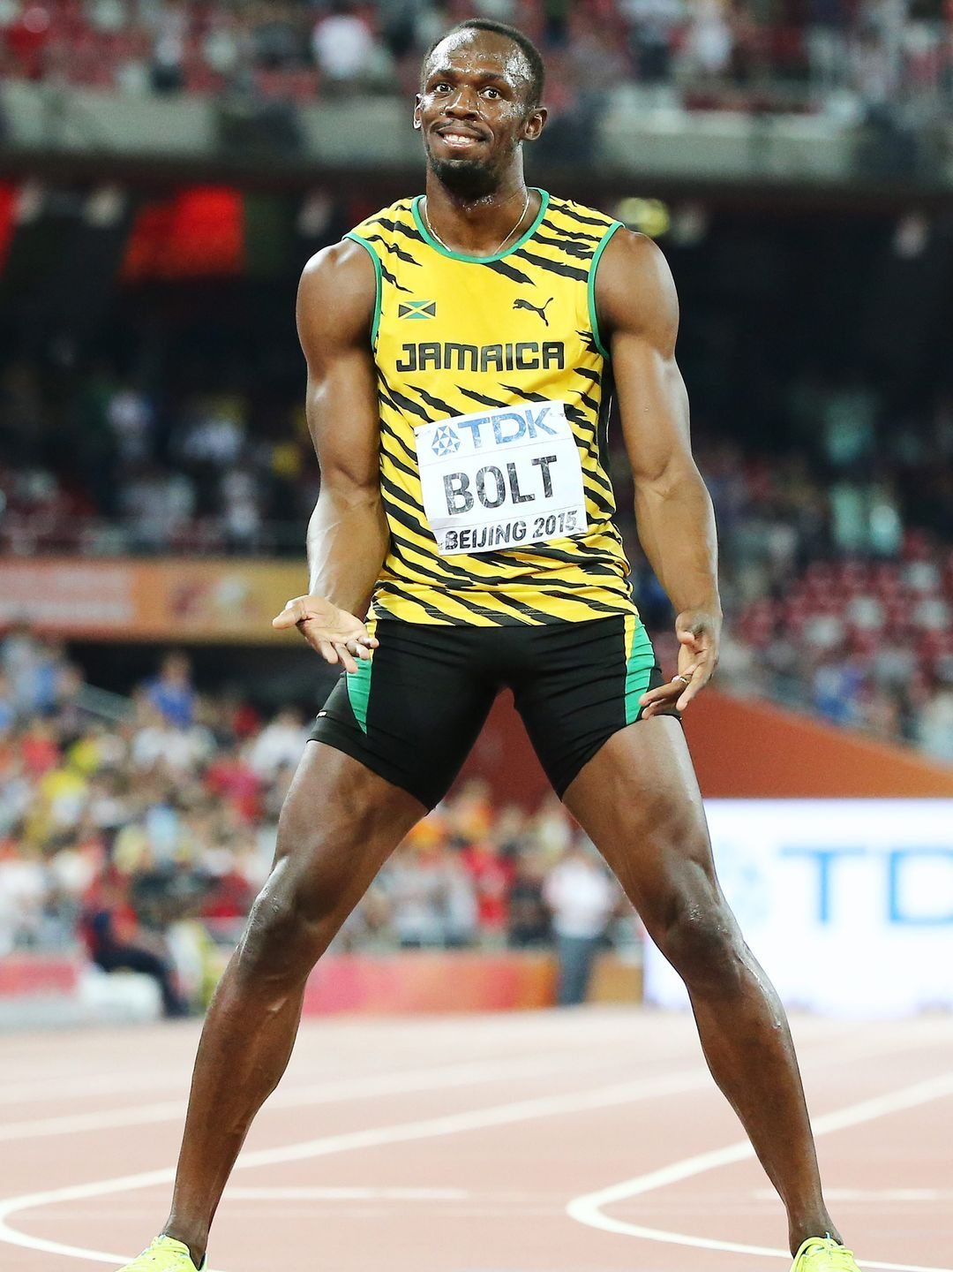
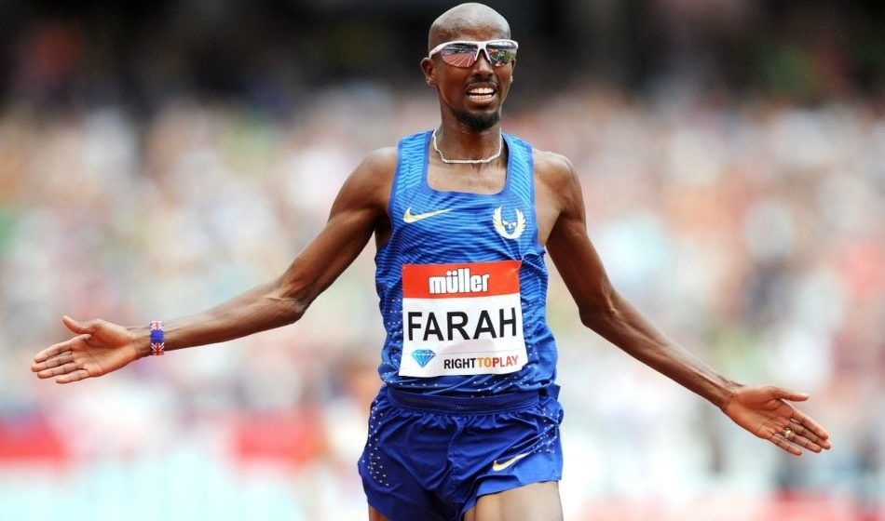
Muscle Fibre Types
Type 1 Slow-Twitch Fibres | Type 2 Fast-Twitch Fibres
Suited to low-intensity and long-duration activities. | Suited to high-intensity, short-duration activities.
Slow muscle contraction speed Muscle fatigues slowly Use oxygen (aerobic) Dark red in colour due to presence of lots of oxygen | Very fast muscle contraction speed Produces a strong force Muscle fatigues very quickly Contract without oxygen (anaerobic) White in colour due to absence of oxygen
Marathon Runners
Sprinters

Slide 14
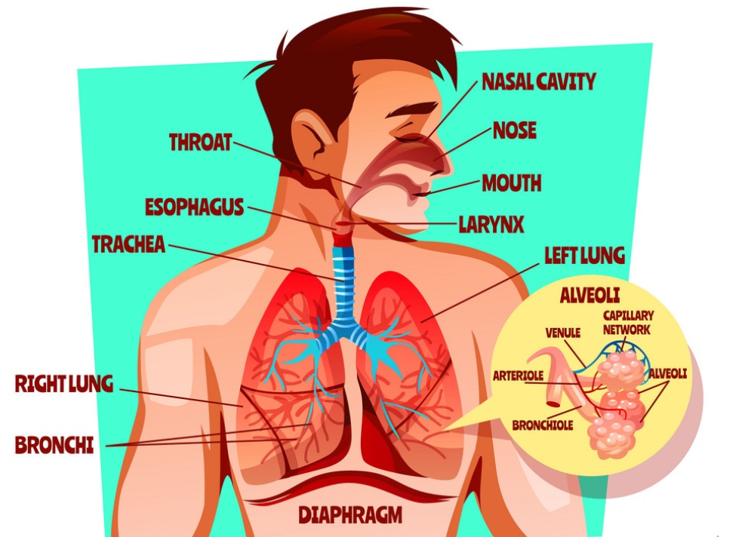
Structure of the Respiratory System
NOSE / MOUTH
PHARYNX
The throat
LARYNX
The voice box
TRACHEA
The windpipe
LUNGS
BRONCHI
Large tubes
BRONCHIOLES
Small tubes
ALVEOLI
Air sacs

Slide 15
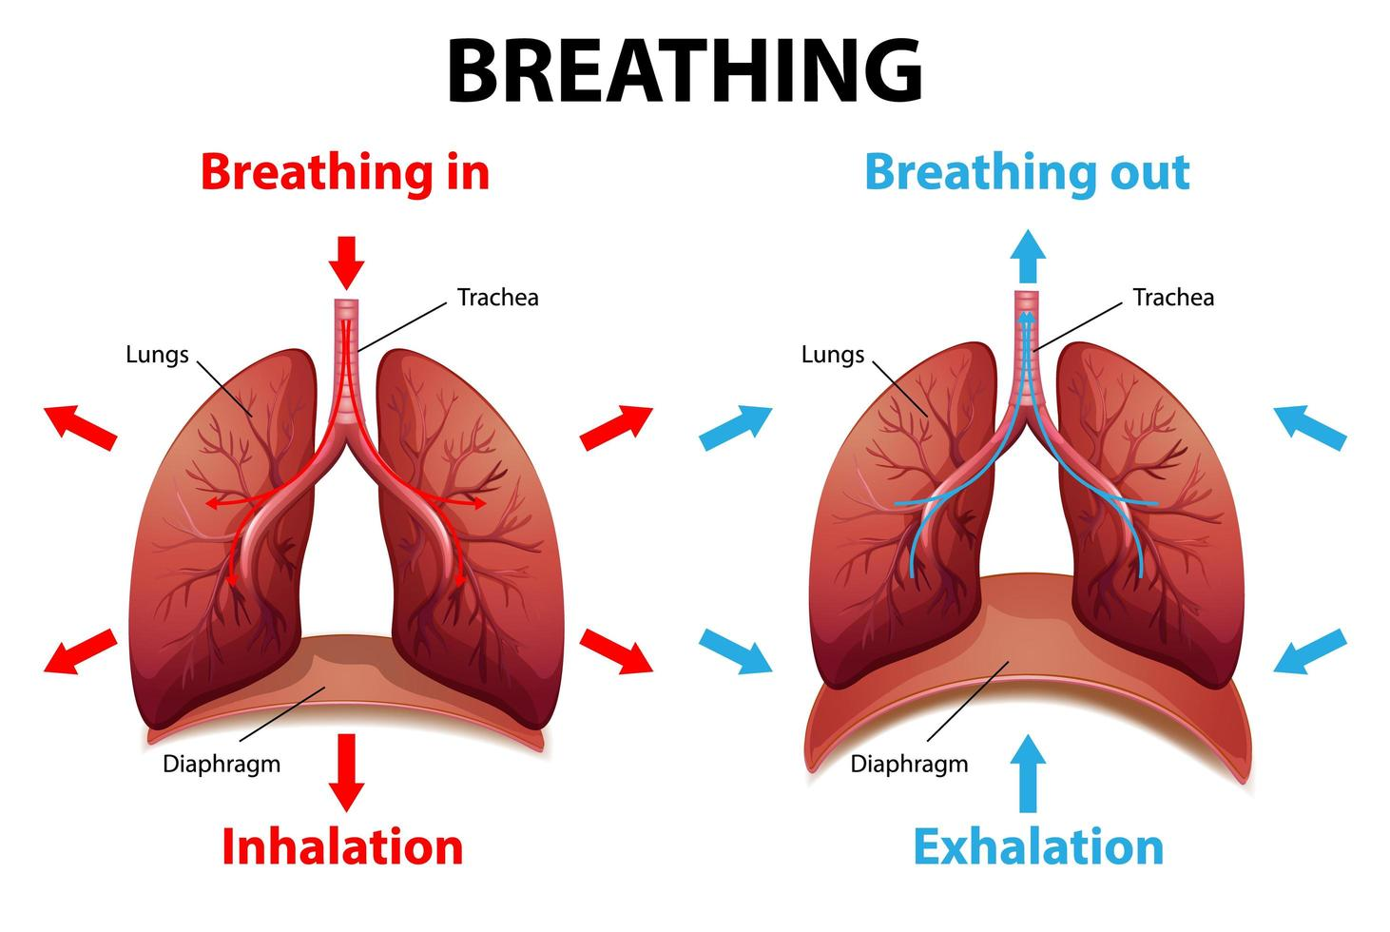
Mechanics of Breathing
TOP TIP
Breathe in and hold. Now breathe out and hold.
Which one feels more relaxed?
Diaphragm contracts and moves down (flattens) Intercostal muscles contract Ribs move outwards to increase thoracic cavity Air pressure in lungs decreases | Diaphragm relaxes and moves up Intercostal muscles relax Ribs move inwards to decrease thoracic cavity Air pressure in lungs increases

Slide 16
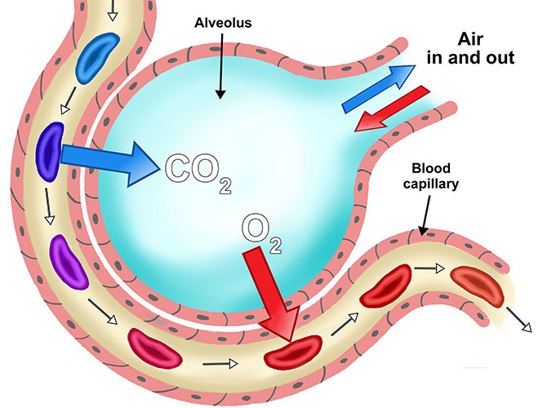
Diffusion and Gaseous Exchange
Diffusion | A gas moving from a high concentration to a low concentration.
Gaseous Exchange | The movement of oxygen and carbon dioxide between the alveoli and capillaries in the lungs.
Features of the Alveoli | Moist to assist with faster diffusion rates Large surface area for gaseous change to occur Very thin walls (one cell thick) to decrease diffusion distance Surrounded by lots of capillaries allowing for more diffusion locations

Slide 17
Respiratory Measurements
Breathing Rate (BR) | The number of breaths taken per minute.
Inspiratory Reserve Volume (IRV) | The maximum volume of air that can be inhaled after tidal volume inhalation.
Vital Capacity (VC) | The amount of air that can be forcibly breathed out after fully breathing in.
Tidal Volume (TV) | The amount of air you move through your lungs each time you inhale and exhale while you're at rest.
Expiratory Reserve Volume (ERV) | The maximum volume of air that can be exhaled after tidal volume exhalation.
Residual Volume (RV) | The volume of air remaining in the lungs after breathing out fully. This prevents the lungs from collapsing.

Slide 18
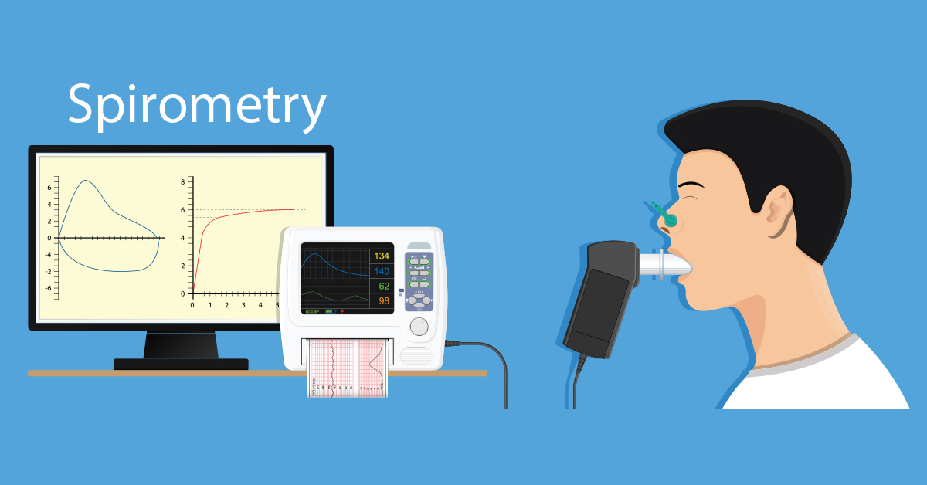
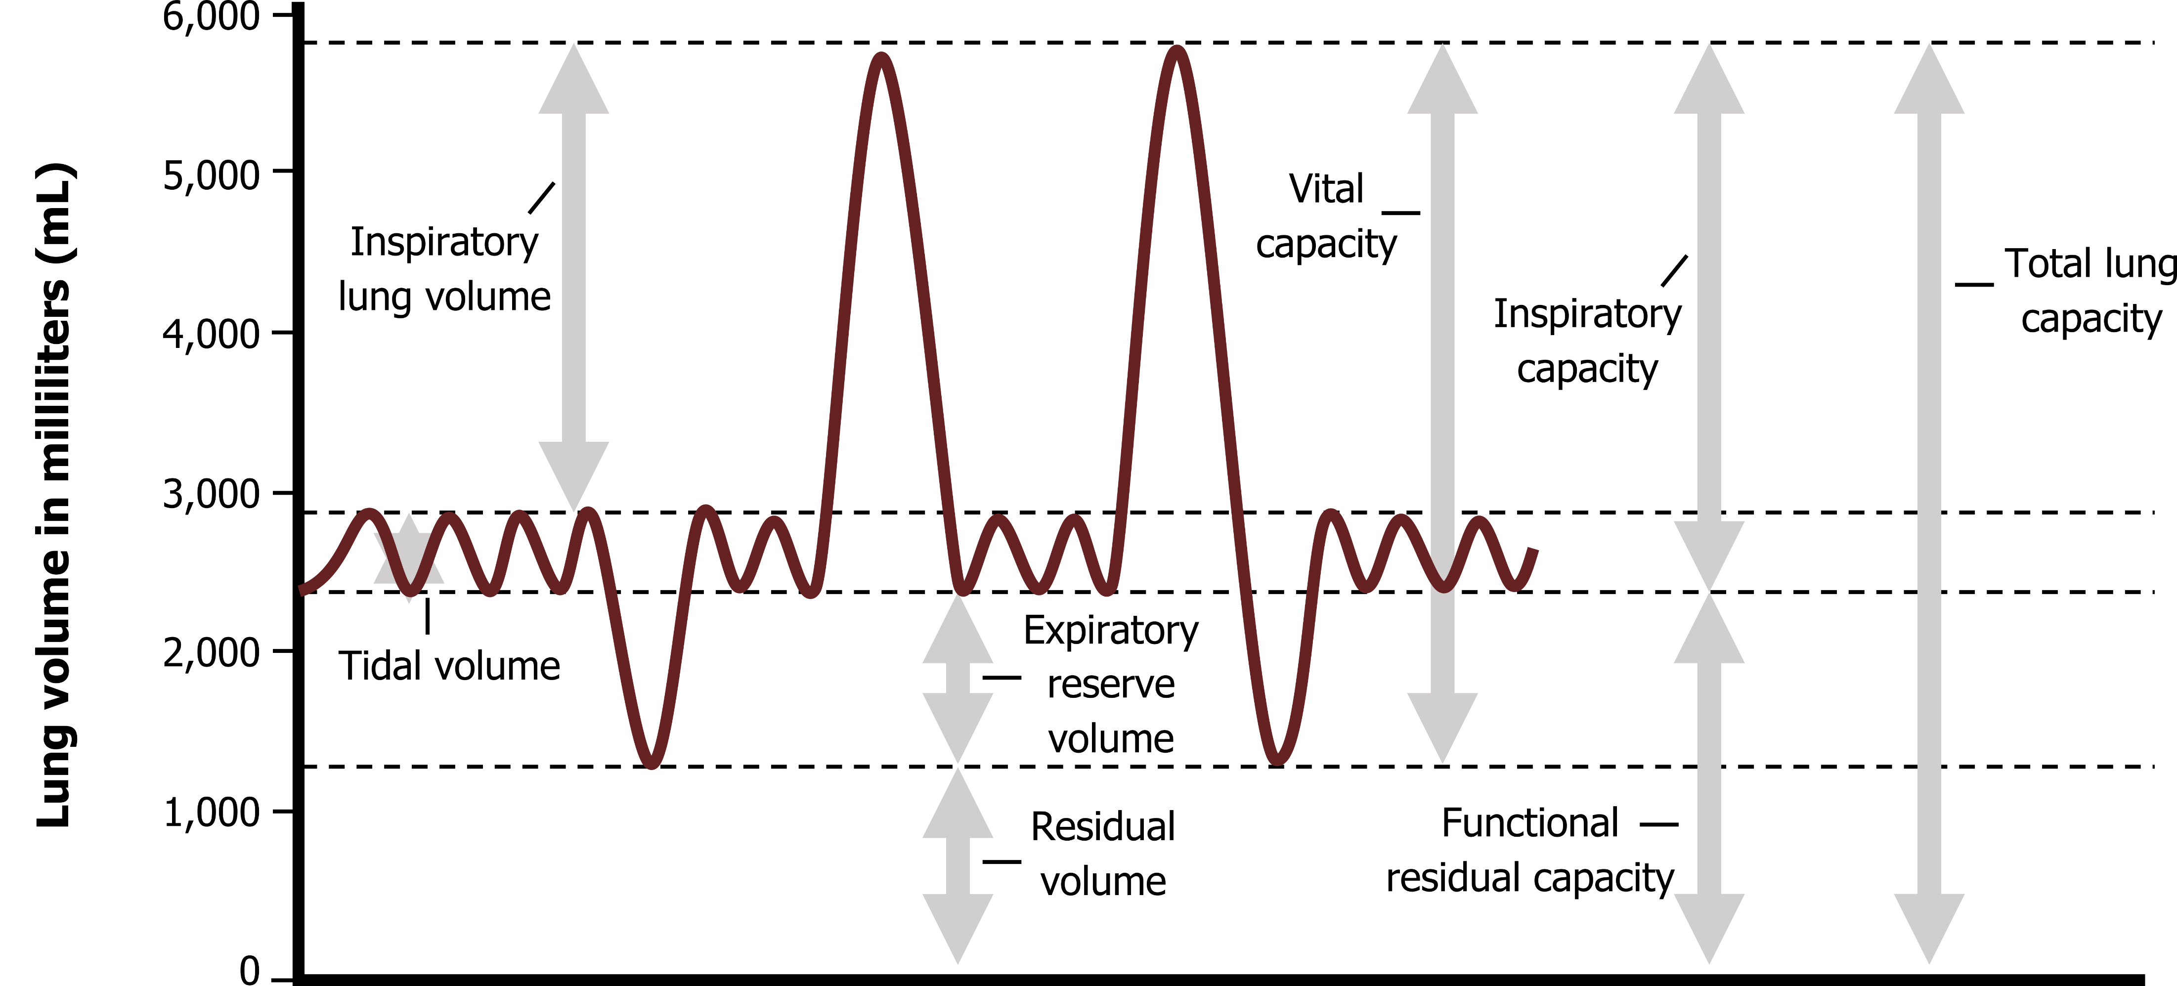
Spirometer Trace

Slide 19
Respiratory Changes in Exercise
Taking part in health and fitness activities increases the muscles demands for oxygen.
The lungs can meet these demands by increasing the rate and depth of breathing (increasing tidal volume).
BREATHING RATE | BREATHING DEPTH
The number of breaths taken | The volume of air breathed in or out

Slide 20
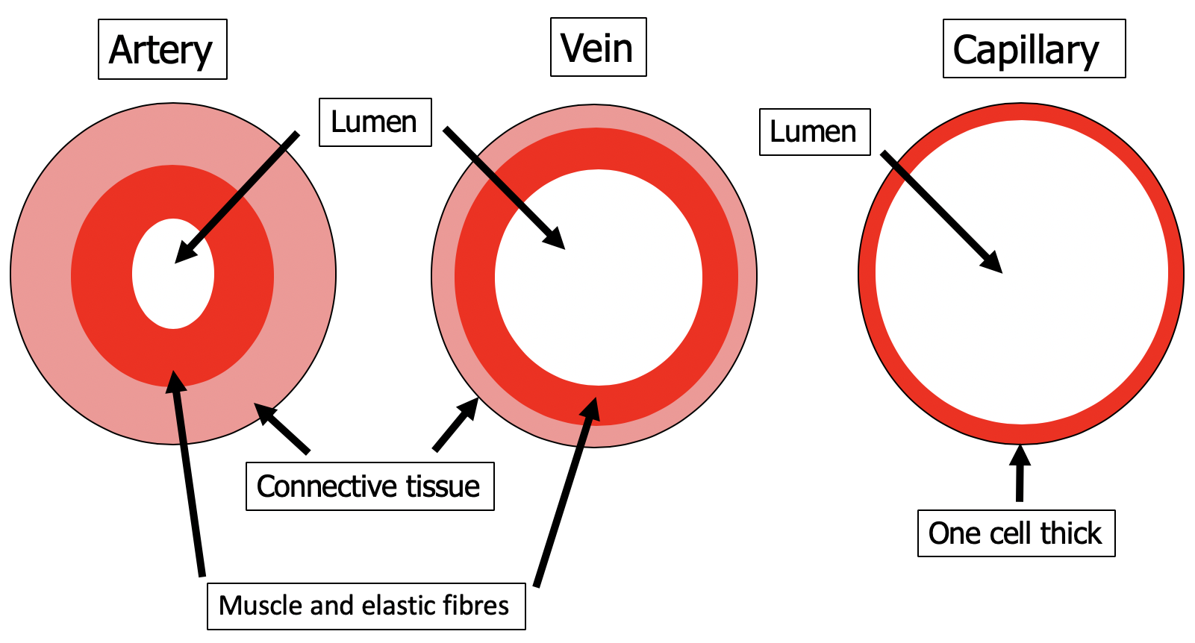
Structure & Function of Blood Vessels
Arteries | Carry blood away from the heart High blood pressure Thick, muscular and elastic walls (smooth muscle) Small/narrow lumen
Veins | Carry blood towards the heart Lower blood pressure Thin walls Contain valves to prevent back-flow Large/wide lumen
Capillaries | Smallest blood vessel with a very narrow lumen Very thin walls to reduce diffusion distance Carry out gaseous exchange at the lungs, working muscles and other organs
TOP TIP
Arteries = Away from heart
Veins = Visiting the heart

Slide 21
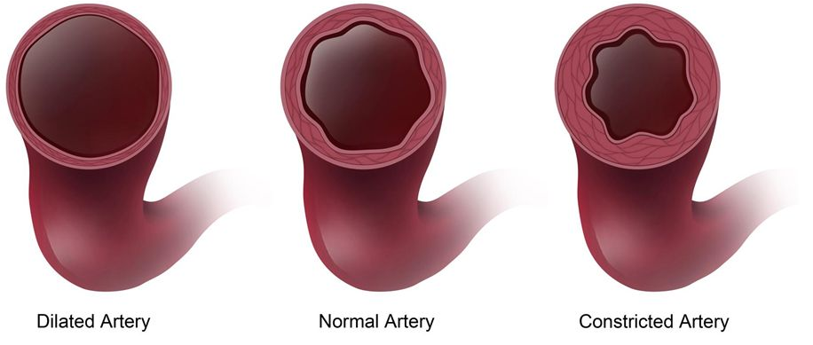
Blood Redistribution
Vascular Shunt | Increasing blood flow to areas of the body where it is needed (e.g. working muscles) and reducing blood flow to areas where it is needed less.
Vasodilation | The widening of blood vessels to increase flow of red blood cells and oxygen
Vasoconstriction | The narrowing of blood vessels to decrease flow of red blood cells and oxygen

Slide 22
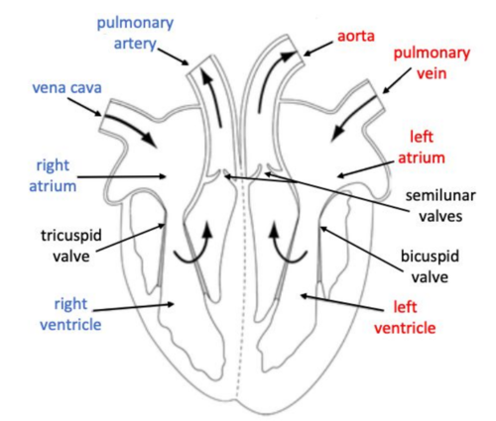
Structure of the Heart
Top Tip
Don’t confuse the left and right sides of the heart on a diagram. Remember that you’re looking at it face on.
Cardiac Hypertrophy:
An increase in the size and strength of the heart

Slide 23
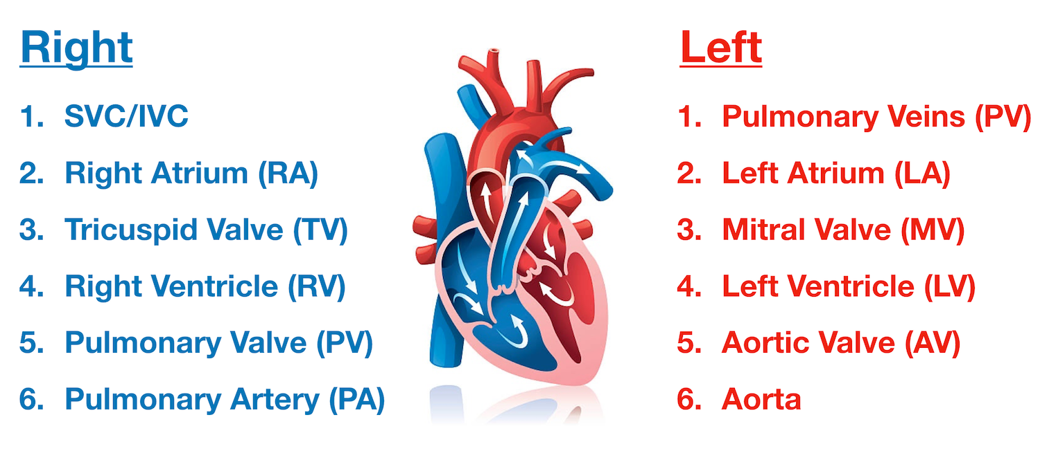
Cardiac Cycle
Systole: Period of contraction of the heart
Diastole: Period of relaxation of the heart

Slide 24
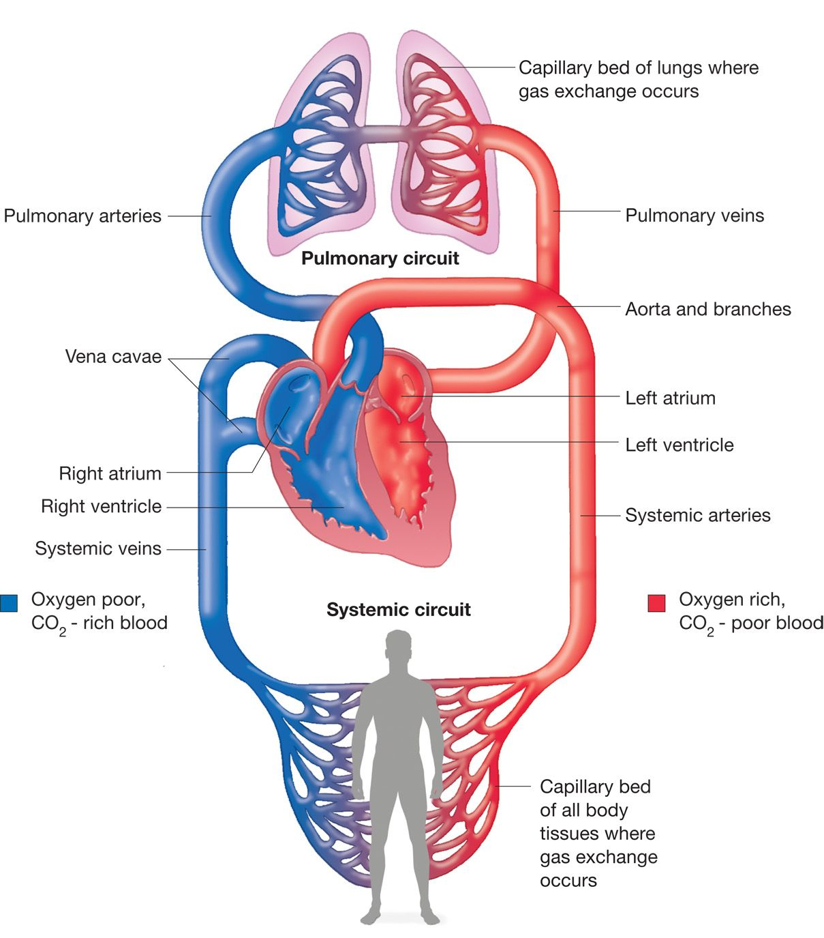
Pulmonary and Systemic Circulation

Slide 25
Cardiovascular Measurements
Heart Rate (HR) | Number of times the heart beats per minute. Measured in beasts per minute (bpm)
Stroke Volume (SV) | Volume of blood pumped out of the heart per beat. Measured in millilitres (ml)
Maximum Heart Rate (MHR) | Maximum number of beats of the heart per minute. Measured in beasts per minute (bpm)
Cardiac Output (CO) | Volume of blood pumped out of the heart per minute. Measured in millilitres/litres per minute (ml/min or L/min)
CARDIAC OUTPUT = STROKE VOLUME x HEART RATE
MAXIMUM HEART RATE = 220 - AGE

Slide 26
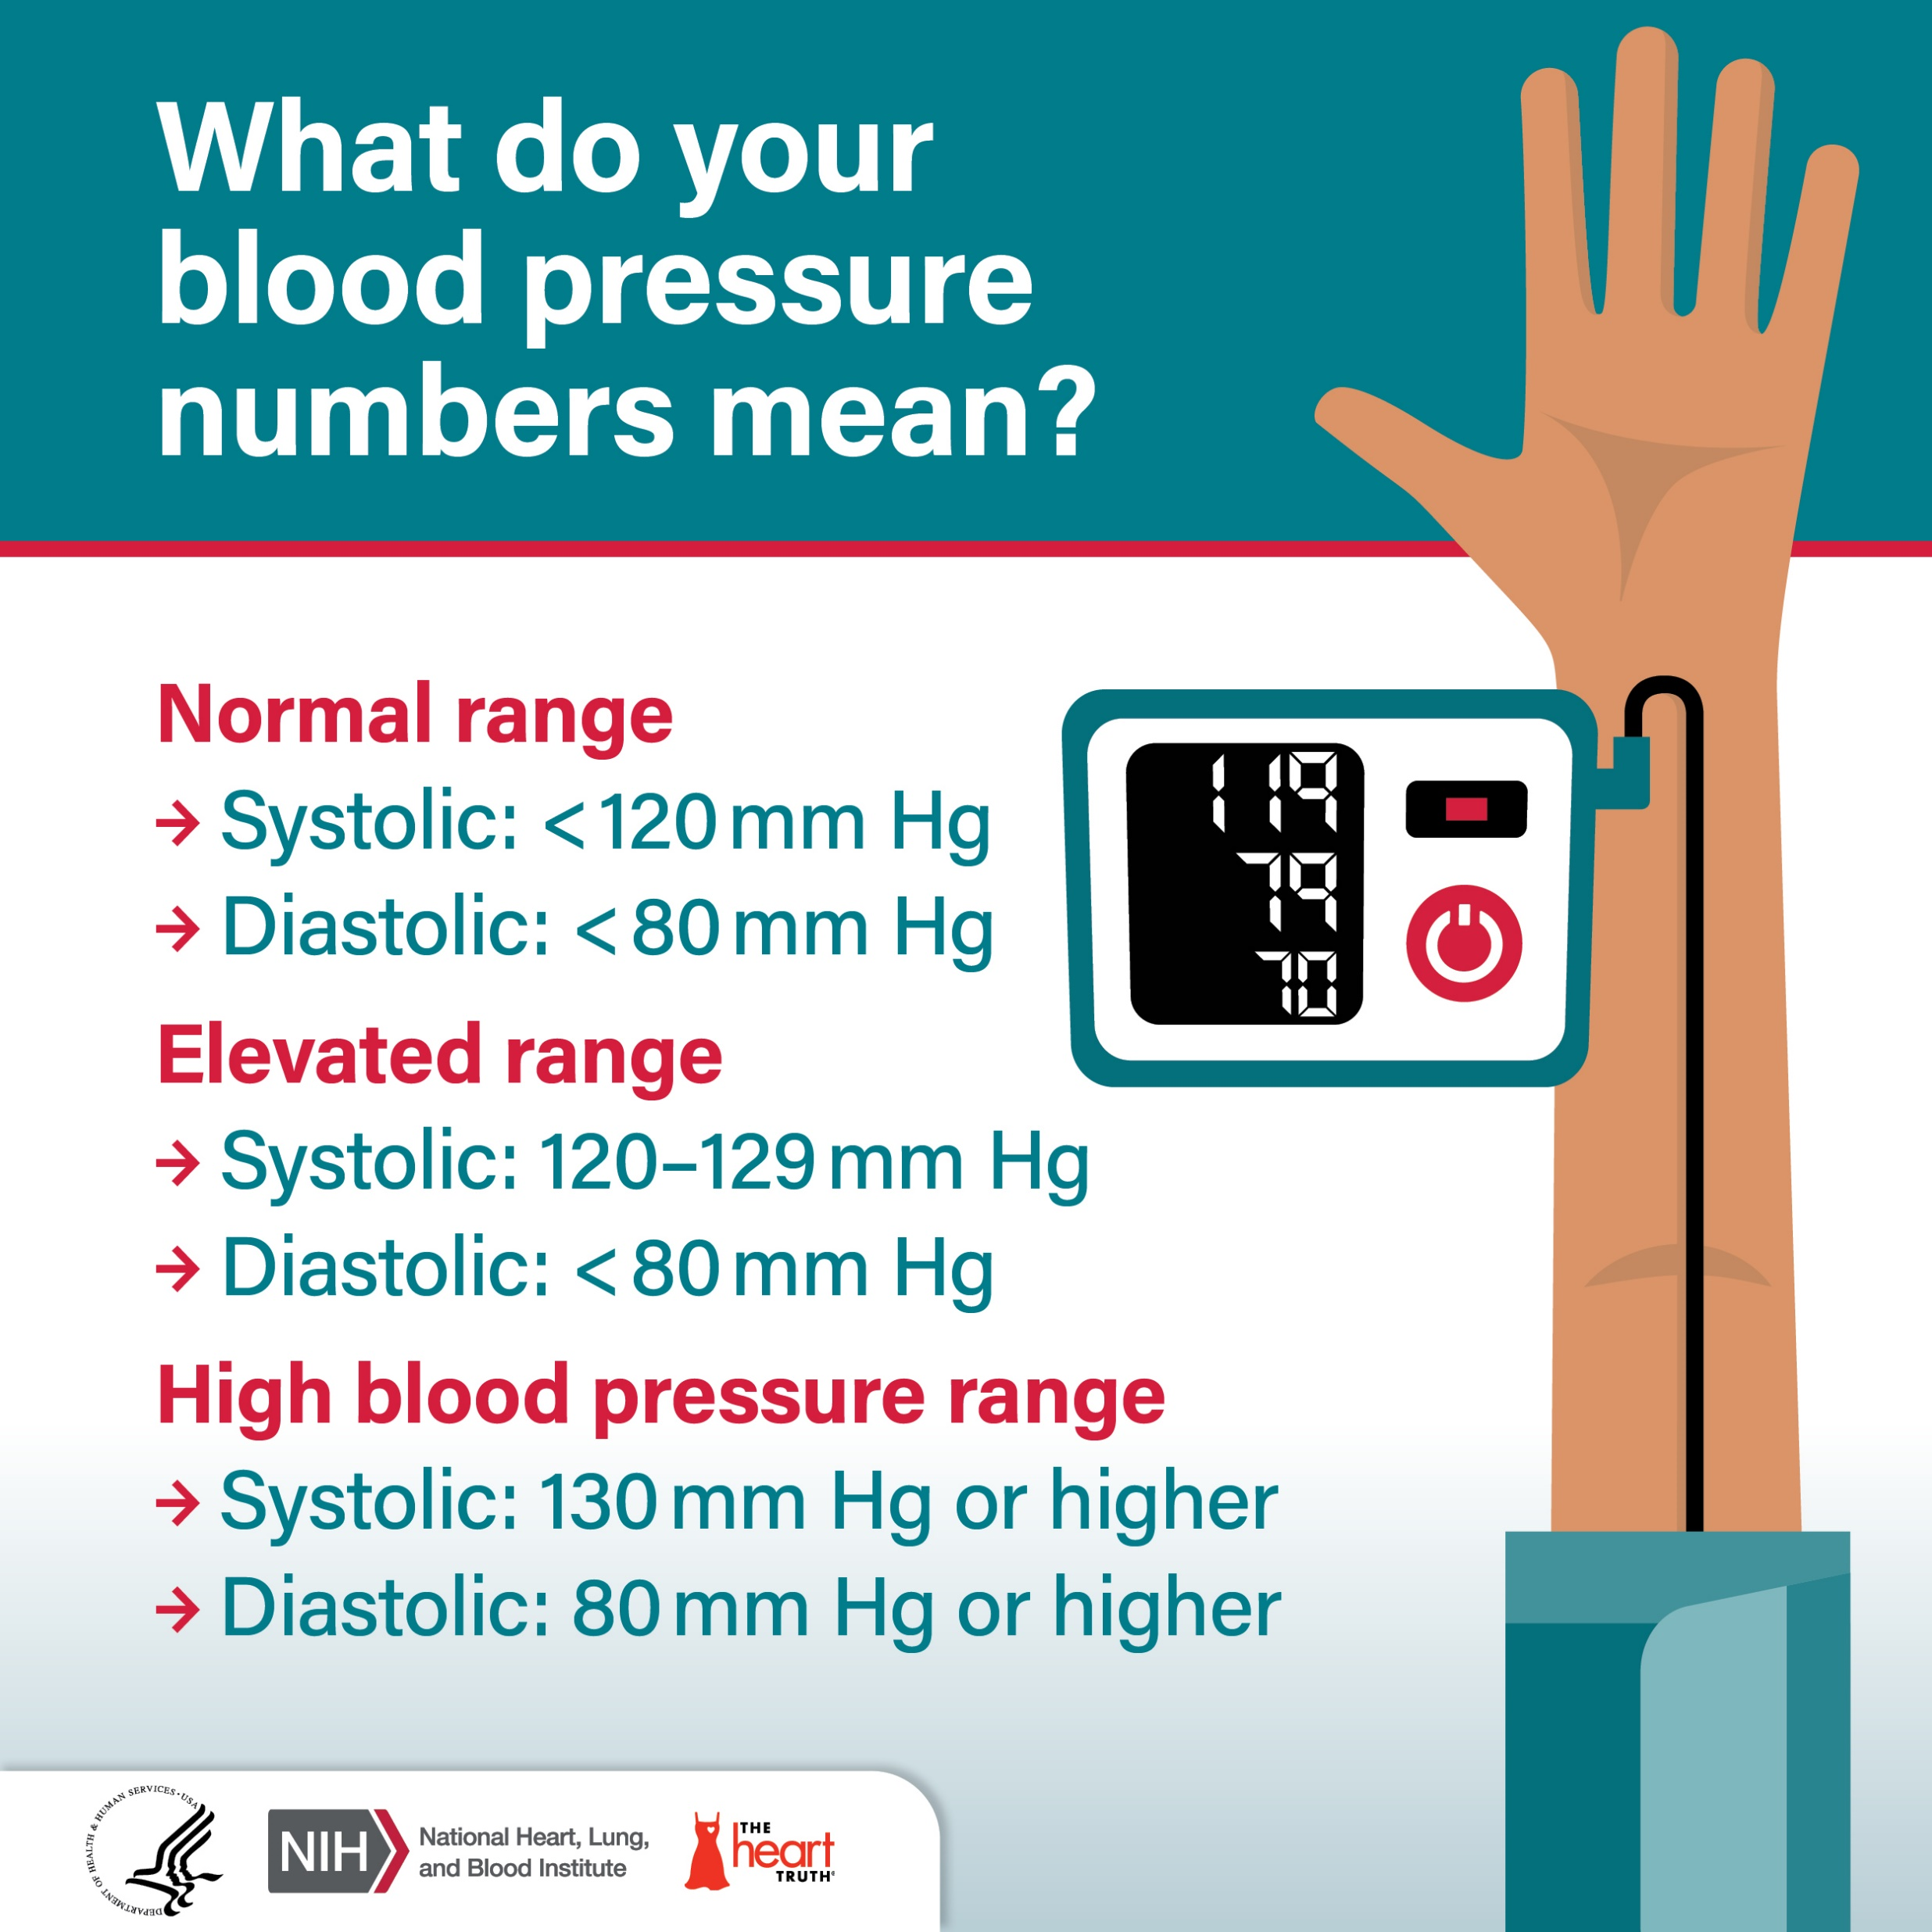
Blood Pressure
Systolic Pressure | The pressure inside the arteries when the heart contracts (the larger measurement).
Diastolic Pressure | The pressure inside the arteries when the heart relaxes (the smaller measurement).
Factors that affect blood pressure | Age: older = higher blood pressure Stress: causes the heart hate to increase Diet: Fruit and veg lowers blood pressure. Fat, salt and sugars increase blood pressure Activity levels: Exercise increases heart rate for short term. Lack of exercise causes permeant high blood pressure.

Slide 27
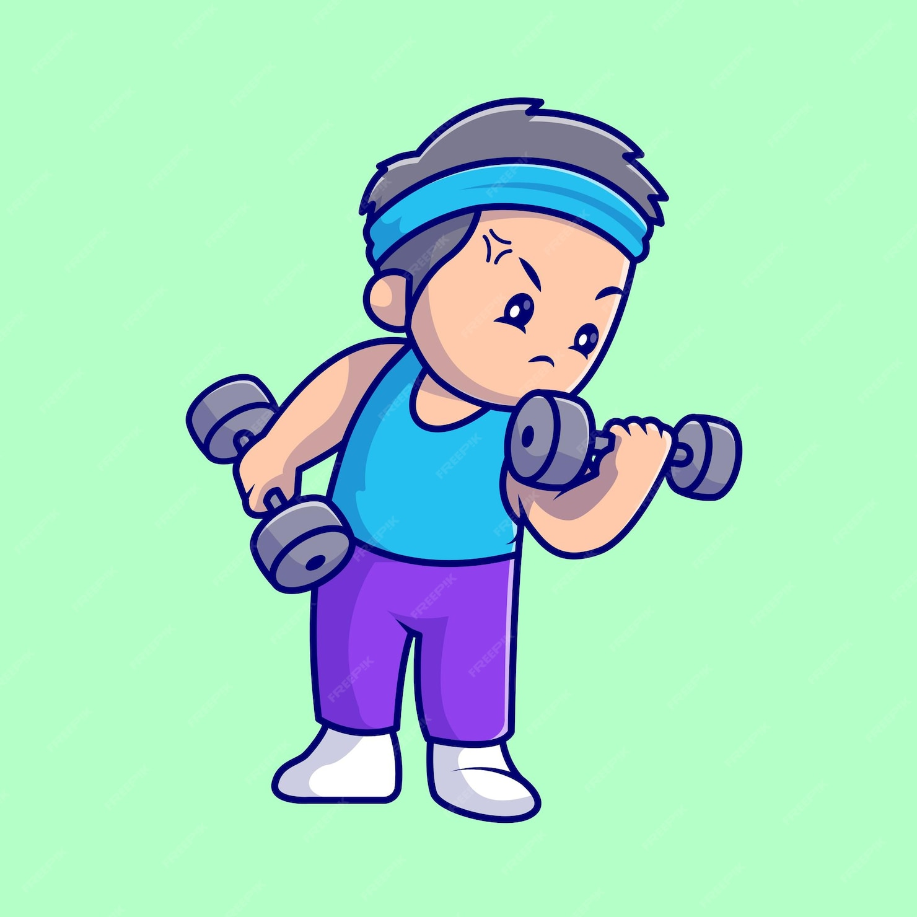
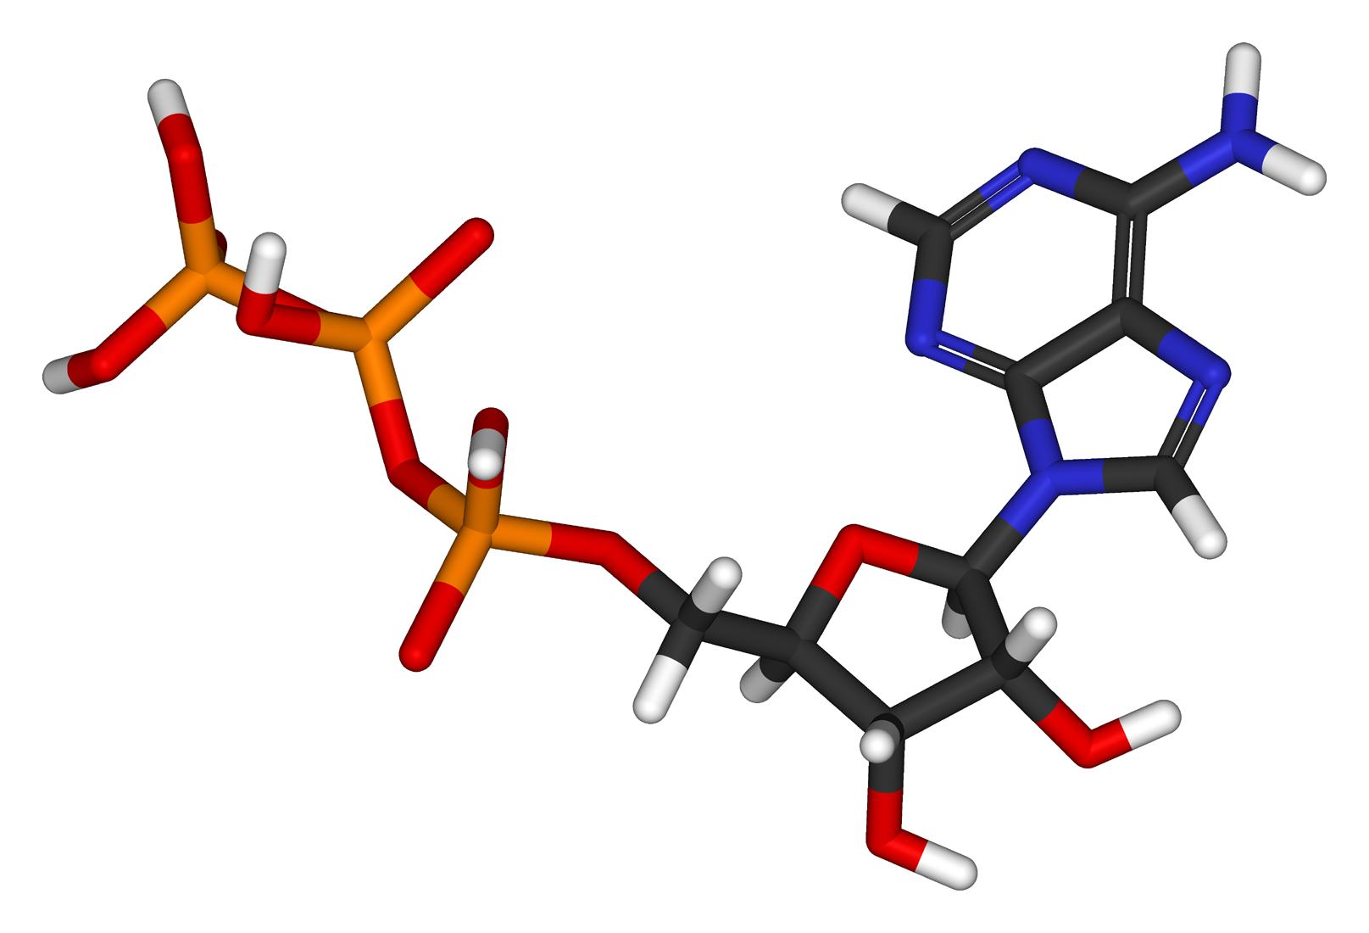
Adenosine Tri-Phosphate (ATP)
ATP
Stored in muscles
Reserves last 2 – 3 seconds
Resynthesis = recreating ATP
Exercise requires energy
There are 2 energy systems that the body can use to resynthesise ATP
AEROBIC RESPIRATION
ANAEROBIC RESPIRATION

Slide 28
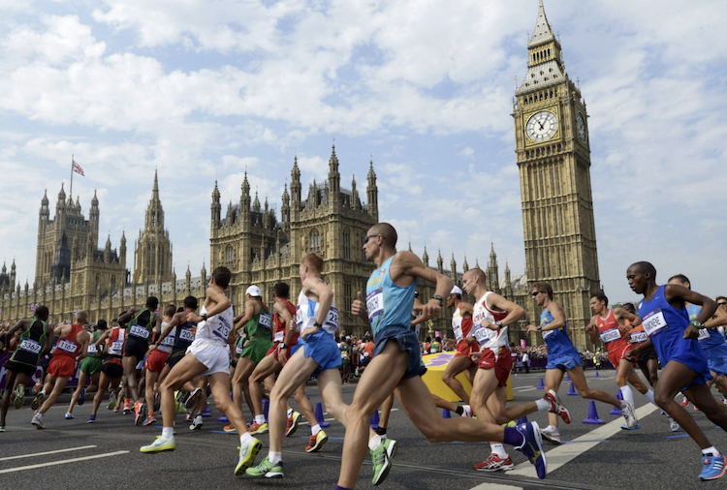
Aerobic Respiration
This energy system is able to resynthesise large amounts of ATP and can supply energy for a long time.
Aerobic | With oxygen
Equation | Oxygen + Glucose → Energy + CO₂ + water
Activities | Over 1 minute, low-intensity
Examples | Marathon running Road cycling Swimming Triathlon

Slide 29
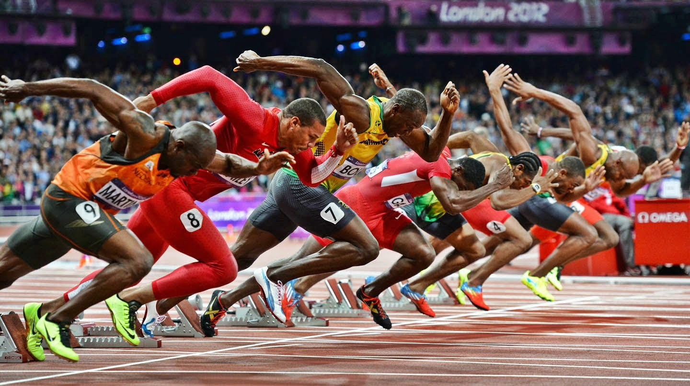
Anaerobic Respiration
In this energy system, the energy needed to resynthesise ATP is provided by glucose that we get from food and drinks
Anaerobic | Without oxygen
Equation | Glucose → Energy + Lactic Acid
Activities | Under 1 minute, high-intensity
Examples | Sprinting Throwing events Jumping events Pushing in a rugby scrum

Slide 30
Short-Term Effects of Exercise
Effects during and/or up to 36 hours after exercise
EFFECT | WHY? | IMPACT ON PERFORMANCE
Muscle fatigue | Build-up of lactic acid. Insufficient levels of oxygen left. | The athlete will not be able to maintain their current level of performance.
Delayed onset muscle soreness (DOMS) | Felt around 24 hours after high intense exercise. Caused by tiny tears in the muscle. | Pain. Decreased range of motion at joints.
Increase body temperature | Muscle cells burn glucose and fat during exercise. This process produces heat. | High body temperature can decrease performance To prevent this, blood vessels dilate near the skin and sweat ducts open.
Hydration levels decrease | Water is lost through sweat | Lack of hydration can lead to overheating which can decrease performance levels.

Slide 31
Short-Term Effects of Exercise
Effects during and/or up to 36 hours after exercise
EFFECT | WHY? | IMPACT ON PERFORMANCE
Cardiac output (HR x SV) increases | Increased demand for oxygen. More oxygen-rich blood pumped to the working muscles. | An athlete can exercise for longer without fatiguing.
Blood pressure increases | Circulation speed increases within the blood vessels. | The muscles keep working for longer without fatiguing.
Light-headedness | Lack of hydration or sudden decrease in blood pressure because of overexertion. | Dizziness. Unable to exercise effectively.
Nausea | Vascular shunt redirects blood away from stomach and digestive tract. | Sickness. Unable to exercise effectively.

Slide 32
Short-Term Effects of Exercise
Effects during and/or up to 36 hours after exercise
EFFECT | WHY? | IMPACT ON PERFORMANCE
Breathing rate increases | Increased demand for oxygen. Increase levels of carbon dioxide needing to be removed. | An athlete can work for longer without fatiguing.
Breathing depth increases | [ same as above ] | [ same as above ]
HOW MANY OF THE 10 CAN YOU REMEMBER!?

Slide 33
Long-Term Effects of Exercise
Effects over 36 hours after exercise
EFFECT | WHY? | IMPACT ON PERFORMANCE
Improved flexibility | Regular stretching causes muscles and tendons to be more elastic (stretchy). | Reduced injury risk.
Improved cardiovascular endurance | Stronger heart muscle can pump more blood. Stronger respiratory muscles can take in more oxygen. | An athlete can keep working for longer aerobically without fatiguing.
Improved muscular endurance | Increase is number of capillaries within the muscle. | An athlete's muscles can keep working for longer without fatiguing.
Improved muscular strength | Damaged muscles repair stronger and thicker. | An athlete can exert more force against a resistance. Reduced injury risk.

Slide 34
Long-Term Effects of Exercise
Effects over 36 hours after exercise
EFFECT | WHY? | IMPACT ON PERFORMANCE
Body shape change | Loss of body fat. Gain in muscle mass. | Increased suitability for certain sports.
Muscle hypertrophy | Muscle mass increases. | An athlete can exert more force against a resistance.
Cardiac hypertrophy | Increase in size and strength of heart muscle. Decrease in resting blood pressure. | An athlete can keep working for longer without fatiguing.
Decrease resting heart rate (bradycardia) | As the heart gets stronger, it isn’t required to pump as often. | An athlete can perform specific activities at a lower heart rate.

Slide 35
Long-Term Effects of Exercise
Effects over 36 hours after exercise
EFFECT | WHY? | IMPACT ON PERFORMANCE
Lower blood pressure | As the heart gets stronger, blood is pumped more easily. Wall of arteries become more elastic. | Lower risk of heart disease and stroke making exercise safer.
Increase volume of red blood cells | Greater amount of oxygen carried to working muscles. | An athlete can keep working for longer without fatiguing.
Improved resistance to fatigue | The body uses its oxygen more efficiently. | An athlete can keep working for longer without fatiguing.
Improved efficiency to use oxygen | Stronger respiratory muscles and increased lung capacity can take in more oxygen. | An athlete can keep working for longer aerobically without fatiguing.

Slide 36
Health and Fitness
Health: A state of complete physical, mental and social well-being and not merely the absence of disease or infirmity.
Physical
Mental
Social
Health-related fitness
Fitness: Being physically fit and able to meet the demands of the individual’s environment.
Skill-related fitness
The relationship between Health and Fitness:
It’s possible to be fit but not healthy.
Poor physical = Sumo wrestling
Poor social = Lack of team/friends
Poor mental = Depression
It’s also possible to be healthy but not fit.
A healthy person may fatigue quickly if asked to play a tennis match.

Slide 37



Health-Related Fitness
There are 5 components of health-related fitness
Body Composition | Measurement of fat mass compared to muscle mass
Cardiovascular Endurance | Long periods of work at high intensity without fatigue
Muscular Endurance | The ability for muscle performance without fatiguing
Flexibility | The range of motion at a joint
Muscular Strength | Ability to create great force [ 3 different types below ]
Static Strength | Muscles contract to maintain a position
Dynamic Strength | Muscles contract and extend repeatedly creating movement
Explosive Strength | Muscles contract at high speed

Slide 38
Skill-Related Fitness
There are 6 components of skill-related fitness
Agility | The ability to change the direction of the body at speed
Reaction Time | React quickly to a stimulus
Co-ordination | Ability to move one or more body parts efficiently
Speed | The ability to move from A to B quickly
Power | The ability to exert rapid force
Balance | The ability to maintain a centre of mass

Slide 39
Fitness Tests
What are the test procedures?
Body Composition | Body Mass Index (BMI) | Skinfold Callipers
Cardiovascular Endurance | Multi-stage Fitness Test | 12-min Cooper Run
Muscular Endurance | Sit-up Test | Press-up Test
Flexibility | Sit and Reach Test
Muscular Strength | Hand Grip Dynamometer
Agility | Illinois Agility Run
Reaction Time | Ruler Drop Test
Co-ordination | Alternate Hand Wall Toss
Speed | 30 Meter Sprint
Power | Standing Long Jump | Standing Vertical Jump
Balance | Standing-Stork Test

Slide 40
Training Zones
What is the equation for MHR?
KEY TERM | DESCRIPTION
Anaerobic training zone | Over 80% of MHR
Aerobic training zone | Between 60% - 80% of MHR
Repetitions (Reps) | A full completion of an exercise movement
Sets | Repetitions of an exercise followed by a rest period
1 Rep Max | Maximum amount of weight lifted in one repetition of an exercise

Slide 41
Training Methods
METHOD | DESCRIPTION | PURPOSE
Interval | Alternating periods of high-intensity exercise with periods of rest. | Improve aerobic and/or anaerobic fitness.
Circuit | Rotating around a series of exercise stations for a set time with periods of rest in between. | Adapted to improve any type of fitness.
Fartlek | Form of continuous training involving changes in speed incline, direction and terrain. | Improve aerobic and/or anaerobic fitness.
Continuous | Steady rate of submaximal exercise over a prolonged period. | Improve aerobic fitness.
Weight | Form of interval training using weight to resist contraction of muscles. | Improve muscular strength and muscular endurance.
Plyometric | Quick, powerful movements. The combination of eccentric and concentric contractions. | Increase speed, power and muscular endurance.
Flexibility | Activities that improve the range of motion around a joint. | Improve flexibility, posture and coordination.
ACTIVITY
Research an example exercise for each method of training.
15 minutes

Slide 42
Principles of Training
S. P. O. R. T. | DESCRIPTION
Specificity | Making your training suitable for your sport or target.
Progression | Increasing the amount of training done gradually to prevent injury.
Overload | Making the body work harder than normal over a period of time.
Reversibility | Fitness gains are lost due to stopping or reducing the level of training.
Tedium | Client becomes uninterested or unmotivated due to lack of variety.
F. I. T. T. | DESCRIPTION
Frequency | How often you train.
Intensity | How hard you train.
Time | How long you train for.
Type | Changing the activity to match the sport/individual needs.

Slide 43


Activity Levels
VIGOROUS
MODERATE
LIGHT
INTENSITY
Active lifestyle: regular physical activity and exercise to improve an individual's health
Sedentary lifestyle: no or very little physical activity and exercise leading to poor health and fitness.
AGE GROUP | NHS GUIDELINES
Infants Under 5 yrs | Babies (under 1): regular movement throughout the day. Toddlers (1 – 2): physically active for 3+ hours per day. Pre-schoolers (3 – 4): physically active for 3+ hours per day including 1 hour of moderate/vigorous exercise.
Children 5 – 18 yrs | At least 1 hour of moderate/vigorous activity a day.
Adults 19 – 64 yrs | Option 1: at least 150 mins of moderate intensity activity per week Option 2: at least 75 mins of vigorous intensity activity per week. Option 3: a combination of options 1 and 2.
Elderly Over 65 yrs | Light activity every day at a minimum.
Research example activities for each level of exercise

Slide 44


Balanced diet: a diet consisting of a variety of foods from all the major food groups, in the right amounts.
Diet
NUTRIENT | PURPOSE | SOURCE
Carbohydrates | Provide energy | Bread, Rice, Pasta Banana, Sweets, Chocolate
Protein | Growth Repair of muscles | Meat, Beans, Fish
Fats | Reserve energy supply Warmth and insulation | Butter, Cheese, Avocadoes
Water | Hydration Reduce body temperature | Water, Milk, Fruit, Veg
Fibre | Aids digestion | Wholegrains, Nuts
Vitamins | Vitamin C – fight infections Vitamin D – strong bones Vitamin A – good vision | Fruit and Vegetables
Minerals | Iron – aids transport of oxygen Calcium – strong bones a muscular contractions | Green Vegetables Red Meat, Milk, Yogurt
MACRO
Recommended Daily Allowance
Men: 2500 kcal
Women: 2000 kcal
MICRO

Slide 45
Rest and Recovery
FACTOR | PURPOSE
Sleep | Allows the body to recover and repair Maintains energy levels
Rest | Decreases risk of overtraining Emotional and social balance
Cool-down | Decreases heart and breathing rate Decreases body temperature Reduces effect of DOMS
Static Stretching | Gently relaxes muscles
Massages | Reduces effect of DOMS Increases blood flow to specific areas to promote healing
FACTOR | PURPOSE
Diet | Allows body to function as normal
Intake of Food | Carbs post-exercise to restore energy Protein post-exercise to build and muscle repair
Rehydration | Replaces fluid and electrolytes
Ice Baths | Causes vasoconstriction to aid removal of waste products Reduces effect of DOMS

Slide 46
Performance Enhancing Drugs (PEDs):
Illegal substances taken to improve athletic performance
Drugs
PEDs | EFFECT | SIDE-EFECT
Anabolic Steroids | Increase muscle mass | Infertility Severe acne | Hair loss Risk of cancer
Human Growth Hormone (HGH) | Increases growth and repair | Vision problems Joint pain and stiffness
Diuretics | Reduce body weight | Dehydration Muscle weakness
RECREATIONAL | EXAMPLE | SIDE-EFECT
Hallucinogens | LSD Ketamine | Weight loss Cardiovascular problems
Relaxants | Cannabis | Loss of concentration
Stimulants | Cocaine Ecstasy | Muscle wastage (atrophy)

Slide 47



Other Factors
SMOKING
Breathlessness
Reduced blood flow due to a narrowing of the arteries
Lung cancer
ALCOHOL
Reduced co-ordination
Decreased reaction time
Dehydration
STRESS
Anxious performance
Fatigue
Irritability

Slide 48
Goal Setting
S. M. A. R. T. | EXPLINATION
Specific | Detailed and precise
Measurable | Quantifiable to track progress
Attainable | Challenging but achievable
Realistic | Within the availability of resources, knowledge and time
Time-bound | Set period for completion
SHORT
MEDIUM
LONG
Up to 1 month
1 – 6 months
6+ months

