Slide 1
Keywords
Communicable diseases | Diseases that can be passed from one organism to another.
Non-communicable diseases | Diseases that cannot be passed from one organism to another.
Pathogens | Microorganisms that cause disease.
Virus | Pathogens that reproduce inside living cells of other organisms.
Bacteria | Single celled prokaryotic organisms. A type of pathogen.
Fungus | Resemble plant cells but without chloroplasts. Can be pathogenic.
Protist | Single celled organisms. Can be pathogenic.
Vaccines | Dead or inactive pathogenic material used in a vaccination to develop immunity to a disease in a healthy person.
B3 Communicable Disease
Viral Diseases
1. Measles: symptoms of fever and a red skin rash. Can be fatal if complications arise. Most young children are vaccinated. Spread by inhalation of droplets from sneezes and coughs. 2. HIV: initially causes a flu-like illness. Virus attacks the body’s immune cells. Leads to AIDS when the body’s immune system becomes badly damaged. Spread by sexual contact or exchange of body fluids. 3. Tobacco mosaic virus (TMV): gives a distinctive ‘mosaic’ pattern of discolouration on the leaves of plants which affects the growth of the plant due to lack of photosynthesis.
Bacterial Diseases
1. Salmonella food poisoning: spread by bacteria in undercooked or contaminated food. Causes fever, abdominal cramps, vomiting, and diarrhoea. 2. Gonorrhoea: an STD with symptoms of a thick yellow or green discharge from the vagina or penis and pain on urinating. Spread by sexual contact.
Human Defense Responses
1. Skin: creates a barrier and produces antimicrobial secretions. 2. Nose: full of hairs and produces mucus, which traps pathogens. 3. Trachea and bronchi: secrete mucus and covered in cilia. 4. Stomach: produces acid. 5. The immune system: destroys pathogens using white blood cells. - Phagocytosis: white blood cells ingest pathogens, destroying them. - Antibody production: target particular pathogens and destroy them. - Antitoxin production: counteract the toxins released by pathogens.
Fungal Diseases
Rose black spot: purple or black spots develop on leaves, which often turn yellow and drop early. Affects the growth of the plant as photosynthesis is reduced.
Protist Diseases
Malaria: causes recurrent episodes of fever and can be fatal. The malarial protists has a life cycle that includes mosquitos.

Slide 2
Keywords
Vaccine | Dead or inactive pathogenic material used in vaccination to develop immunity to a disease in a healthy person.
Placebo | A medicine that does not contain the active drug being tested.
Herd immunity | Where a large proportion of the population is immune to a disease.
Antibiotics | Drugs that damage bacteria and eventually kill them, without harming your own cells.
B3 Preventing and Treating Disease
New Drugs
New drugs must be: 1. Effective 2. Safe 3. Stable 4. Successfully taken into and removed from your body
Vaccinations
1. A small amount of dead or inactive forms of a pathogen is injected. 2. This stimulates WBCs to produce the antibodies needed. 3. The antibodies destroy the antigens without giving you the disease. 4. If you meet the same, live pathogen, memory cells (type of WBC) respond rapidly because they ‘remember’ the correct antibody to use. 5. Therefore, you are now immune to future infections.
Discovering Drugs
Traditionally drugs were extracted from plants and microorganisms. • The heart drug digitalis originates from foxgloves. • The painkiller aspirin originates from willow. • Penicillin was discovered by Alexander Fleming from the Penicillium mould.
Antibiotic Resistance
1. You start taking an antibiotic. 2. Some bacteria are susceptible to (killed by) the antibiotic. Some are resistant to (not killed by) antibiotic. 3. The susceptible (weak) bacteria are killed first. 4. Only resistant (strong) bacteria are left. 5. You start to feel better. 6. You stop taking the antibiotic. 7. The resistant (strong) bacteria reproduce. 8. The resistant (strong) bacteria are now more common. 9. If you take the antibiotic again, it won’t work - all the bacteria are resistant.
Developing Drugs
Step 1: Research Researchers target a disease and make lots of possible new drugs. Step 2: Preclinical testing The drugs are tested in the lab for toxicity and efficacy. They are tested on cells, tissues, whole organs, animals. Step 3: Clinical trials Clinical trials use healthy volunteers and patients. First, low doses are given to healthy people to check for side effects. If it is safe, it is tested on patients to test for efficacy and dosage.

Slide 3
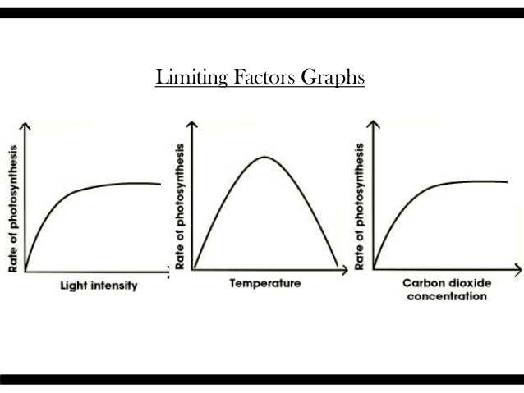
Keywords
Limiting Factors | Limits the rate of reaction
Photosynthesis | The process by which plants make food using carbon dioxide, water and light
Chloroplasts | The organelles where photosynthesis takes place
Chlorophyll | The green pigment contained in the chloroplasts
B4 - Photosynthesis
Algae
Algae are small photosynthesizing plants you find in water. They are adapted to photosynthesis in aquatic conditions. They absorb the CO₂ they need from the water around them
Light intensity | Temperature | Carbon dioxide levels
Lots of light = lots of photosynthesis. Not much light = not a lot of photosynthesis | Affects chemical reactions. The rate of photosynthesis will increase up to 40ºC. After this, enzymes needed for photosynthesis are denatured. | CO₂ is the raw material for photosynthesis. There is only 0.04% CO₂ in the atmosphere. More CO₂ = photosynthesis increases
Leaf Adaptations
Large surface area: to absorb as much sunlight Thin: short distance for diffusion Chlorophyll: green pigment in chloroplasts necessary for photosynthesis Stomata: allows the diffusion of gases into and out of the leaf. Xylem: (plant veins) supply plenty of water to the leaf.
Using Glucose
Glucose: a small, simple, soluble sugar made during photosynthesis. Starch: an insoluble polymer (chain) of glucose. Glucose must be converted to starch for storage. Cellulose: a complex carbohydrate made from glucose to strengthen cell walls. Amino acids: the building block of proteins, made by combining glucose with nitrate ions from the soil. Fats & oils: made from glucose, used to strengthen cell walls and as an energy store.
Photosynthesis
Plants and algae have evolved to harness the energy of sunlight and use it to make the sugar glucose in a process called photosynthesis. Chloroplasts are the organelles responsible for photosynthesis, they contain the green pigment chlorophyll. Carbon dioxide + Water → Oxygen + Glucose 6CO₂ + 6H₂O → 6O₂ + C₆H₁₂O₆

Slide 4
Keywords
Aerobic respiration | Breaking down glucose with oxygen to release energy and producing carbon dioxide and water.
Anaerobic respiration | Releasing energy from the breakdown of glucose without oxygen, producing lactic acid (in animals) and ethanol and carbon dioxide (in plants and microorganisms).
Breathing | The inflation and deflation of the lungs.
Fermentation | Yeast anaerobically respiring to produce ethanol and carbon dioxide.
Lactic acid | The mild poison made during anaerobic respiration.
Glycogen | A carbohydrate store in animals.
Oxygen debt | The extra oxygen that must be taken into the body after exercise has stopped to complete the aerobic respiration of lactic acid.
B4 - Respiration
Effect of Exercise
Heart rate: increases and the arteries to your muscles dilate. This has the effect of increasing oxygen and glucose supply and increasing carbon dioxide removal. Breathing rate and volume: increases and you breathe more deeply. You breathe more often and also bring more air into your lungs in each breath. This increases the rate of oxygen uptake and carbon dioxide removal. Temperature: increases. Respiration is an exothermic reaction and some energy is lost as heat. Glycogen stores: decrease. Glycogen is converted back into glucose to supply the cells with the fuel they need for increasing cellular respiration.
Aerobic Respiration
glucose + oxygen → carbon dioxide + water C₆H₁₂O₆ + 6O₂ → 6CO₂ + 6H₂O Respiration is the chemical process of turning glucose and oxygen into carbon dioxide and water. It releases energy and is controlled by enzymes. Respiration is an exothermic process.
Metabolism and the Liver
Metabolism is the sum of all the chemical reactions that take place in a cell or in the body. The liver has many different roles: Detoxifies substances such as the ethanol from alcoholic drinks. Breaks down products into the blood so they can be excreted in urine via the kidneys. Breaks down old, worn out blood cells and stores iron until it is needed.
Anaerobic Respiration
glucose → lactic acid C₆H₁₂O₆ → C₃H₆O₃ Anaerobic respiration releases energy in the absence of oxygen. It is much less efficient than aerobic respiration. It produces a poisonous waste product called lactic acid, which can be removed by reacting it with oxygen. Lactic acid + oxygen → carbon dioxide + water
Metabolism and the Liver
The liver also deals with the lactic acid produced in anaerobic respiration. The blood transports the lactic acid to the liver. Here, it is converted back into glucose, which is then broken down in aerobic respiration to form carbon dioxide and water. If the glucose isn’t needed, it can be stored as glycogen in the liver.

Slide 5
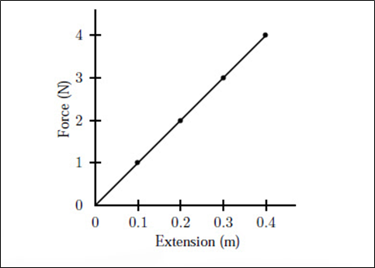
Keywords
Energy | The ability for something to do work. Energy is measured in Joules (J). energy cannot be created or destroyed but can shift between stores of energy.
Power | The rate at which energy is transferred. Power is measured in Watts (W)
GPE (gravitational potential energy) | The potential energy an object possesses due to its position above the earth. GPE is measured in Joules (J) and depends on the mass off the object, the gravitational field strength and the height above the earth’s surface.
KE (kinetic Energy) | The energy an object possesses when it is moving. KE is measured in Joules (J) and depends on the mass and speed of an object.
Thermal energy | A form of kinetic energy caused due to the motion of particles (hotter particles are more active and therefore have more KE).
Elastic potential energy | The energy an elastic object stores if it is stretched.
P1 - Energy (Topic Three)
Hooke’s Law
The extension of a spring is directly proportional to the force that is applied to it, provided the limit of proportionality is not reached. Past this point, the elastic object will no longer return to its original shape.
Word Equation | Symbol Equation | Units
GPE = mass x gravitational field x change in height, | GPE = mgΔh | GPE: Joules (J), Mass: kilograms (Kg), Height: Metres (m)
work done = force applied x distance moved | W = fs | Work done: Joules (J), Force applied: Newtons (N), Distance moved: Metres (m)
KE = ½ x mass x speed² | KE = ½mv² | KE: Joules (J), Mass: Kilograms (Kg), Speed: metres/second² (m/s²)
elastic potential energy = ½ x spring constant x extension² | Ee = ½ke² | Elastic potential energy: Joules (J), Spring constant: Newtons per metre (N/m), Extension: metres (m)
efficiency = useful output energy (x 100%) total input energy |  | Energy: Joules (J)
efficiency = useful output power (X 100%) total input power |  | Power: Watts (W)
Power = energy transferred time | E = P/T | Power: Watts (W), Energy transferred: Joules (J), Time: Seconds (s)

Slide 6
Keywords
Thermal conductivity | Ability of a material to transfer energy by heating.
Conductor | A material with high thermal conductivity.
Insulator | A material with low thermal conductivity.
Conduction | The transfer of energy through a material by the vibration of atoms in a lattice and, in the case of metals, by the movement of ‘free-electrons’.
Convection | Circulation of a liquid or gas caused by increasing its thermal energy.
Specific Heat Capacity | The amount of energy required to increase the temperature of 1kg of a substance by 1ºC.
Specific Heat Capacity
If the temperature of the system increases, the increase in temperature depends on the mass of the substance heated, the type of material, and the energy input to the system. The following equation applies: change in thermal energy = mass × specific heat capacity × temperature change [Δ E = m c Δθ ] - Change in thermal energy (ΔE) in joules, J - Mass (m) in kilograms, kg - Specific heat capacity (c) in joules per kilogram per degree Celsius, J/kg °C - Temperature change (Δθ) in degrees Celsius, °C.
P1 - Energy Transfers (Topic Three)
Insulation
Material | How it works
Loft insulation | Glass fibres are long and thin so don’t conduct heat very well. The material is mainly air which is a poor conductor. The glass fibres stop the air circulating, preventing convection.
Cavity wall insulation | The cavity is the space between the two layers of bricks. Insulation is pumped into the cavity - this can be foam, fibres or polystyrene balls. It is a better insulator than just air alone.
Aluminium foil behind a radiator | Reflects radiation away from the wall, reducing energy transfer by radiation.
Double-glazed windows | Between the two panes is dry air or a vacuum. The air insulates because gases are poor conductors. The space is narrow (16mm) so that the gas cannot circulate and transfer heat by convection.

Slide 7
Keywords
Fossil fuel | Fuel made from the fossilised remains of plants and animals
Biofuel | Fuel made directly from plant material
Carbon neutral | Total amount of carbon dioxide emitted during combustion is balanced by the amount absorbed during growth
Renewable | Is replaced at the rate it is used
Reliable | Can generate electricity irrespective of time of day or weather conditions.
P1 - Energy Resources (Topic Three)
Energy type | Description
Biofuels | Any fuel taken from living or recently living organisms. Biofuels can be used instead of fossil fuels in modified engines for transport and in generators at power stations
Nuclear | Takes energy from the splitting of atoms. Energy is transferred from the nucleus when this happens. Because there are lots of atoms, the core becomes very hot.
Wind | A wind turbine contains a generator at the top of a narrow tower. The force of the wind drives the turbines blades which turn the generator inside.
Wave | Waves are used to make a floating generator move up and down. This motion turns the generator so that electricity can be made. The generators are connected to the grid system by a cable.
Hydroelectric | Uses the power of flowing water. A reservoir at high ground, collects rainwater, which is then allowed to flow downhill. This motion drives turbines that turn electricity generators at the bottom of the hill.
Tidal | Traps water from each high tide behind a barrage. The high tide can then be released into the sea through turbines. The turbines drive generators in the barrage.
Solar | Harnesses the sun’s energy to generate electricity through solar cells or to heat water in solar heating panels.
Geothermal | Radioactive decay of rocks deep within the earth releases thermal energy. This rises to the surface as boiling water or steam. This can be used to turbines and drive generators.
Advantages of renewable energy | Disadvantages of Renewable energy
-They won’t run out because they are being replenished by natural processes. -They do not produce greenhouse gases or cause acid rain. -They do not create radioactive waste products. -They can be used where connection to the national grid is uneconomical e.g. solar cells in remote areas. -Biomass is a cheap and readily available source of energy. -Renewable facilities often require less maintenance. | Incapable of meeting world energy demand alone. -Noise from wind turbines disturbs people nearby and can interfere with echolocation processes. Some people consider them to be unsightly. -Tidal barrages affect estuarine habitats and wildlife. -Hydroelectric schemes often involve the mass flooding of surrounding areas to create dams. -Solar cells need large amounts of space to generate large amounts of power. -The majority of renewable energy devices are unreliable.
Meeting electricity demands
The variable demand for electricity is met by: -Using nuclear and coal-fired power stations to provide a constant amount of electricity (the base load demand). -Using gas fired power stations and pumped storage schemes to meet daily variations in demand and extra demand in winter. -Using renewable energy resources when demand is high and when the conditions for electricity generation in this way are suitable. -Using renewable energy resources when demand is low to store energy in pumped storage schemes.

Slide 8
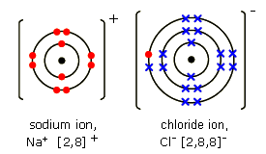
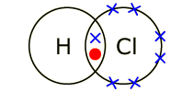
Keywords
Covalent bond | The attraction between two atoms that share one or more electrons
Ionic bond | The electrostatic force of attraction between positively and negatively charged ions.
Intermolecular forces | The attraction between the individual molecules in a covalently bonded substance.
Polymer | A substance made from very large molecules made up of many repeating units
Delocalised electrons | Bonding electron that is no longer associated with any one particular atom
Fullerene | Form of the element carbon that can exist as large cage-like structures, based on hexagonal rings of carbon atoms.
Metallic bonding | The electrostatic attraction between the positively charged atomic nuclei of metal atoms and the delocalized electrons in the metal.
Alloy | A mixture of two or more elements, at least one of which is a metal.
C2 Structure & Bonding
Ionic Bonding | Covalent Bonding
Electrons are transferred Ions are formed Between metals High melting/boiling points Conductive when liquid/molten | Electrons are shared No ions are formed Between non metals Low melting/boiling points Non conductive – no free electrons
Drawing dot and cross diagrams
When sodium and chlorine bond, one electron is transferred from the sodium atom to the chlorine atom. In the process, both gain a full outer shell and become ions. This is ionic bonding. When hydrogen and chlorine bond, a pair of electrons is shared between the two atoms. In this way, they both gain the one electron they need to have a full outer shell.
Structures and properties
Graphite: a form of carbon in which the atoms form layers. Layers can slide over each other, so graphite is much softer than diamond. It is used in pencils. Each carbon atom in a layer is joined to three other carbons. Conducts electricity. Diamond: a form of carbon where each carbon atom is joined to four other carbons. Diamond is very hard and has a high melting point. It does not conduct electricity. Silica: similar structure to diamond. It is hard and has a high melting point. Contains silicon and oxygen atoms, instead of carbon atoms. It is a semiconductor, which makes it useful in the electronics industry.
Metallic Bonding
Metallic bonding: Metallic bonding is the strong attraction between closely packed positive metal ions and a 'sea' of delocalized electrons. High melting and boiling points: metallic bonds are strong and a lot of energy is needed to break them. This is why metals have high melting points and boiling points. Conducting electricity: metals contain electrons that are free to move in the metal structure, carrying charge from place to place and allowing metals to conduct electricity well.

Slide 9
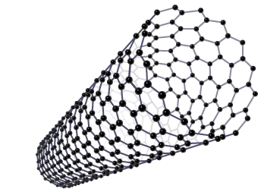
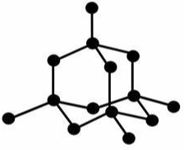
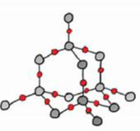
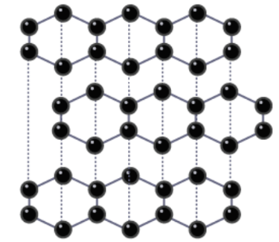
C3 Structure & Bonding
Allotrope | Different forms of the same element.
Giant covalent structure | Compounds formed of many atoms joined together by covalent bonds.
Simple covalent molecule | Compounds, or molecules that are formed from only a few atoms joined together by covalent bonds.
Fullerene | Allotropes of carbon that include bucky balls and carbon nanotubes.
Carbon nanotubes
Nanotubes are a type of fullerene and are molecular-scale tubes of carbon arranged similarly to the layers in graphite.
Carbon nanotubes have a very high melting point, as each carbon atom is joined to three other carbon atoms by strong covalent bonds. This also leaves each carbon atom with a spare electron, which forms a sea of delocalised electrons within the tube, meaning nanotubes can conduct electricity.
Diamond
Each carbon atom is bonded to four other carbon atoms by very strong covalent bonds and therefore has no free electrons. It cannot conduct electricity. The four strong covalent bonds give diamond a very high melting point.
Silicon dioxide
Silicon dioxide has the same structure as diamond. It is made from many SiO₂ molecules joined together.
Silicon dioxide (silica) is the main component of sand.
It is often used to line kilns because it can withstand extremely high temperatures.
Graphite
Each carbon is bonded to 3 carbon atoms with weak intermolecular forces between the layers, which allows the layers to easily slide over each other. They also have a delocalised electron which allows graphite to conduct electricity. Graphite is used in lubricants as the layers can slide.

Slide 10
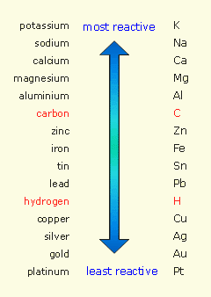
Keywords
Ion | The charged particle formed when an atoms gains or loses electrons
Displacement Reaction | When a more reactive substance takes the place of a less reactive substance
Oxidation | The gaining of oxygen OR the loss of electrons (OIL)
Reduction | The loss of oxygen OR the gain of electrons (RIG)
Base | Ionic compounds that can neutralise acids
Alkali | Soluble bases
Extracting Metals
Least reactive metals occur native. More reactive metals occur as ores. For ores containing metals less reactive than carbon, carbon can be used to reduce the metal in a displacement reaction. Example: Iron (III) oxide + carbon → Iron + carbon dioxide Some less reactive metals can be reduced using hydrogen: Copper (II) oxide + hydrogen → copper + water
Common Salts
Hydrochloric acid (HCl) → chlorides (Cl⁻) Sulphuric acid (H₂SO₄) → sulphates (SO₄²⁻) Nitric acid (HNO₃) → nitrates (NO₃⁻)
C5 Chemical Changes
General Word Equations
Metal + oxygen → Metal oxide Metal + water → Metal hydroxide + hydrogen Metal + acid → Metal salt + hydrogen Acid + base → Salt + water Acid + alkali → Salt + water Acid + carbonate → Salt + water + carbon dioxide
Ionic and Half Equations
Step 1: Write a balanced symbol equation: Mg_{(s)} + CuSO_{4(aq)} → MgSO_{4(aq)} + Cu_{(s)} Step 2: Separate the ions: Mg_{(s)} + Cu²⁺_{(aq)} + SO₄²⁻_{(aq)} → Mg²⁺_{(aq)} + SO₄²⁻_{(aq)} + Cu_{(s)} Step 3: Delete the species that appear exactly the same on both sides: Mg_{(s)} + Cu²⁺_{(aq)} → Mg²⁺_{(aq)} + Cu_{(s)} Half equations: Mg_{(s)} → Mg²⁺_{(aq)} + 2e⁻ Cu²⁺_{(aq)} + 2e⁻ → Cu_{(s)} State symbols: (s) = solid, (l) = liquid, (g) = gas, (aq) = aqueous
Charges on +ve ions | Charges on -ve ions
Group 1 metals = +1 Ammonium (NH₄⁺) = +1 Group 2 metals = +2 Aluminium = +3 Transition metals can vary (roman numerals) | Group 7 = -1 Nitrate (NO₃⁻) = -1 Hydroxide (OH⁻) = -1 Sulphate (SO₄²⁻) = -2 Carbonate(CO₃²⁻) = -2 Oxide (O²⁻) = -2

