Slide 1

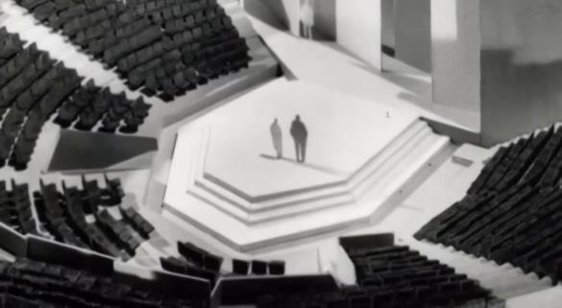
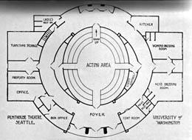
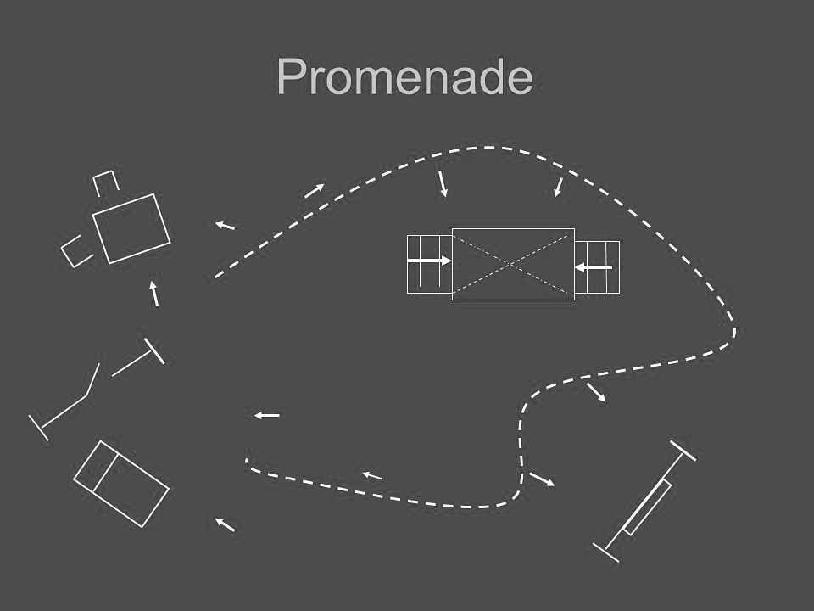
The Bourne Academy
Knowledge Organiser: Year 9 Autumn Term - Drama
Staging configurations
Theatre in the round
Advantages:
Directors and actors often find this a very dynamic, interesting space because the audience is close to the stage.
The actors enter and exit through the audience, which can make the audience feel more engaged.
Unlike spaces such as proscenium arch theatre, there is no easily achieved ‘fourth wall’ separating the audience from the acting area.
Thrust stage
Advantages:
Combine some of the advantages of proscenium arch and theatre in the round stages.
As there is no audience on one side of the stage, backdrops, flats and large scenery can be used.
The audience may feel closer to the stage.
Disadvantages:
Sightlines for audience on the extreme sides can be obstructed.
The audience on the left and right sides of the auditorium have each other in their view.
Box sets cannot be used.
Disadvantages:
Designers cannot use backdrops or flats, as this would block the audience’s view.
Stage furniture has to be chosen very carefully so that sightlines are not blocked.
Actors have to be carefully blocked so that no section of the audience misses important pieces of action or facial expressions for too long.
Disadvantages:
The audience may find moving about the space difficult or get tired standing.
Actors and crew need to be skilled at moving the audience along and controlling their focus.
There can be health and safety risks.
Promenade
Advantages:
This is an interactive and exciting type of theatre where the audience feel very involved.
To promenade means ‘to walk’ and promenade theatre is when the audience stand or follow the actors through the performance.
1

Slide 2
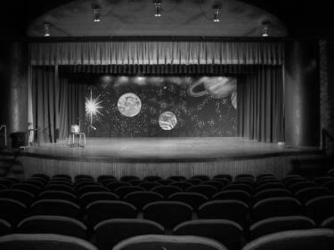
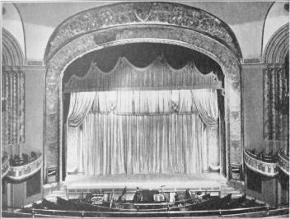
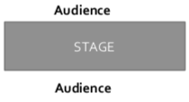
The Bourne Academy
Knowledge Organiser: Year 9 Autumn Term - Drama
Staging configurations
Traverse
Advantages:
The audience feel very close to the stage as there are two long front rows.
They can see the reactions of the other side of the audience facing them, which can work well for audience interaction.
Sometimes, extreme ends of the stage can be used to create extra acting areas.
End on staging
Advantages:
The audience all have a similar view.
Stage pictures are easy to create.
Large backdrops or projections may be used.
Disadvantages:
Audience members on the back rows may feel very distant from the stage.
It doesn’t have the frame of the proscenium arch theatre, which can enhance some types of theatre.
Disadvantages:
Big pieces of set, scenery or backdrops can block sightlines.
The acting area is long and thin, which can make some blocking challenging.
Actors must be aware of making themselves visible to both sides of the audience.
Lighting for traverse stages needs to be arranged carefully to avoid shining light in to the audience’s eyes or light spilling on to them unnecessarily.
6) Proscenium Arch
Advantages:
Stage pictures are easy to create as the audience look at the stage from roughly the same angle.
Backdrops and large scenery can be used without blocking sightlines.
The frame around the stage adds to the effect of a fourth wall, giving the effect of a self-contained world on the stage.
Disadvantages:
Some audience members may feel distant from the stage.
The auditorium could feel very formal and rigid. Audience interaction may be more difficult.
1

