Slide 1

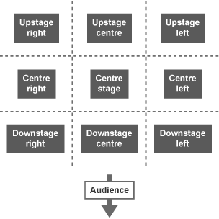


The Bourne Academy
Knowledge Organiser: Year 10 Autumn Term - Drama
1) Terminology and Areas of the stage
Component One
Multi role | When an actor plays more than one character in a performance.
Plot | The main events of the play.
Tension | A sense of anticipation or anxiety.
Playwright | The person responsible for writing a play.
Act | A play is divided into Acts
Scene | An Act is divided into scenes
2) Vocal skills
3) Physical skills
Accent | A way of pronouncing a language (country, area or social class)
Volume | How loud or quietly someone speaks
Pitch | How high or low someone speaks
Tone | How something is said – sarcastic tone, happy tone, sad tone
Timing | Use of pause or silence. The rhythm of the way you speak
Pace | How fast or slow someone speaks
Phrasing | How something is said for dramatic effect (pause, emphasise words)
Delivery of lines | Working with other actors (linked with timing) action - reaction
Gesture | How someone uses their hands and arms when they are speaking
Facial expression | How the face is used to communicate feeling.
Movement | How someone moves around the stage space. This also includes physical theatre movement.
Gait | How someone walks (stride, leap, shuffle.)
Posture | How someone stands and/or sits
1

Slide 2

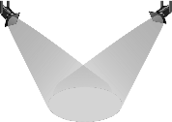

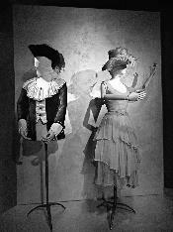
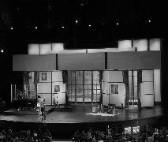



The Bourne Academy
Knowledge Organiser: Year 10 Autumn Term - Drama
Roles and Responsibilities
1) Playwright
7) Costume designer
4) Lighting designer
What they do:
Design what the actors wear on stage. Make sure that costumes are appropriate for the style and period of the piece.
What they do:
Write the script of the play including the dialogue and stage directions.
What they do:
Design the lighting states and effects. Must understand the technical capabilities of the theatre and create a lighting plot.
2) Set designer
8) Director
5) Understudy
What they do:
Oversee the creative aspects of the production. Liaise with designers, rehearses the actors and ensures all technical elements are ready.
What they do:
Design the set of the play. Provide sketches and design materials before overseeing the creation of the play.
What they do:
Learn a part including lines and movements, so they can take over from someone when needed.
3) Performer
9) Technician
6) Sound designer
What they do:
Appear in a production, for example by acting, singing, dancing or singing.
What they do:
Operate the technical equipment (lighting and sound boards) during a performance.
What they do:
Design the sound required for the performance. Consider if microphones are needed and create a sound plot.
1

