Slide 1
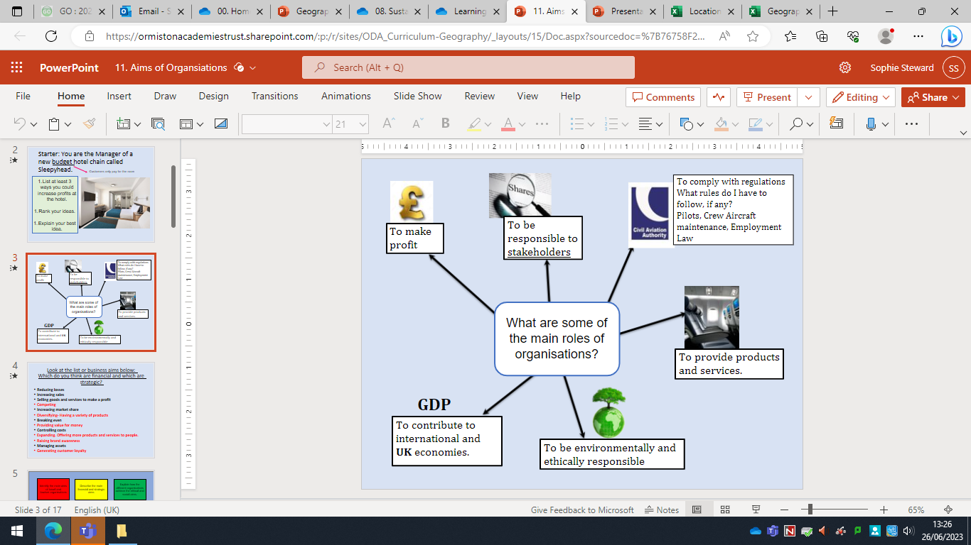
Types of Attraction | Definition
Natural Attractions | Non-Manmade attractions such as beaches, forests and caves.
Heritage Attractions | Allowing us to find out how people lived in the past, such as castles and ruins.
Purpose Built Attractions | Specifically designed to attract a certain type of visitor, such as theme parks, museums and resorts.
Arts and Cultural Attractions | Special events, festivals and theatre, such as Sundown.
BTEC Tech Travel & Tourism – Component 1
Types of ownership
Private sector: Characteristics: organisations owned or controlled by private individuals or shareholders. Functions: Sales of goods and services to make a profit, maximise sales revenues, increase market share, support members.
Public sector: Characteristics: funded and sometimes owned by central and local government. Functions: To provide a service, regulation, to educate, promote and/or inform.
Voluntary sector: Characteristics: Independent organisations, sometimes funded by membership, donations, grants, sales of products and services. Functions: To provide a service, provide/sell products, support members, promote a particular cause, educate and inform.
Types of Accommodation | Definition ​
Serviced ​ | Accommodation with facilities and services that can be included in the price of a room e.g. housekeeping, meals, concierge, room service, gym and entertainment.​
Non- Serviced​ | The product is accommodation only e.g. a bed. Additional facilities may be available like tea and coffee making.​
Self Catering​ | Accommodation which includes a kitchen so you can cook for yourself.​
Online Travel Agents
Easy for the customer to book their holiday when they want, customers can compare products and costs of services of lots of holiday providers, easy to make up the holiday that matches your own needs, you find out instantly what is available, making it easy to get last minute deals.
No expert help, no one to talk to for advice, limited choice of itinerary, lack of security online can lead to credit card theft or identity theft, customer must sort out their own problems if something goes wrong, it is easy to miss things when you book yourself.
Ancillary services
These are additional services to provide tourists with a more complete holiday whilst making more profit for travel companies. These services can include car hire, tours, airport lounge access, foreign currency exchange and airport parking.
Notes:
Spring 1

Slide 2
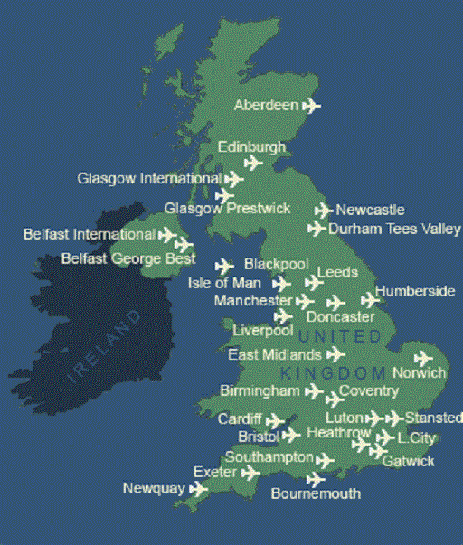
BTEC Tech Travel & Tourism – Component 1
Mode of transport | Advantages and disadvantages
Air | Travel times are often very quick which is good for business travelers who are looking to minimize time travelling. Visitor could choose a short haul flight domestic flight, for example, Edinburgh to Norwich to speed up their journey time. For longer journeys- it is usually the only way to travel e.g. London to Sydney.
Rail | Rail transport is often the most convenient and affordable method of transport. Passengers can avoid the long airport check in queues and security checks, making rail travel times more reasonable. High speed lines line have also helped to make regional and national train travel a viable alternative to flights. You can have refreshments, large windows and at seat entertainment as well.
Sea | Travel by ferry can be much slower but more leisurely. Daytime and overnight ferry services are available There are usually daily crossings to Europe. E.g. Hull to Rotterdam (takes 12 hours) There are also small ships e.g. The Lake District has a number of ships and pleasure boats to travel on the lakes.
Road | Travellers choosing land transport have the option of private cars, buses, coaches and taxis. Offers the ultimate flexibility. Set off when you like and take whichever route you like. Roadworks and unpredictable traffic jams make car travel less desirable. Coach travel is popular with travellers looking to keep costs down. If you book in advance, fares can be very cheap.
Visitor Profiles
When designing a trip for someone, we must consider their specific needs and interests. Things we need to consider are:
Services and facilities
Departure Points
Arrival Points
Date and Time of Arrival
Length of journey
Cost
Mode of transport
Transport Operators
Changes, transfers and stop overs
Types of Tourism
Domestic tourism is when tourists take holidays in the country they live in
Outbound tourism is when tourists travel to another country
Inbound tourism is when tourists visit England from a different country
Climate and Tourism
Seasonal variations are when more people visit an area at certain times of the year, such as more people visit beaches in summer and ski resorts in winter
Peak season is when most people want to visit a place, meaning prices are often higher
Off peak means the times of the year when demand is lower, therefore prices are often lower too
Notes:
Spring 1

Slide 3

BTEC Tech Travel & Tourism – Component 2
Primary research- is research that directly collects new data or facts to address a certain problem, validate a decision taken or answer specific questions
Secondary research- is research that build on and uses existing primary research, sometimes by bringing together similar data from different sources or analysing their findings
Data Type | Definition
Qualitative | Qualitative research provides detailed information. It allows opinions to be expressed and may be based on feelings. This research will usually measure the quality of something. For example, the open question ‘what can we do to improve our customer service?'. Travel organisations will often use qualitative research to understand travel behaviours.
Quantitative | Quantitative research provides statistical data that can be analysed numerically. This will usually measure the quantity of something and assess its value or importance. For example, the closed question ‘ how many holidays have you taken this year?’ will produce quantitative data as the answers will likely only contain a number. Travel organisations will often use quantitative research to plan and forecast by finding out which destinations are growing in popularity and which destinations are in decline.
Product development- Butlins focus
Butlins opened in 1936, yet it is still drawing in many visitors almost 100 years later.
Originally, the park included chalet accommodation, meals and entertainment on site.
Butlins has made improvements to ensure it caters to guests in 2023 and beyond. In 1950 Butlins opened an indoor heated pool and in the 1960s Butlins built revolving bars and a monorail. In the 1980s, on site waterparks were created and in the 1990s Butlins downsized to only 3 camps, however these 3 camps were developed to have a large indoor entertainment area for poor weather.
Butlins now has a website that allows potential customers to research into their holiday and also allows them to book online.
Changing Trends
Increasing cultural and environmental awareness. More people than ever are considering the ethical issues around tourism. 54% of people think say that the green, environmental and sustainability credentials of their holiday are important.
Active and wellness breaks are increasing as people understand that taking time to support their mental health is important. Spa breaks, yoga retreats and relaxing holidays are rising.
Sports tourism is increasing. Global events such as the world cup and the Olympics attract tourists from around the world. However, the amount of tourists travelling to take part in a sport, such as golfing, is also increasing.
Notes:
Spring 1

Slide 4
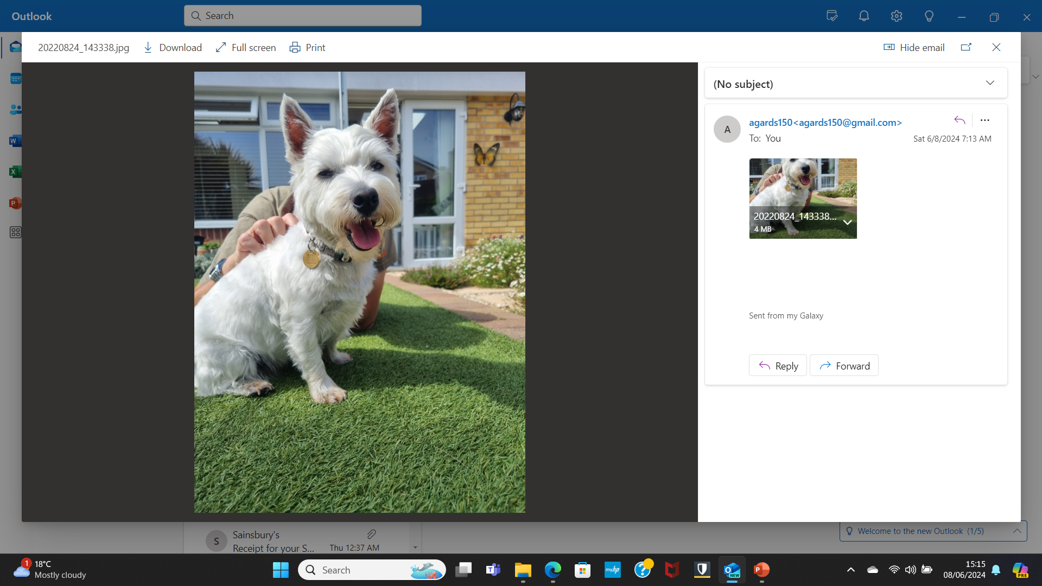
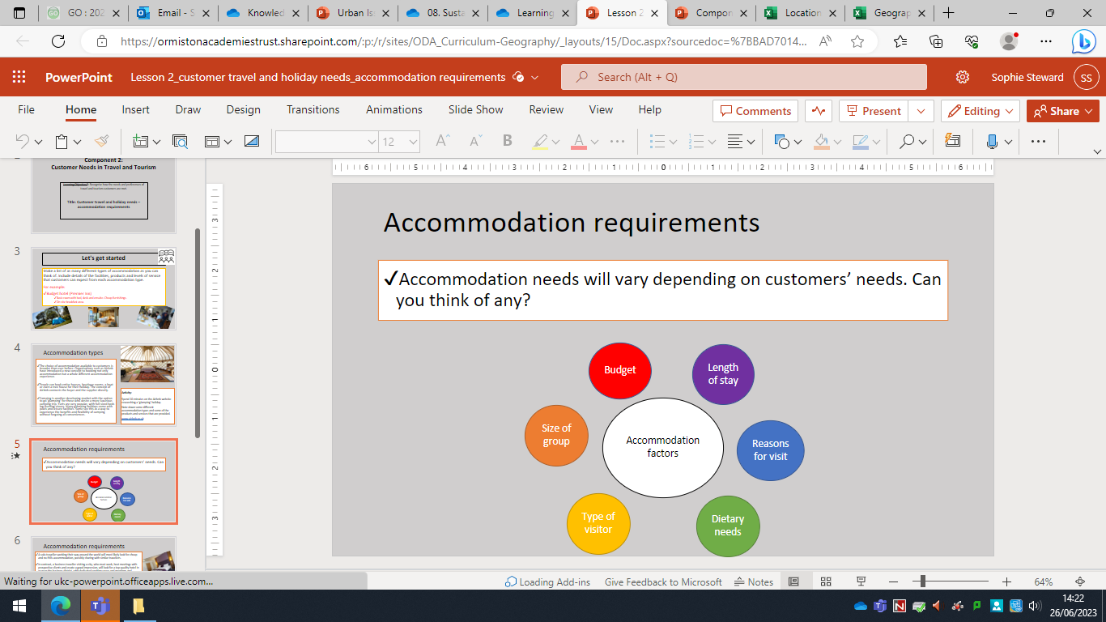
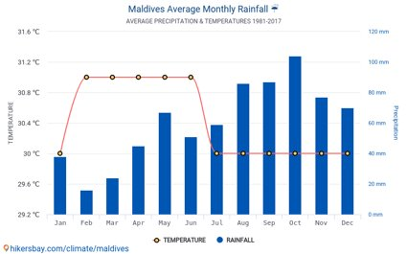
Pet friendly facilities
More customers are taking their pets on their trips, both domestically and internationally. In 2023, there was an increase of 80% in bookings in dog-friendly locations. Many owners expect pets to be allowed in bedrooms, and some accommodation providers go the extra mile and provide pet towels, blankets and bowls.
Petcation- taking your pet on holiday with you.
BTEC Tech Travel & Tourism – Component 2
Accommodation Requirements
Accommodation needs will vary by customer. Business travellers are often looking for adults only hotels close to the city centre, whereas a family may be looking for accommodation with children's meals available.
Responsible Tourism
While most people consider price and location as important when booking a trip, more people are beginning to also consider the ethical issues. More people are choosing to travel by rail due to the decreased carbon footprint. France have banned domestic short haul flights where a train can be taken instead to improve the carbon footprint of travel.
Carbon footprint- is a measure of the amount of carbon dioxide released due to an activity of an individual or organisation
Visiting friends and relatives
People can visit friends and relatives (VFR) as domestic, inbound or outbound tourists. Not only do people spend money travelling to the destination, they also spend money enroute and during their stay. Even if they stay with friends and family, money is likely to spent on activities, food and transport.
Travel Dates
Time of year affects bookings in the travel and tourism industry vastly. This can be due to the climate, specific events or school holidays.
Purpose Of Travel
There are many different holiday types to choose from to give customers a choice of holidays linked to their reason for travel.
Activity- water sports
Adventure- rafting on the Colorado river
Celebrations- abroad wedding
Clubbing- Ibiza nightlife
Culture- Rio carnival
Festivals- Coachella
Relaxation- spa breaks
Sport- golfing
Volunteering- elephant sanctuary
Wellbeing- yoga retreat
Information to plan a holiday
Customer details
Destination, duration, dates
Transport
Accommodation
Activities and excursions
Health risks and entry requirements
Safety/security concerns and local customs
Total and itemised breakdown of costs

Slide 5
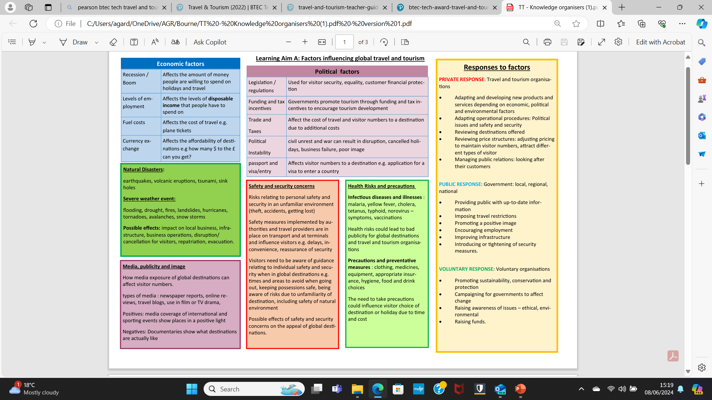
BTEC Tech Travel & Tourism – Component 3

Slide 6
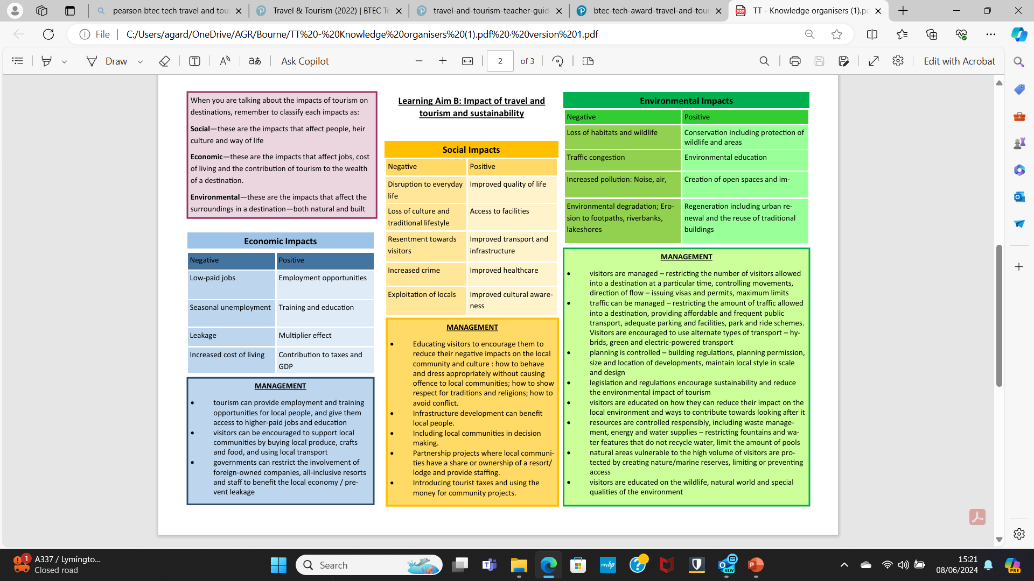
BTEC Tech Travel & Tourism – Component 3

Slide 7
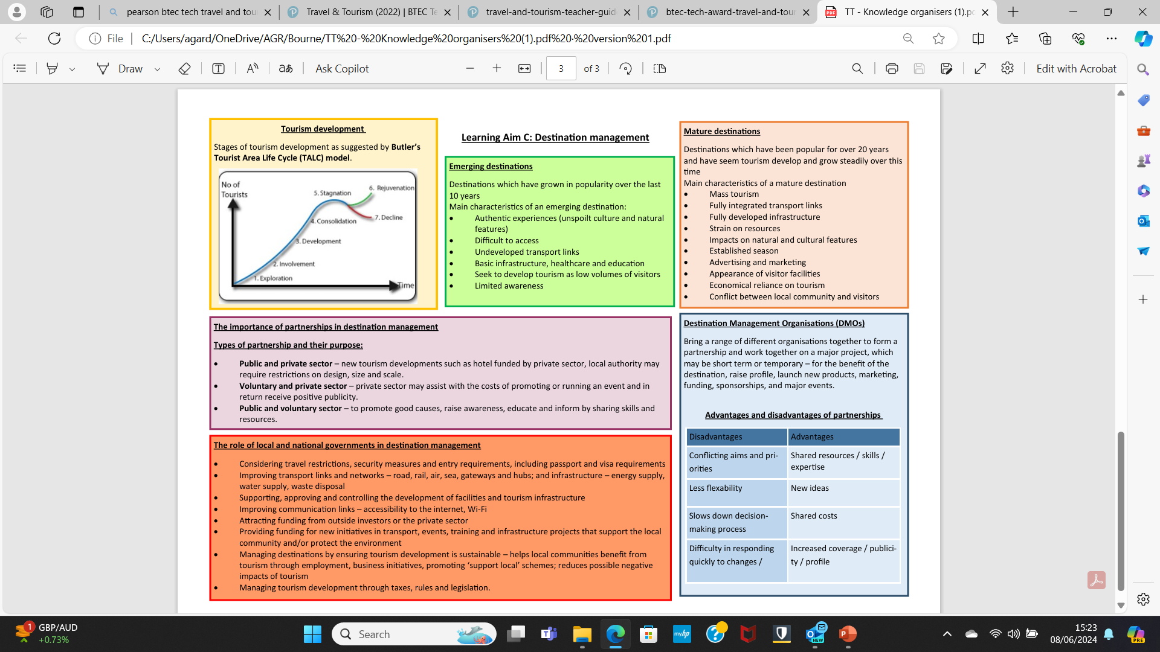
BTEC Tech Travel & Tourism – Component 3

