Slide 1

Assembly
Wellbeing

Slide 2

GCSE’s – how does it make us feel?
Anxious
Pressure
Stressed
Not good enough
Worried
Nervous
Sad
Fearful
Overwhelmed
Motivated
Determined

Slide 3
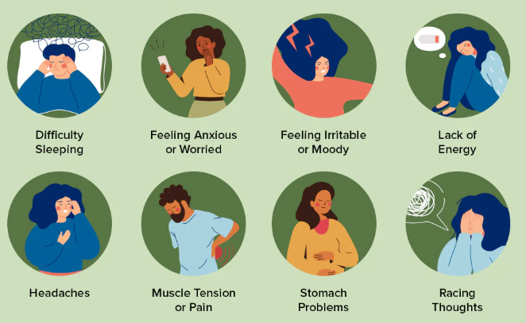
How does our body respond when we feel under stress?

Slide 4
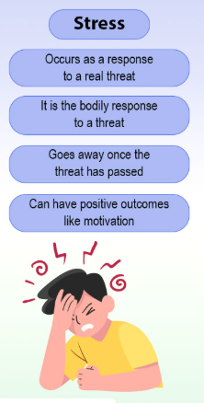
Stress can be positive
When we are challenged we can experience eustress. This is a positive type of stress because it can help us:
Achieve our goals
Be creative in our responses
Improve motivation
Empower us
Improves performance
Taking control can lead to eustress instead of distress!

Slide 5
Moving distress to eustress
Take control of the situation. The exams are going to happen to you, whether you like it or not. How you take control and prepare yourself for them is within your control.
Produce a revision timetable and stick to it. Little and often helps us manage our levels of stress, because it is achievable.
Manage your time effectively – consider where your time is not being used effectively. For example, on the bus could you spend 20 mins revising instead of playing the game on your phone?
Organisation – get your resources organised so there is minimal stress when you do revise. Your time can be spent more wisely.
Find your coping mechanism – socialising, indulging in a hobby, humour, family time
Prioritise your health – exercise, sleep, nutrition

Slide 6
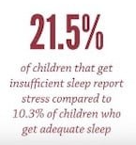
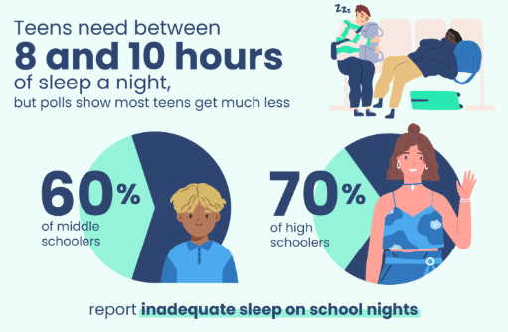
Wellbeing - Sleep
A healthy amount of sleep supports reduction in stress levels. Teenagers need 8-10 hours of sleep a night.
If possible complete your revision away from your bedroom, so you can ‘switch off’ when you have finished.
Maintain a consistent routine before bed, with a regular time of going to bed.
Switch of – screen time before bed increases the chance of not being able to sleep.
Remove distractions – turn your phone off or put it in a different room.
For most people sleep routines are within your control.

Slide 7
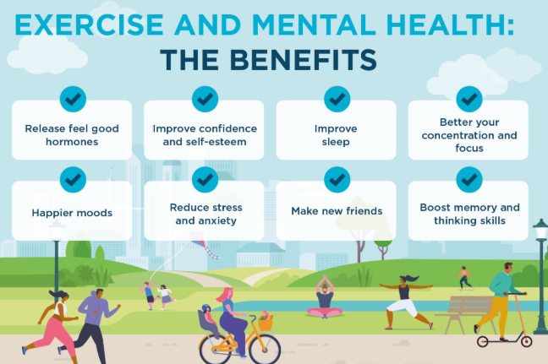
Wellbeing - exercise
Exercise releases endorphins ‘feel good hormones’, which can lower our feelings of stress.
Continue to attend clubs/activities
Meet up with mates for a game of footie
Walk/cycle to/from school
Go out for a walk
Most importantly step away from the revision after completing a sensible amount and get some exercise. This supports wellbeing and feelings of stress.
For most people exercise is within their control

Slide 8
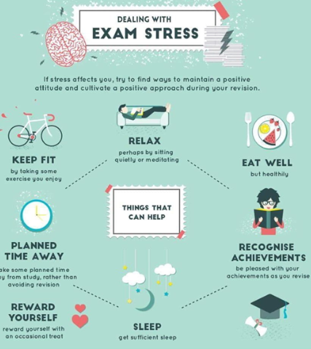
Wellbeing - Nutrition
A healthy balanced diet can improve concentration and performance. It can improve energy ad reduce anxiety and feelings of stress.
Avoid quick fixes like energy drinks
Eat regular meal, food is fuel!
Avoid skipping meals
Drink plenty of water – supports concentration and avoids headaches
For most people nutrition is within their control

Slide 9


