Slide 1

Assembly
Mock Exams & Invigilators

Slide 2


Did you know that more than 5 million GCSE exam papers are taken each year?

Slide 3
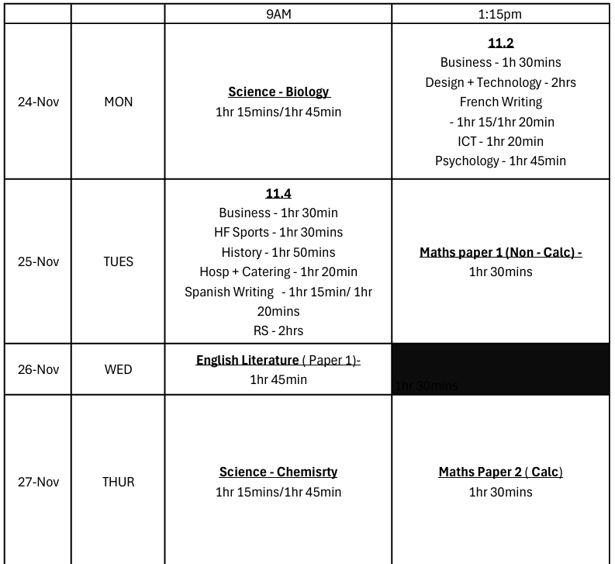

Year 11 Mock Exams
Commence on 24th November
If your have afternoon exams, then you will have an early lunch at 12:30pm.
Timetables have been sent home

Slide 4
Purpose of Exams
Inform tiers of entry for your GCSE’s
Identify what intervention and support is needed for you. This could include additional homework support, coursework catch up and in class intervention.
Identifies specific strengths and weaknesses to direct teaching and independent revision.
Gives an overview of your current attainment, which will be needed for 6th form and/or college applications.

Slide 5
Expectations
Any exam misconduct or malpractice must be reported to the awarding organisation, even for mocks.
Early lunch – 12:30pm if you have afternoon exams
Equipment – Clear pencil case with equipment, scientific calculator, clear water bottle, no watches or phones
Exam concessions – students entitled to exam concessions will have these in place. These exam concessions will have been assessed in Y9. If students do not use them they lose them!
Behaviour – this will be treated like the actual exams, therefore behaviour must be exemplary
Revision preparation – Staff will provide resources to support revision in exam based subjects and revision support booklets have been sent home.

Slide 6

What is the role of an invigilator?
To ensure that all exams are carried out according to the rules set out by the exam boards
To prevent any communication between candidates during an exam
To prevent any access to books, papers or electronic devices during an exam

Slide 7

What is the role of an invigilator?
They make sure that there is no candidate malpractice and administrative failures.
They liaise with the Examination Officer and Senior Invigilator

Slide 8

Did you know that there are serious consequences if you don’t follow exam rules?
This is called malpractice.

Slide 9
What is malpractice?
It means not complying to rules and regulations in relation to the examination. Examples are:
Breach of instructions from an invigilator
Failing to abide by the conditions of supervision
Working with other candidates
Copying from another candidate
Allowing work to be copied
Deliberate destruction of another candidates’ work
Disruptive behavior in the exam room
Misuse of materials or technology to support with the exam

Slide 10

Potential penalties for engaging in malpractice
The awarding body is notified immediately. They may decide to:
Take no action
Carry out a full investigation
Possible sanctions include:
Warnings
Loss of marks
Disqualification
Barred from taking all exams for a set period
Permanent record on your individual results

Slide 11

How can you help invigilators ?
Be polite and respectful at all times
Adhere to rules and regulations of taking exams
Do what they ask you to do
Inform them if you are feeling unwell
Put your hand up if you have a question

Slide 12

When you sit an exam paper, did you know that it started life about a year or two before?
Do you know what happens to your paper when it’s finished?

Slide 13
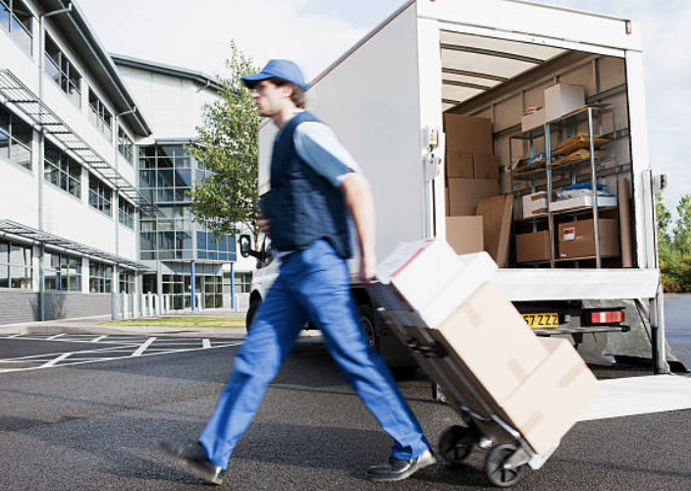
On the day or day after
2. Courier transports completed scripts to Awarding Body for marking.
1. Exam papers, completed scripts and any blank scripts are collected by exams office staff and put back into secure storage to wait for pickup by courier.

Slide 14

Marking & checking
3. Scripts to be marked online are scanned and kept in secure storage by the Awarding Body. Scripts to be marked in hard copy are sent to individual examiners.
4. Scripts are marked by Awarding Body examiners.
5. Rigorous checks are performed by senior examiners to ensure examiner marking is consistent with the Awarding Body mark scheme; that conversions from raw marks to UMS scores have been calculated accurately and the application of grade boundaries is correct.
https://www.ocr.org.uk/Images/232592-timeline.pdf

Slide 15

Exam Results
8. Centres give results to candidates.
6. Results are issued to centres by the Awarding Body.
7. Exams office staff and Head of Centre check candidates got the result(s) they were expected to get and follow-up on grades to be queried.

Slide 16
Mock Results
The results will be released on Wednesday 14th January
Results will be given in an envelope
This ensures all marking has been moderated for accuracy and data entry completed
Staff will not share grades before this date but may share strengths & weaknesses to support revision and lesson feedback

