Slide 1

Assembly
Planning for revision & breaking down the myths

Slide 2

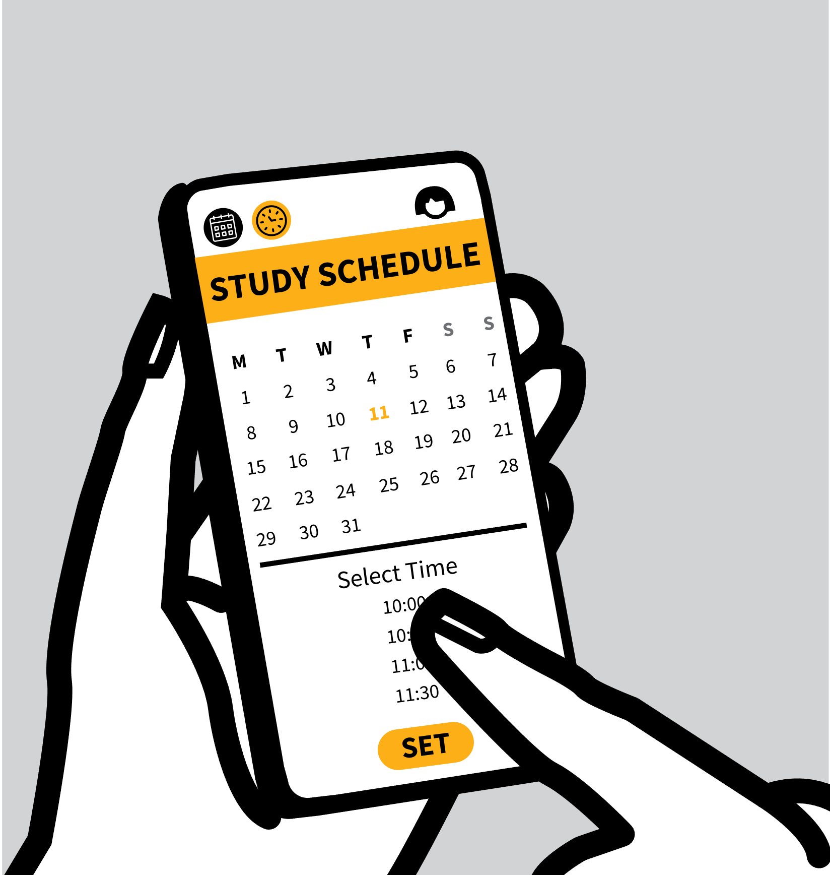
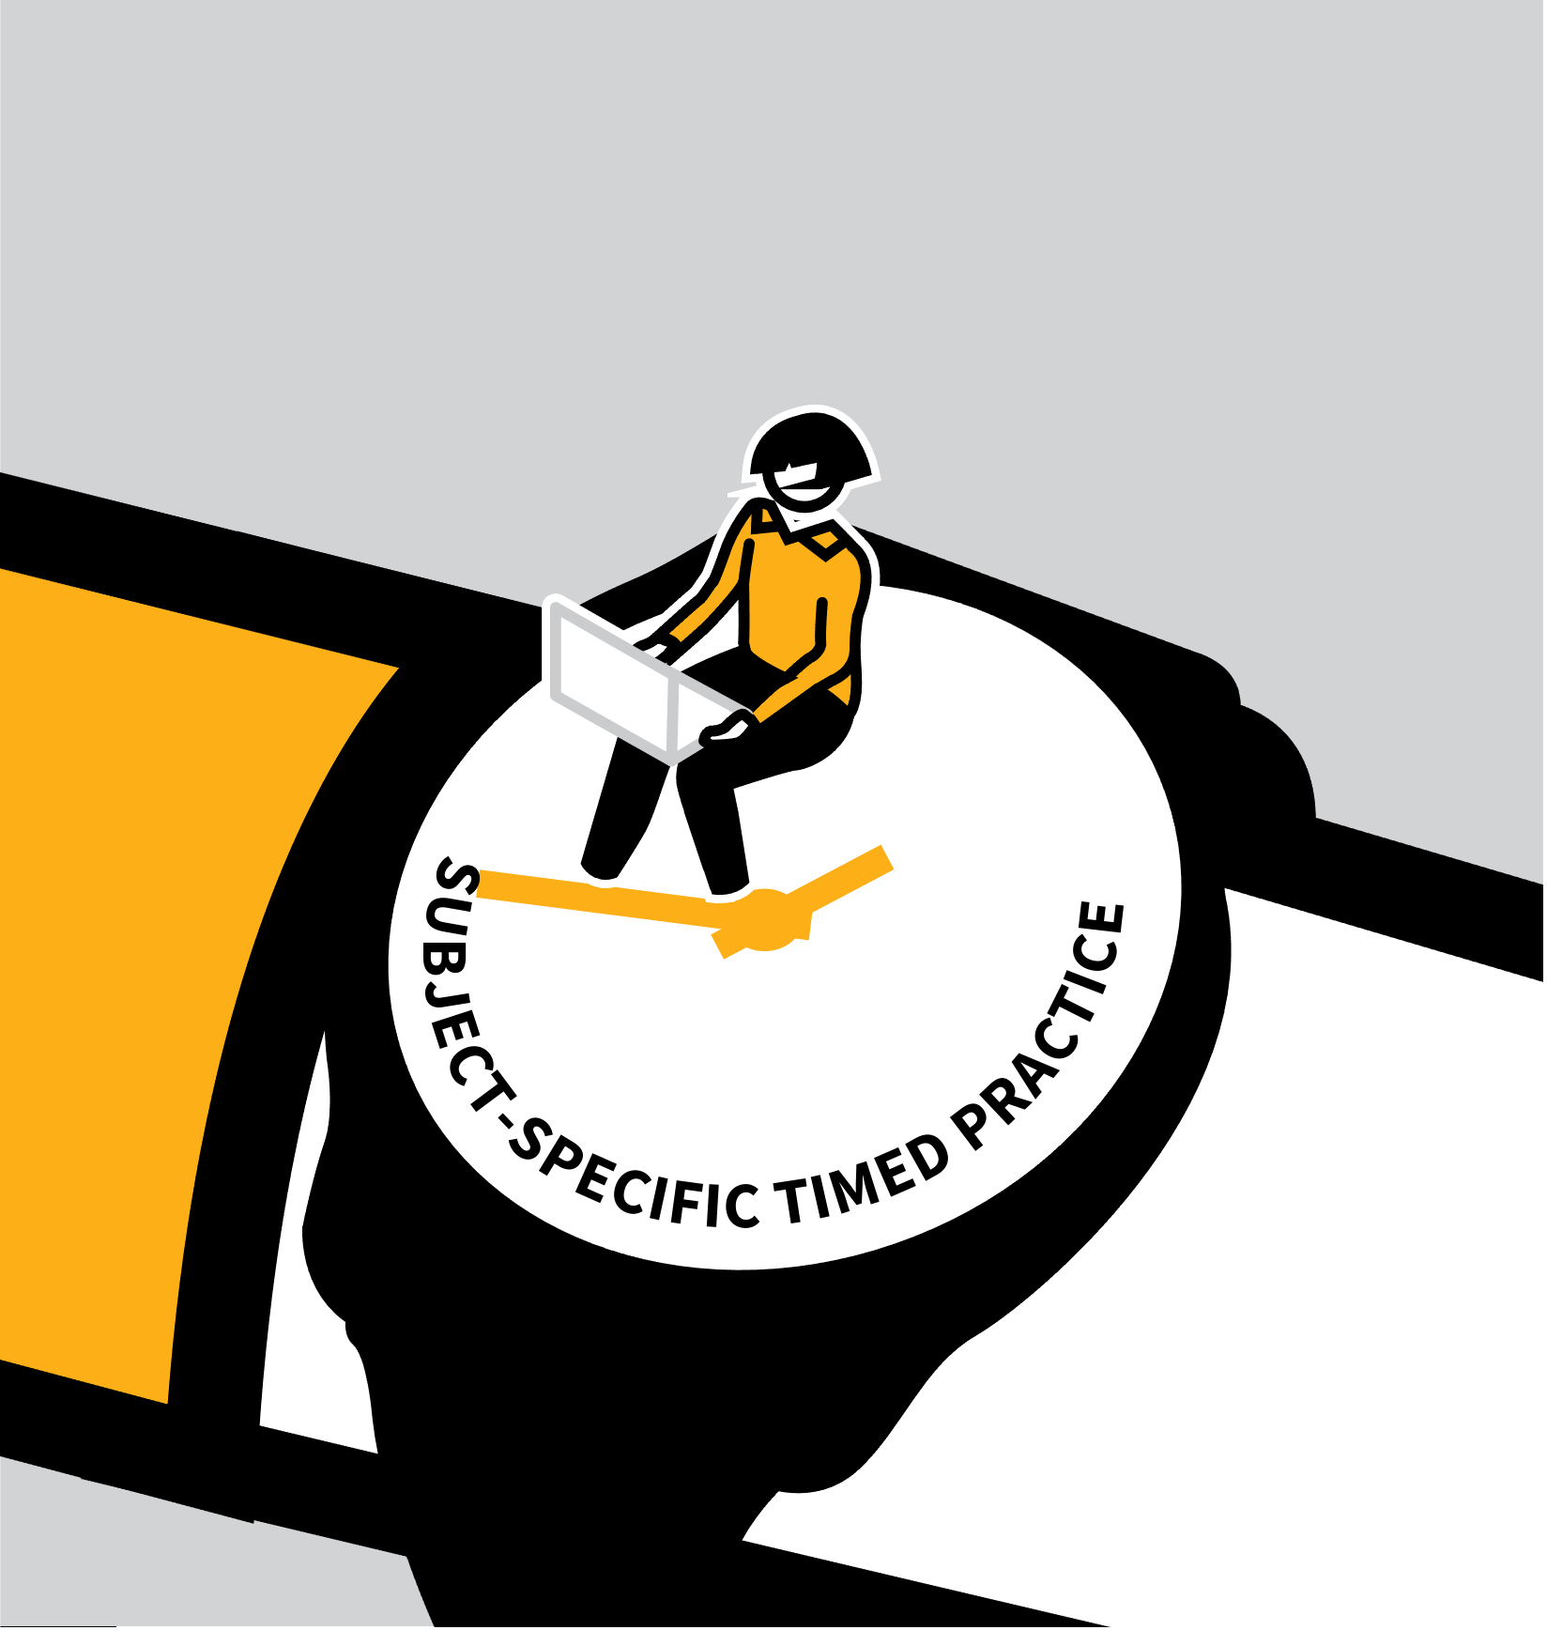

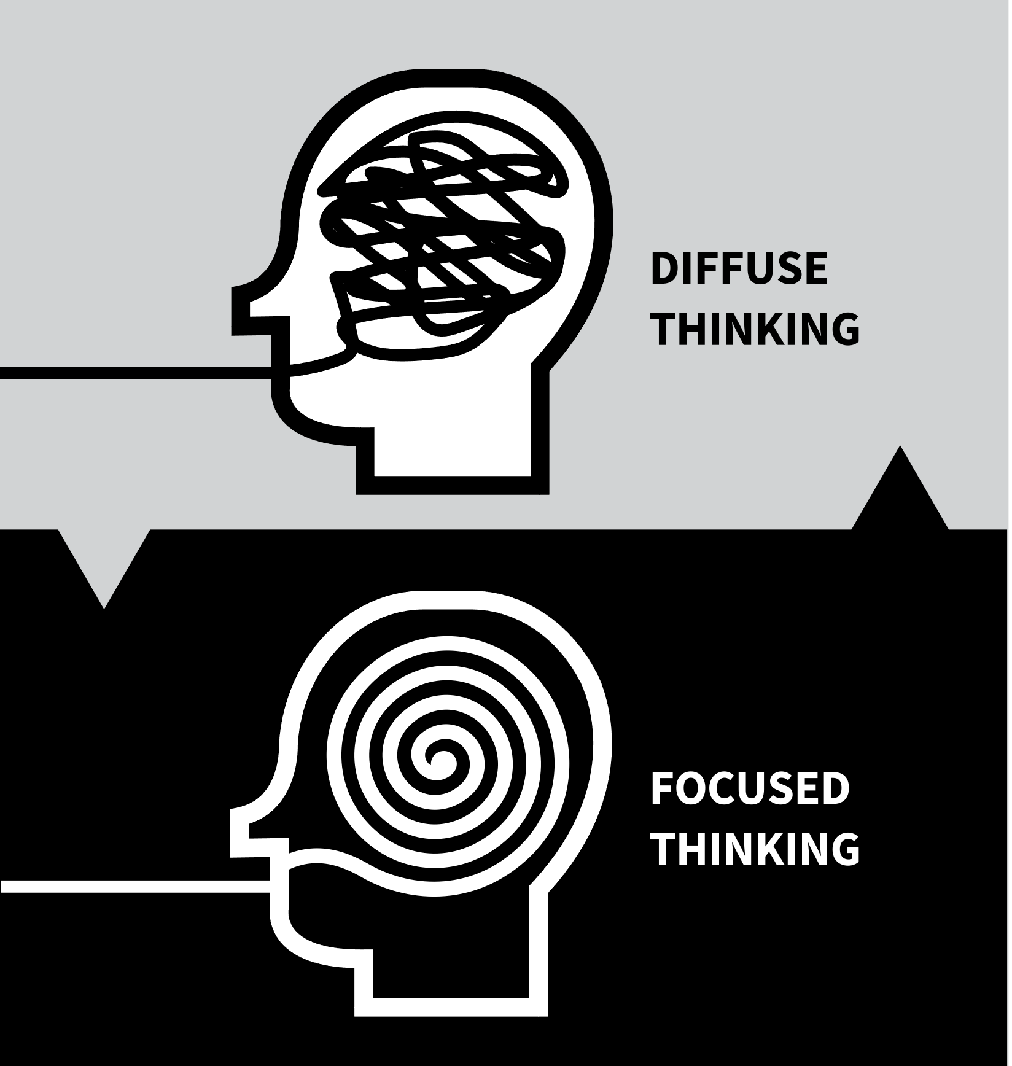

LEARNING WALKTHRUs
HOW WE LEARN SERIES
MAXIMISING TIME & EFFORT
1
2
3
4
5
ORGANISE STUDY TIME
USE SUBJECT-SPECIFIC ROUTINES
ASSEMBLE ALL THE RESOURCES
FOCUSED & DIFFUSE THINKING
SET GOALS & TAKE BREAKS
At a practical level, a challenge you face is that you have a lot to learn and only so much time each day or each week when you can study and practise.
That time has to be woven around time for a healthy, active life including family and friends.
You need to maintain sustainable study routines and use all that time to maximum effect.

Slide 3
LEARNING WALKTHRUs
1 | 2 | 3 | 4 | 5
HOW WE LEARN SERIES
MAXIMISING TIME & EFFORT
ORGANISE STUDY TIME
It’s better to do shorter periods of study several days a week rather than one huge chunk.
Make a schedule and keep this time free; make daily study routines a habit so you just do it like you always do without it being a fuss.
Your revision schedule should include you’re your other commitments including your homework, free time, clubs and chores, so you can be realistic about revision time

Slide 4
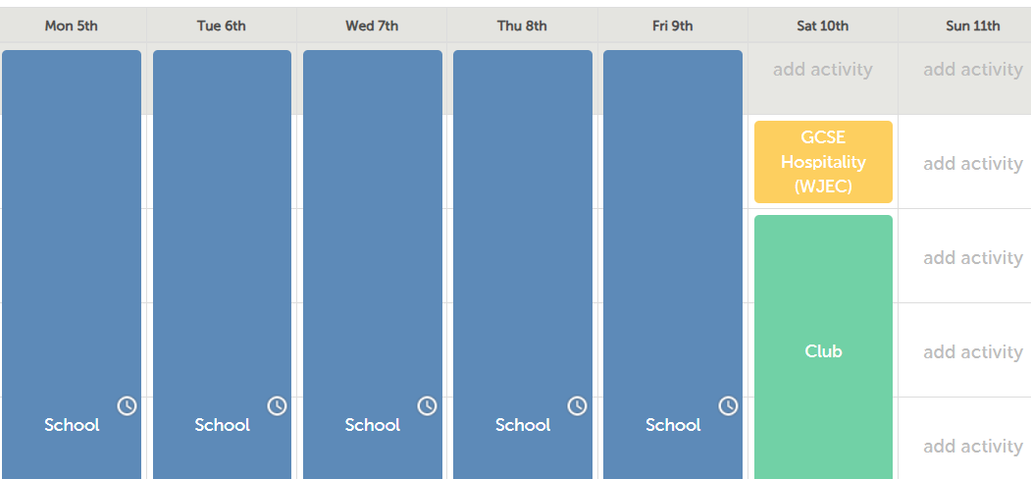
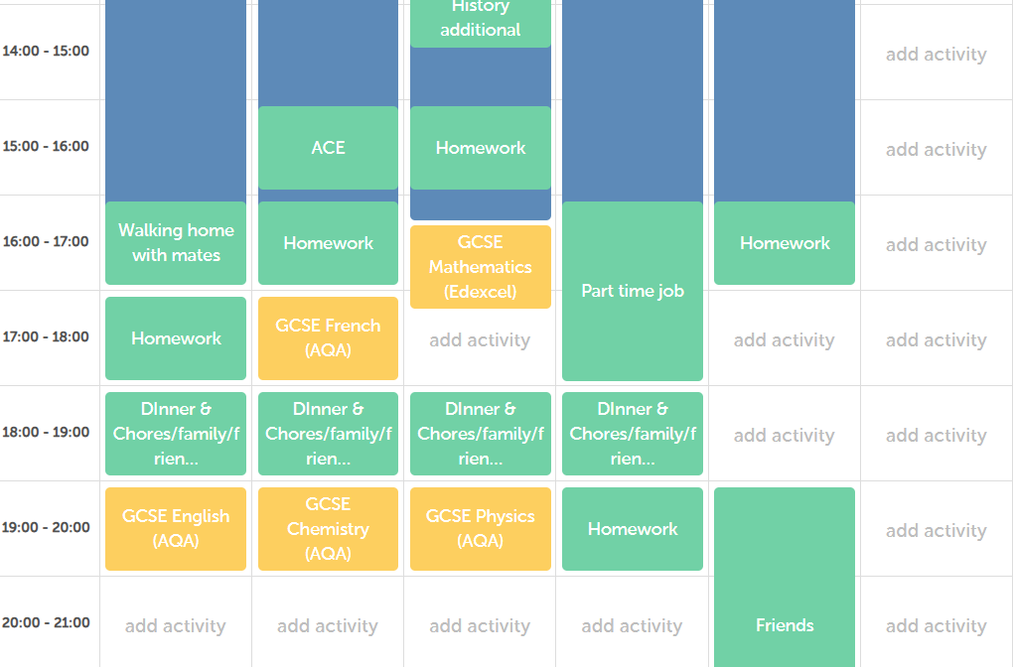
Revision requires:
A plan
Commitment
Specifics
Realism
From 3rd November there are 27 weeks until the first exam.
Revision Timetable Maker / Study Planner
Students should be aiming to commit approx. 30 hours of revision to each subject.
Spacing this out now, means approx. an hour per week for each subject.

Slide 5
LEARNING WALKTHRUs
1 | 2 | 3 | 4 | 5
LEARNING WALKTHRUs
HOW WE LEARN SERIES
SOME MYTHS& WEAK STUDY HABITS
USE SUBJECT-SPECIFIC ROUTINES
MAXIMISING TIME & EFFORT
To study efficiently learn how to practise in each specific subject or activity area. e.g.
  How do you practise maths? Which questions do you do and how do you check them?
  How do you practise French or Spanish vocab?
  How do you practise in music or art at home?
  How can you study geography, science, history or literature effectively?

Slide 6
LEARNING WALKTHRUs
1 | 2 | 3 | 4 | 5
HOW WE LEARN SERIES
MAXIMISING TIME & EFFORT
ASSEMBLE ALL THE RESOURCES
Studying usually involves using resources to guide you in the process. Make sure you’re familiar with them and have them to hand when needed. e.g.
  Textbooks and knowledge organisers.
  Online study platforms; subject websites.
  Sets of practice questions for the subject.
  Answers or exemplars to guide self-checking.
  A unit overview to support planning and monitoring.

Slide 7
LEARNING WALKTHRUs
1 | 2 | 3 | 4 | 5
HOW WE LEARN SERIES
SOME MYTHS & WEAK STUDY HABITS
SET GOALS & TAKE BREAKS
MAXIMISING TIME & EFFORT
Work towards ambitious but achievable goals:
Break down study sessions into short bursts of intense activity, aiming to complete certain tasks before taking a break, say every 20 or 30 minutes.
Studying in short bursts keeps you motivated, is easier to maintain and allows more diffuse thinking.
Reward yourself at the end of your revision

Slide 8

LEARNING WALKTHRUs
1 | 2 | 3 | 4 | 5
HOW WE LEARN SERIES
SOME MYTHS & WEAK STUDY HABITS
SPACE YOUR STUDYING,
DON’T CRAM IT
Get organised by mapping out when you’ll revisit each topic over time. Look at how much time you have until your test and space out your study of each topic to create time to forget in between.
e.g. if you don’t know a topic very well, leave a short gap of a week between study sessions, then leave longer gaps.
Spacing retrieval of ideas strengthens them in your memory far more than cramming in a short period.

Slide 9

LEARNING WALKTHRUs
1 | 2 | 3 | 4 | 5
HOW WE LEARN SERIES
SOME MYTHS & WEAK STUDY HABITS
FOCUS, DON’T MULTITASK
To remember what you’re studying, it needs your full attention; focusing fully, not multitasking. e.g.
BANISH YOUR MOBILE PHONE | Turn your phone off or on silent; put it in another room. If you can see your phone (even if it’s off!), it zaps attention away.
OPT FOR A QUIET SPOT | If possible, study in a quiet environment and without music. If you feel you need music, try music without lyrics.

Slide 10
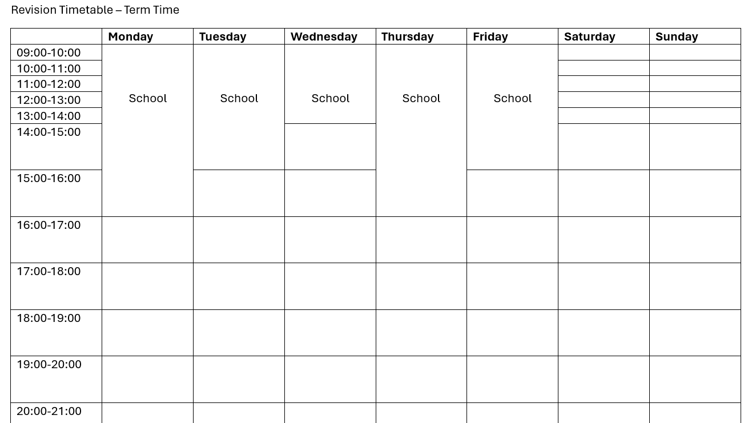
Revision Timetable

