Slide 1
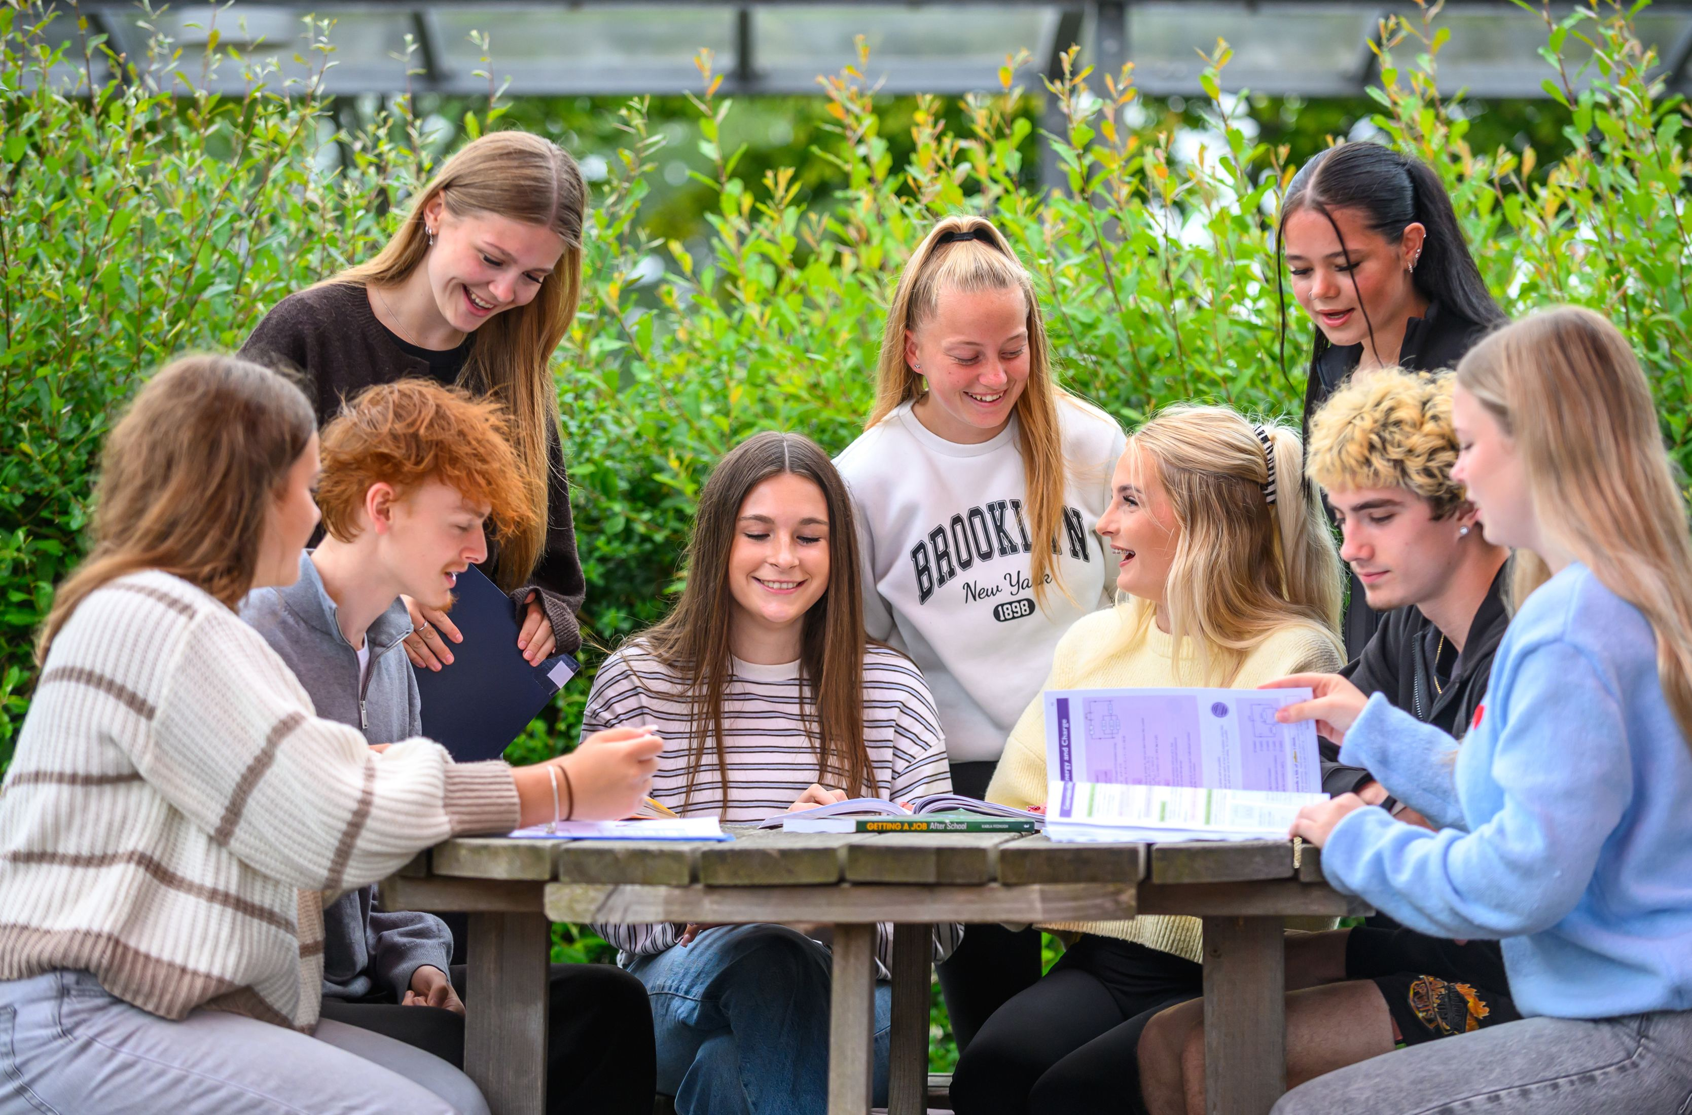

SIXTH FORM
MR TAAFE
MRS DIFFEY
THE BOURNE ACADEMY

Slide 2

A Levels
English Literature
Maths
Biology
Chemistry
Physics
Art, Craft and Design
Design & Technology
Geography
History
MFL: Spanish/French
Photography
Psychology
Religious Studies
Sociology

Slide 3

Other Courses
Applied Science
Core Maths (0.5 A level equivalent) – 1 year
Criminology
EPQ
Music Vocational – Single (1.5 A Level equivalent)
Music Vocational – Triple (3 A Level equivalent)
Performing Arts (Dance and/or Drama)
Performing Arts - Triple (3 A Level equivalent)
Sport – Single (1 A Level equivalent) – subsidised gym membership
Sport – Triple (3 A Level equivalent) – subsidised gym membership
English & Maths GCSE resit
The Bourne Academy - BTEC School of the Year

Slide 4
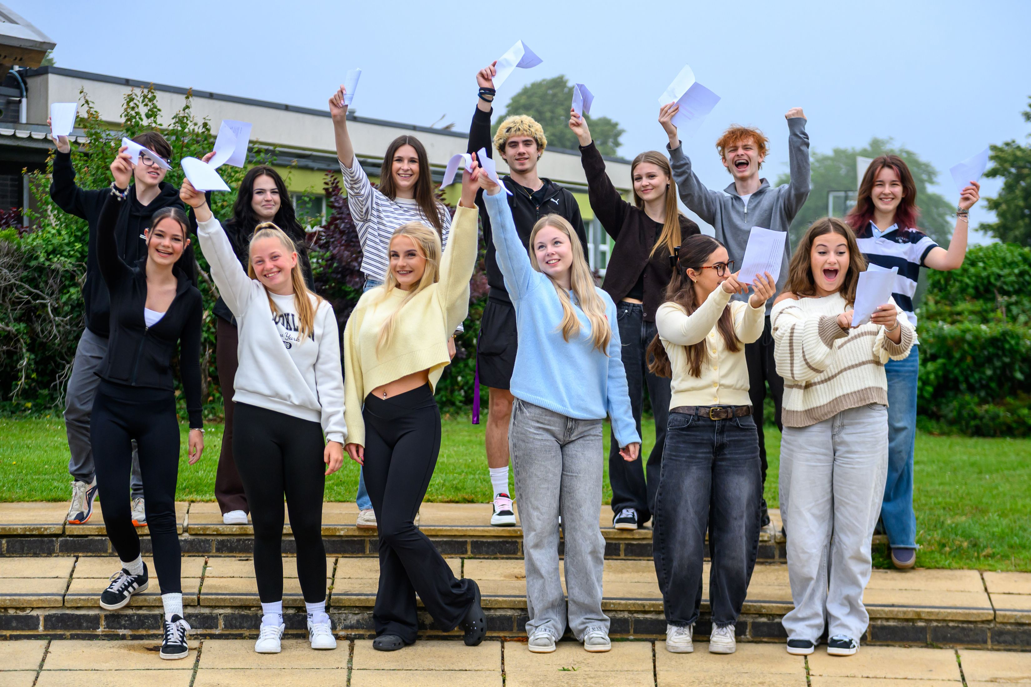

Entrance Criteria
Minimum Standard: Five or more grades at 4+ in GCSE or equivalent, including English and Maths
Grade 5/6 and above in the subjects you would like to study (Maths 7)
Physics - Minimum standard with a 6+ in Physics or a 6-5 in combined science. A grade 6 in Maths is also essential
Sociology - Minimum standard with a 5+ in English (Lang or Lit)

Slide 5




Enrichment
Duke of Edinburgh
Sports & Performing Arts
Unifrog
MOOCS
Academy Public Service
Life Skills
Educational visits
And more…

Slide 6
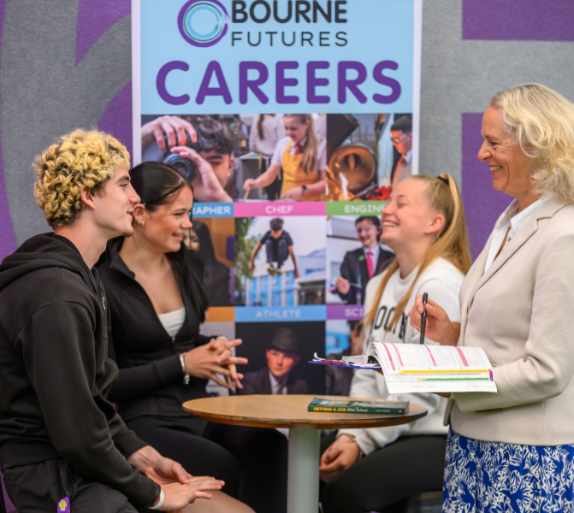
Careers Support
One to One guidance from Level 6 and Level 7 Careers Advisers
Apprenticeship and job application support
CV Checking
Personal branding
Business talks and opportunities
Business mentoring
UCAS discovery
Oxbridge specialist support

Slide 7

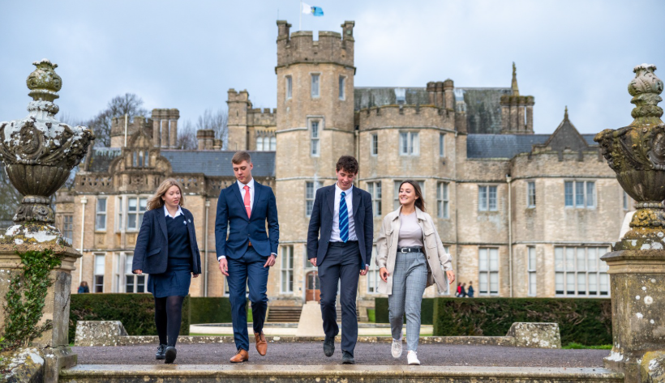

Canford Partnership
Expert preparation for competitive careers and courses such as medicine, dentistry, veterinary and Oxbridge
Preparation courses for Law/Medicine
Personal statement assistance and interview preparation
Events such as Canford Careers Conference

Slide 8


The Elephant Group
Top third for top third – increase the number of students from non-selective state schools progressing into top universities and careers
Partners include – Durham University, UCL, university of Exeter and variety of corporate partners
Live webinars with industry experts
Fully funded summer academy
Specialist support e,g. tech, medicine Oxbridge
Interview preparation and support
Contextual offers
Notes:
<number>

Slide 9

Young Carers
Partnership with MyTime Young Carers
Additional support and opportunities, examples include access to free Level 2 Swim Coach training with Individuality Swimming and Fitness and priority access for trips and events

Slide 10

Work Experience
Year 12 – It is compulsory that you source your own placement
Work Experience Co-Ordinator to support you through the process
Opportunities for extended work experience and summer schools and internships
This Photo by Unknown Author is licensed under CC BY-NC-ND
Notes:
<number>

Slide 11
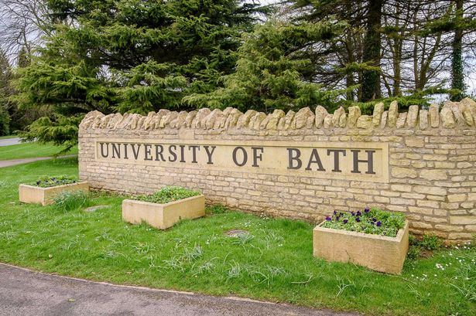

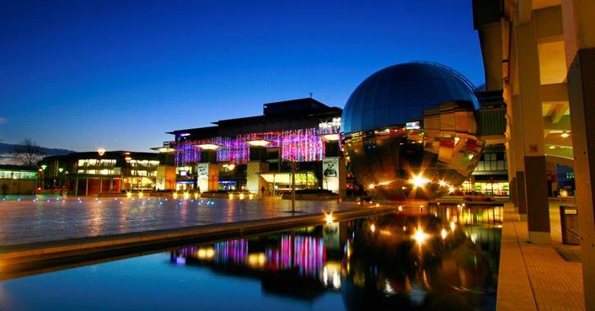
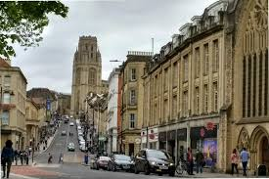
University Exploration Trip
Includes Bed and Breakfast, transport and activities
Opportunity to visit the cities and universities of Bath, Bristol and Cardiff
Bed and Breakfast at Youth Hostel central Bristol location
Notes:
<number>

Slide 12
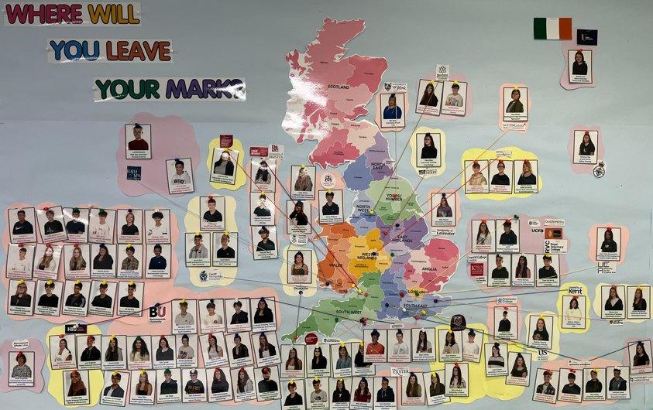
Destinations

Slide 13
Student Perspective
Jaydn Hardy
Lisa Al-Aghbar

Slide 14
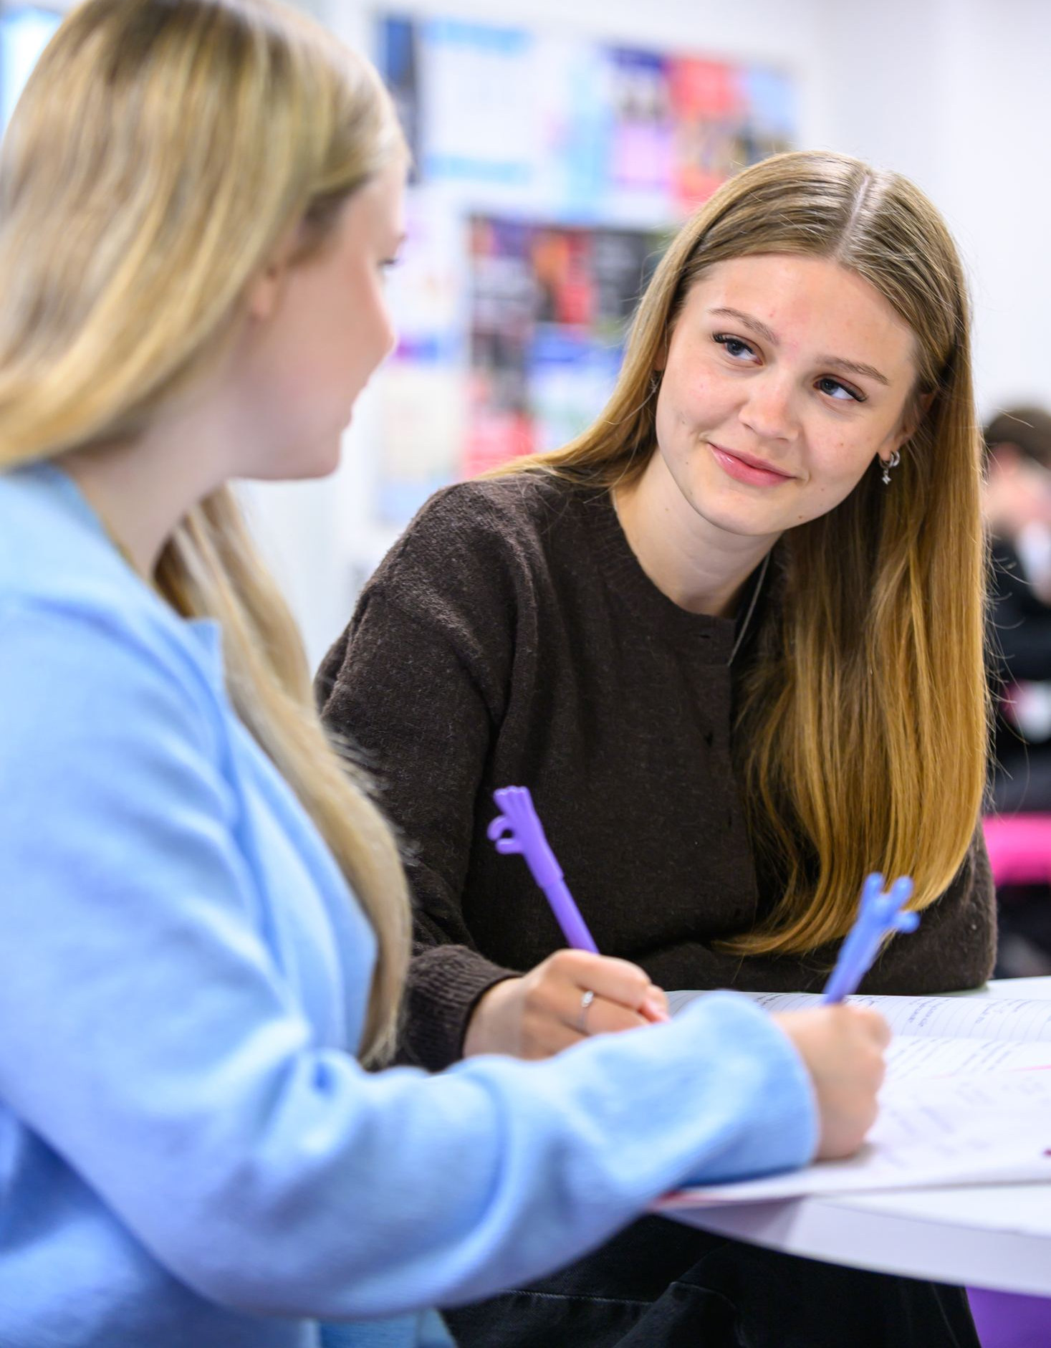

Applications Deadline
Friday 18th December

Slide 15


Dean.taafe@thebourneacademy.com
Mary.diffey@thebourneacademy.com

